Slide 1
Lesson 7
JSM Doctrinal Statement (Pt 2)
The objectives of Lesson 7 are:
What is Divine / Verbal Plenary Inspiration (VPI) of the Scriptures in its original language?
What exactly does it mean when we declare that the word of God is inerrant and infallible?
Why do we profess that we believe in “The Triune God, Father, Son, and the Holy Spirit”.

Slide 2
Our Doctrinal Statement
We believe in:
1)The Plenary Divine Inspiration of the Scriptures in the original languages, their consequent inerrancy and infallibility, and the Word of God as the supreme and final authority in faith and life;
2) The Triune God, Father, Son, and Holy Spirit;
3)The essential Deity and the real and proper, but sinless, humanity of our Lord Jesus Christ;
4) His birth of the virgin Mary;
5) His substitutionary, expiatory death, in that He gave His life "a ransom for many";

Slide 3
Our Doctrinal Statement
We believe in:
6) His resurrection from the dead in the same body in which He was crucified and the second coming of the same Jesus in power and great glory;
7) Salvation, the effect of the sovereign grace of God in regeneration by the Holy Spirit and the Word, through faith, not of works;
8) The everlasting bliss of the saved, and the everlasting suffering of the lost;
9) The spiritual unity of all redeemed by His precious blood;
10) The necessity of maintaining, according to God's Word, the purity of the Church, in doctrine and life; and still believing the Apostles’ Creed to be statement of Scriptural truth, we therefore incorporate it in these articles of faith.

Slide 4
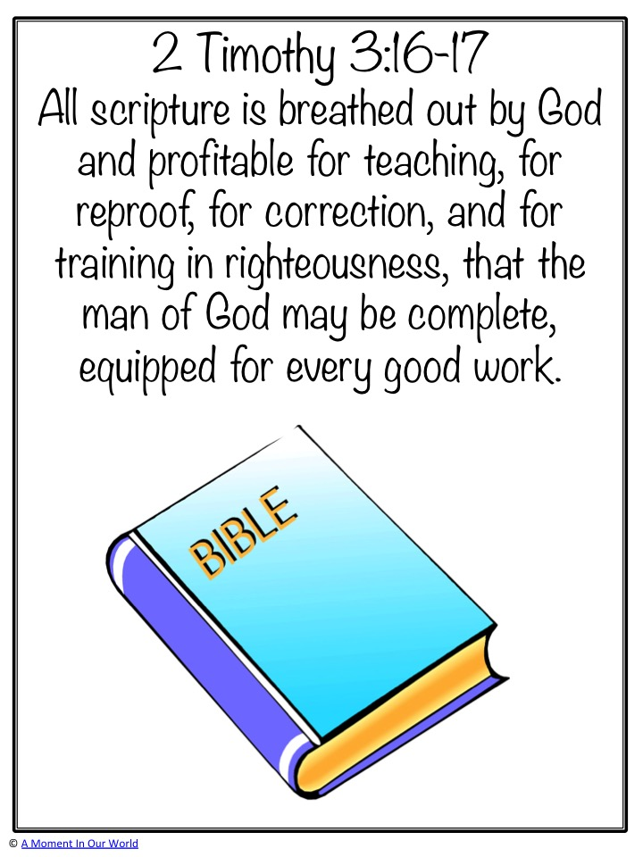
All Scripture is inspired by God and profitable for teaching, for reproof, for correction, for training in righteousness. That the man of God may be perfect, thoroughly furnished unto all good works
2 Timothy 3:16–17

Slide 5
Five “Solas” of the Protestant Reformation
Reformed Understanding | Sola Scriptura | Sola Christus | Sola Gratia | Sola Fide | Sola deo Gloria
Meaning | The “Scripture alone” contains primary authority to dictate the lives of believers. | The work of “Christ alone” is the basis for justification. | Justification is by means of God’s “grace alone.” | “Faith alone” is the only instrumental cause of justification. | All is done for “God’s glory alone.”
Notes:
Presentation Notes:
This will be covered more in Soteriology.

Slide 6
Question: "What is sola scriptura?"
Answer: The phrase sola scriptura is from the Latin: sola having the idea of “alone,” “ground,” “base,” and the word scriptura meaning “writings”—referring to the Scriptures. Sola scriptura means that Scripture alone is authoritative for the faith and practice of the Christian.
The Bible is complete, authoritative, and true. “All Scripture is God-breathed and is useful for teaching, rebuking, correcting and training in righteousness” (2 Timothy 3:16).

Slide 7
Three things this passage teaches us
All Scripture is inspired by God and profitable for teaching, for reproof, for correction, for training in righteousness. That the man of God may be perfect, thoroughly furnished unto all good works
2 Timothy 3:16–17
  Scriptures are sufficient for salvation.
  Scriptures are sufficient for sanctification.
  Scriptures are uniquely God-breathed (theopnoustos).

Slide 8
What sola Scriptura does not mean?
That there are no other sources of authority in the life of a Christian.
That each Christian is an autonomous interpreter of the Scriptures, being independent of the interpretive community of the body of Christ.
That Tradition is not valuable for understanding matters of faith and practice.
That there is no institutional authority at all to which believers must submit.

Slide 9
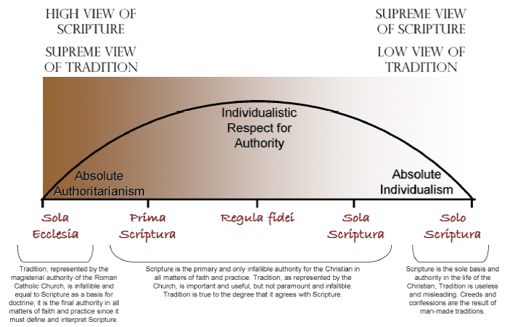

Slide 10
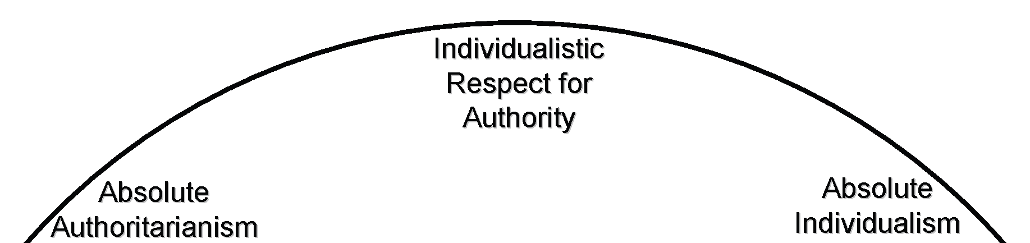
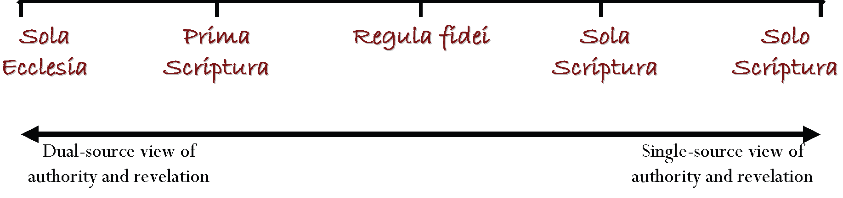
Roman Catholics
Eastern Orthodox
Reformed, Independent
Radical

Slide 11
What is Verbal Plenary Inspiration of the Scriptures in its original language?
1)The Plenary Divine Inspiration of the Scriptures in the original languages, their consequent inerrancy and infallibility, and the Word of God as the supreme and final authority in faith and life;

Slide 12
Verbal Plenary / Plenary Divine Inspiration
VPI
The belief that every word (verbal) of the Bible is inspired by God, and that all parts (plenary) of Scripture are fully inspired.
Key Emphases
  Verbal → Inspiration extends to the very words, not just ideas.
  Plenary → All 66 books of the Bible are equally inspired.
  God guided the human authors so that the exact words convey His intended message.
Plenary Divine Inspiration
The belief that the entire Bible (plenary) is inspired by God (divine), emphasizing the source rather than the specific words.
Key Emphases
  Divine → God is the ultimate author.
  Plenary → Inspiration extends to the whole of Scripture.
  Focuses on the Bible’s authority as God’s revelation.

Slide 13
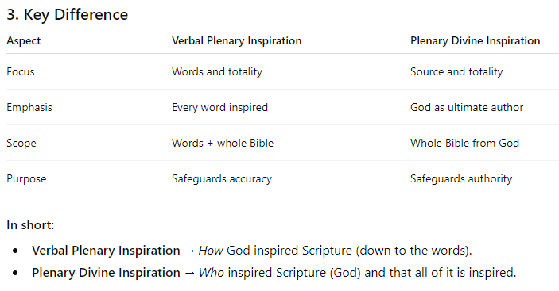

Slide 14
What is Verbal Plenary Inspiration of the Scriptures in its original language?
Key Terms
Revelation: The act whereby God reveals truth to mankind through both special revelation (Scripture, prophets, etc.) and natural revelation (nature, conscience, etc)
Inspiration: The act whereby God guided the writers of Scripture, giving them His words while fully utilizing the human element within man to produce the Scriptures.
Illumination: The act whereby God enlightens people to understand His revelation and its relevance to their lives.

Slide 15
Temporary Gifts Permanent Gifts
Supernatural Sign
Speaking
Serving
Revelatory
Confirmatory
Apostleship
Prophecy
Discerning of spirits
Word of wisdom
Word of knowledge
Tongues
Interpretation of tongues
Healings
Miracles
Tongues
Evangelism
Teaching
Pastor-teacher
Exhortation
Service
Showing Mercy
Giving
Administration
Helps
Notes:
Presentation Notes:
This chart is meant to help understand the difference in the different type of gifts. The revelatory sign gifts are those which were meant for the establishment of the Church based on the message of the Gospel and the writing of the New Testament. The confirmatory gifts are those which were given to confirm the word of the Apostles and prophets. For the hard cessationist, both the revelatory and confirmatory sign gifts ceased with the death of the last apostle and the completion of the New Testament since there was no longer need of either.
Many of the gifts—such as tongues, interpretation of tongues, discerning of spirits, word of wisdom, word of knowledge—are difficult to place on this chart because of the wide disagreement among cessationists and continuationists as to their meaning and purpose. We have placed them here because it is generally agreed that they are supernatural and are not related at all with talent or personality as are the permanent gifts in most cases.
Therefore, the question “Does God still speak today?” is tied to the discussion about the gifts of the Spirit. This will be covered more in Ecclesiology and Eschatology.

Slide 16


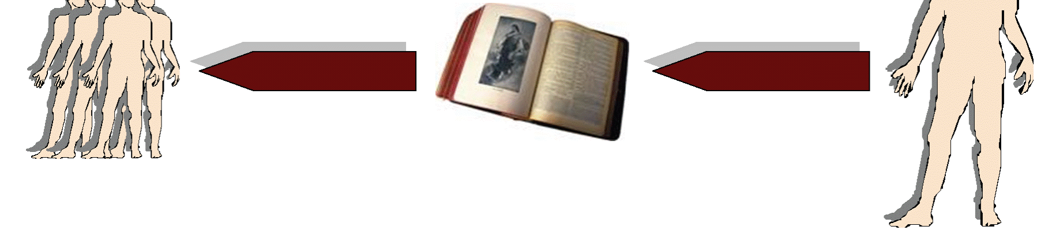
Give eg of general revelation.

Slide 17
Inspiration and Illumination
  What is the difference between illumination and inspiration?
  Is the Holy Spirit involve in illumination?
    Indirect and gradual. Subjective.
  If I am illuminated to teach/preach, am I infallible?

Slide 18
Wrong Interpretation | Correct Interpretation
Refers to the interpretation of the revelation of the readers so that they might read the Scriptures correctly. | Refers to the interpretation of the revelation to the author so that he might write the Scriptures correctly.
Knowing this first, that no prophecy of the scripture is of any private interpretation. For the prophecy came not in old time by the will of man: but holy men of God spake as they were moved by the Holy Ghost. - 2 Pet. 1:20–21

Slide 19
  “All Scripture is inspired by God and profitable for teaching, for reproof, for correction, for training in righteousness. That the man of God may be perfect, thoroughly furnished unto all good works” - 2 Timothy 3:16–17
  qeovpneusto" =qeov" (theos) pneusto" (pneustos). Lit. “God breathed”
  Knowing this first, that no prophecy of the scripture is of any private interpretation. For the prophecy came not in old time by the will of man: but holy men of God spake as they were moved by the Holy Ghost. - 2 Pet. 1:20–21

Slide 20
Theories of inspiration
  Natural: Belief that certain people were extremely gifted through their natural God-given abilities to write Scripture. (100% man)
  Illumination: Belief that the Holy Spirit moved within certain individuals to write above their natural capacity. (90%man, 10% God)
  Partial: Belief that some Scripture is inspired, namely, that which is profitable for doctrine, matters of “faith and practice,” but not all is inspired. Matters of history and science are not included because they are irrelevant to God’s purpose. (50% man, 50% God)
  Degree: Belief that all Scripture is inspired, but some passages are more inspired than others. The “days of creation” narrative, for example, was written in accommodating language, a sort of “baby-talk,” but was nonetheless inspired. (90 % God, 10% man)
  Mechanical Dictation: God simply used the hand of man to passively write His words. (100% God)
  Verbal Plenary: All Scripture is inspired by God who utilized the human element within man to accomplish this without error. (100% man, 100% God)

Slide 21

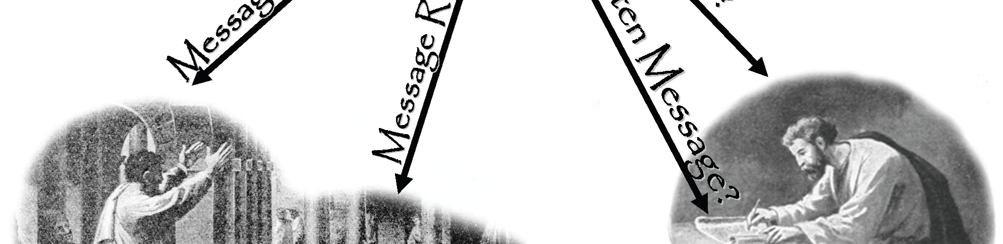
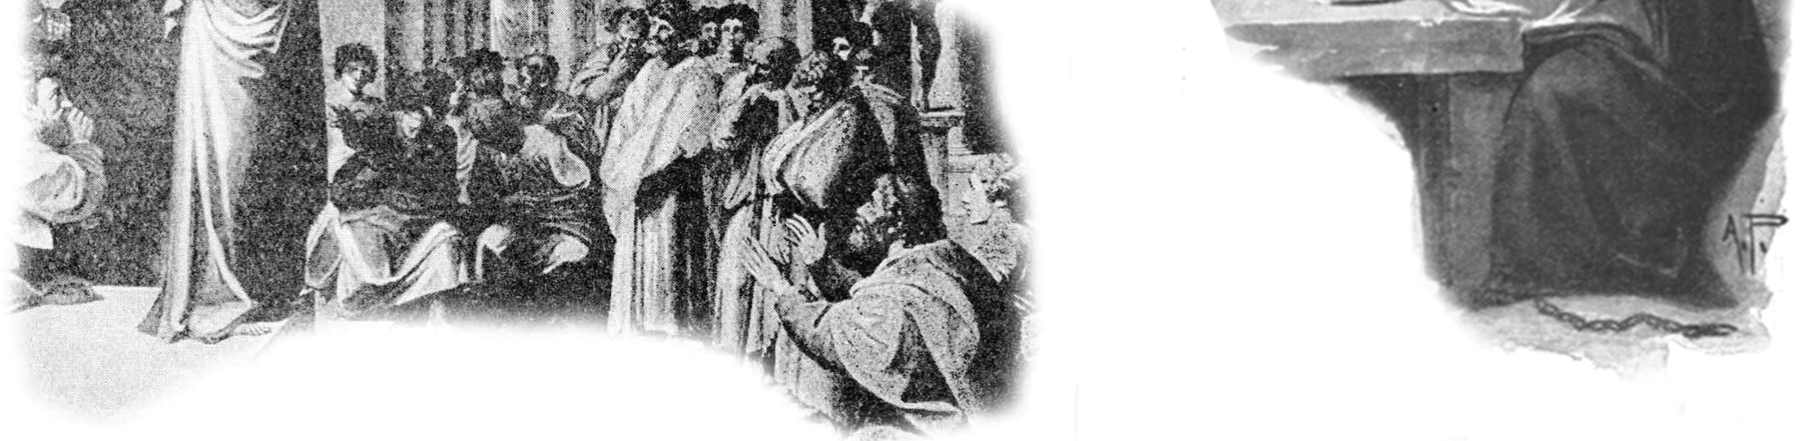
Illumination
Inspiration

Slide 22
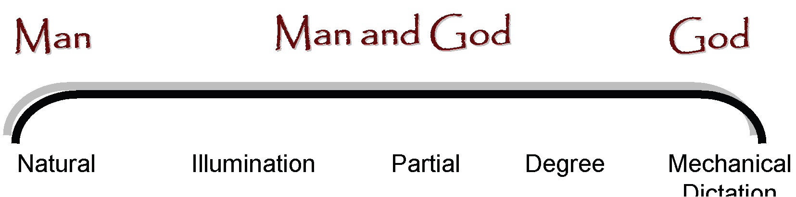
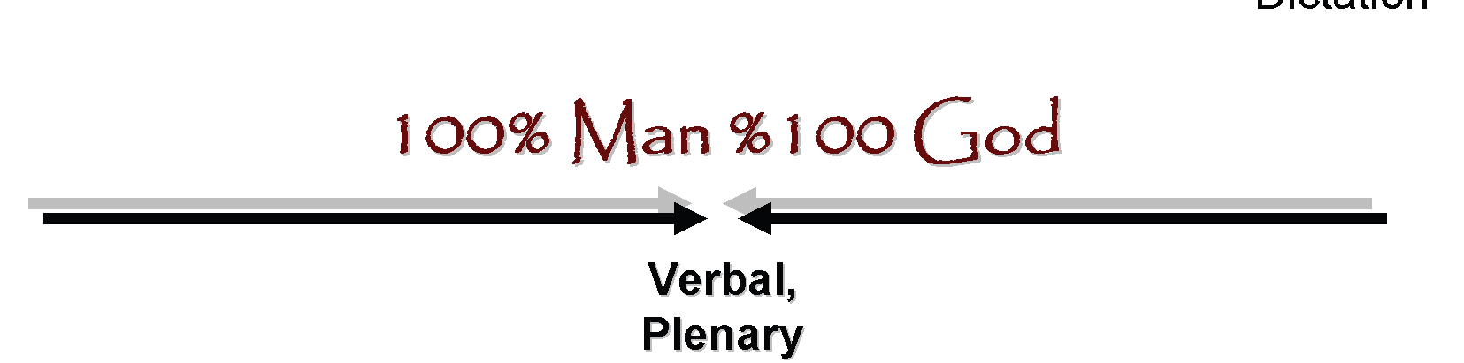

Slide 23
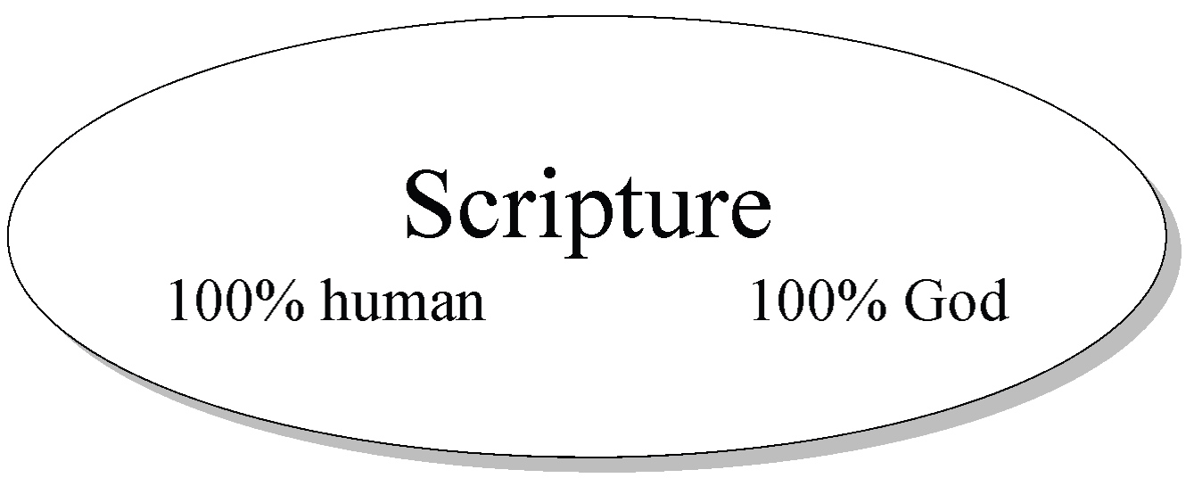
Inspiration: The act whereby God guided the writers of Scripture, giving them His words while fully utilizing the human element within man to produce the Scriptures.
          Inspiration is . . .
    • Verbal: Extends to the very words of Scripture, not just teachings.
    • Plenary: Extends to everything in the Bible, not just parts that speak on matters of faith and practice.

Slide 24
Inspiration is . . .
Verbal: Extends to the very words of Scripture, not just teachings. (counter Degree)
Plenary: Extends to everything in the Bible, not just parts that speak on matters of faith and practice. (counter Partial)

Slide 25
Inspiration is . . .
• Verbal: Extends to the very words of Scripture, not just teachings.
• Plenary: Extends to everything in the Bible, not just parts that speak on matters of faith and practice.
Examples of human element within the Scripture:
Emotion: Psalms, Roman 9
Grammatical Differences: Hebrews and John
Phenomenological language: Joshua 10:13
Use of round numbers

Slide 26
Lesson 7
JSM Doctrinal Statement (Pt 2)
The objectives of Lesson 7 are:
What is Divine / Verbal Plenary Inspiration (VPI) of the Scriptures in its original language?
What exactly does it mean when we declare that the word of God is inerrant and infallible?
Why do we profess that we believe in “The Triune God, Father, Son, and the Holy Spirit”.

Slide 27
What exactly does it means when we declare that the word of God is inerrant and infallible?
Key Terms
Inerrancy: The doctrinal teaching that the Scriptures in the autographa (original manuscripts) are true in all that they teach, and thus without error.
Infallibility: The doctrinal teaching sometimes used synonymously with inerrancy, that the Scriptures cannot fail in matters of faith and practice.

Slide 28
Arguments for Inerrancy
If the Scriptures are “God-breathed,” representing the voice of God, and God is without error, and then the Scriptures are without error.
Premise 1: God is truthful and therefore beyond error (2 Sam. 7:28; Titus 1:2; Heb. 6:18).
Premise 2: God is the ultimate author of Scripture (2 Tim. 3:16; 2 Pet.1:20–21)
Conclusion: Scripture is truthful and therefore beyond error.

Slide 29
Alleged Error #1: 2 Sam. 10:18 vs. 1 Chron. 19:18
2 Samuel 10:18 | 1 Chronicles 19:18
And the Syrians fled before Israel; and David slew the men of seven hundred chariots of the Syrians, and forty thousand horsemen, and smote Shobach the captain of their host, who died there. | But the Syrians fled before Israel; and David slew of the Syrians seven thousand men which fought in chariots, and forty thousand footmen, and killed Shophach the captain of the host.
Alleged Error #1 Solution Error in transcription

Slide 30
Alleged Error #2: Matt. 27:5 vs. Acts 1:18
Matthew 27:5 | Acts 1:18
And he cast down the pieces of silver in the temple, and departed, and went and hanged himself. | Now this man purchased a field with the reward of iniquity; and falling headlong, he burst asunder in the midst, and all his bowels gushed out.
Alleged Error #2 Solution Faulty Assumption
Two writers can include different details of the same event for their own purposes. Judas could have hanged himself and then fallen. Peter was emphasizing the fulfillment of prophecy through the death of Judas, while this was not a concern of Matthew.

Slide 31
Alleged Error #3: Matt 26:34, 74–75 vs. Mark 14:30, 72
Matthew 26:34 | Mark 14:30
Jesus said unto him, Verily I say unto thee, That this night, before the cock crow, thou shalt deny me thrice | And Jesus saith unto him, Verily I say unto thee, That this day, even in this night, before the cock crow twice, thou shalt deny me thrice. .
Alleged Error #3 Solution. Faulty Assumption
One writer can be more detailed than another

Slide 32
Lesson 7
JSM Doctrinal Statement (Pt 2)
The objectives of Lesson 7 are:
What is Divine / Verbal Plenary Inspiration (VPI) of the Scriptures in its original language?
What exactly does it mean when we declare that the word of God is inerrant and infallible?
Why do we profess that we believe in “The Triune God, Father, Son, and the Holy Spirit”.

Slide 33

Question?
Why do we profess that we believe in “The Triune God:
  Father, Son, and the Holy Spirit”.

Slide 34
Trinitarinism
The knowability of God
The existence of God
Attributes of God
Doctrine of Trinity
Deity of Christ
The Humanity of Christ

Slide 35
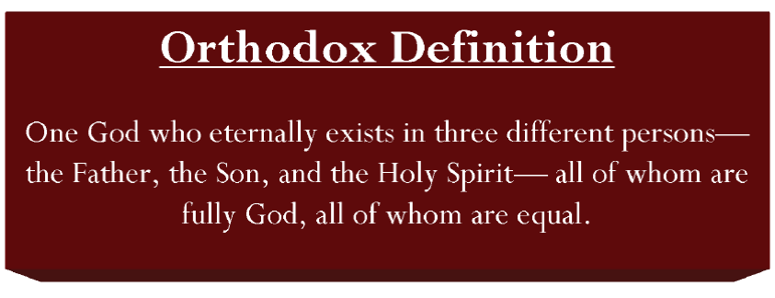
Unity and Plurality.
First Issue that the Church wrestle with.

Slide 36
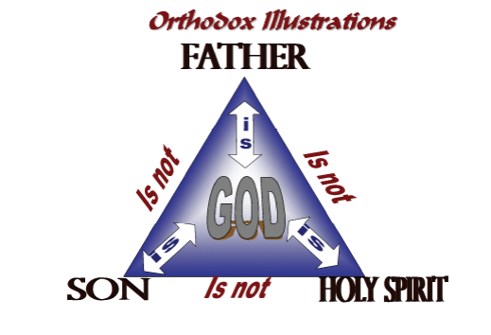
Not Contradictory but a Mystery (comprehensibility)

Slide 37
How did the early Church understand Trinity?
Deut 6:4 Hear, O Israel: The Lord our God is one Lord: | John 17 ³ And this is life eternal, that they might know thee the only true God, and Jesus Christ, whom thou hast sent.
Isaiah 44: ⁶ Thus saith the Lord the King of Israel, and his Isaiah redeemer the Lord of hosts; I am the first, and I am the last; and beside me there is no God. ⁷ And who, as I, shall call, and shall declare it, and set it in order for me, since I appointed the ancient people? and the things that are coming, and shall come, let them shew unto them. ⁸ Fear ye not, neither be afraid: have not I told thee from that time, and have declared it? ye are even my witnesses. Is there a God beside me? yea, there is no God; I know not any. | 1 Cor 8 ⁴ As concerning therefore the eating of those things that are offered in sacrifice unto idols, we know that an idol is nothing in the world, and that there is none other God but one. ⁵ For though there be that are called gods, whether in heaven or in earth, (as there be gods many, and lords many,) ⁶ But to us there is but one God, the Father, of whom are all things, and we in him; and one Lord Jesus Christ, by whom are all things, and we by him.
 | 1 Tim 2 ⁵ For there is one God, and one mediator between God and men, the man Christ Jesus;

Slide 38
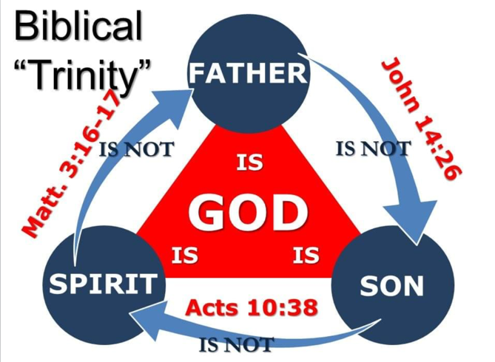

Slide 39
Spirit is NOT the Father
Matt 3: ¹⁶ And Jesus, when he was baptized, went up straightway out of the water: and, lo, the heavens were opened unto him, and he saw the Spirit of God descending like a dove, and lighting upon him:
Father is NOT the Son
John 14: ²⁶ But the Comforter, which is the Holy Ghost, whom the Father will send in my name, he shall teach you all things, and bring all things to your remembrance, whatsoever I have said unto you.
The Son is Not the Spirit
Acts 10: ³⁸ How God anointed Jesus of Nazareth with the Holy Ghost and with power: who went about doing good, and healing all that were oppressed of the devil; for God was with him.
¹⁷ And lo a voice from heaven, saying, This is my beloved Son, in whom I am well pleased.
John 8: ¹⁶ And yet if I judge, my judgment is true: for I am not alone, but I and the Father that sent me.

Slide 40
Oneness: O.T.
Deut 6:4 - Hear, O Israel: The Lord our God is one Lord:
Isa 44:6 - Thus saith the Lord the King of Israel, and his redeemer the Lord of hosts; I am the first, and I am the last; and beside me there is no God.
Isa 44:8b - Fear ye not, neither be afraid: have not I told thee from that time, and have declared it? ye are even my witnesses. Is there a God beside me? yea, there is no God; I know not any.
Isa 45:5a - I am the Lord, and there is none else, there is no God beside me: I girded thee, though thou hast not known me:

Slide 41
Plurality: O.T.
Gen 1:26-27 - And God said, Let us make man in our image, after our likeness: and let them have dominion over the fish of the sea, and over the fowl of the air, and over the cattle, and over all the earth, and over every creeping thing that creepeth upon the earth.So God created man in his own image, in the image of God created he him; male and female created he them.
Isa 48:16 - Come ye (Isaiah) near unto me (Jesus), hear ye this; I have not spoken in secret from the beginning; from the time that it was, there am I: and now the Lord God, and his Spirit, hath sent me.

Slide 42
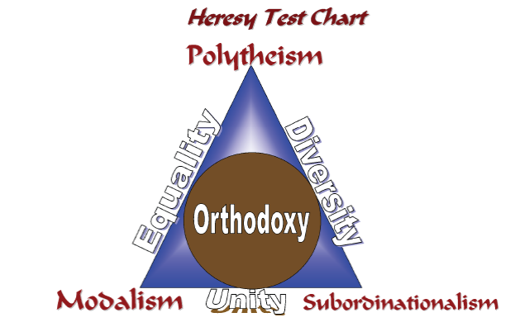

Slide 43
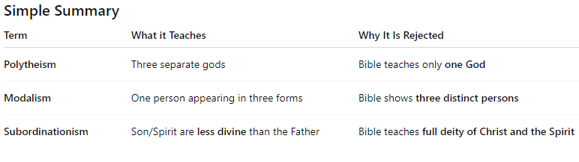

Slide 44
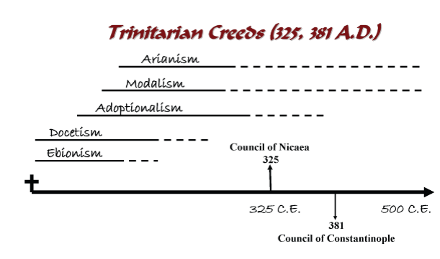
Who is Constantine the Great?

Slide 45
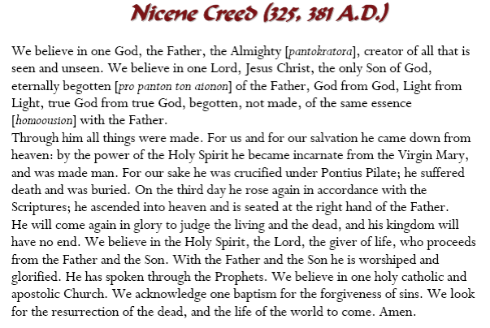

Slide 46
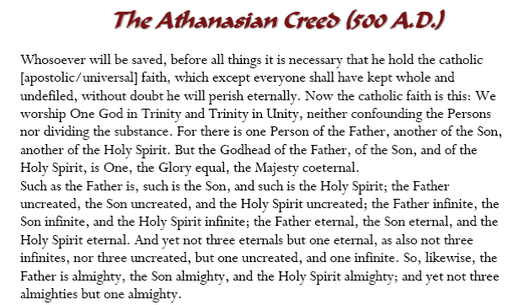

Slide 47
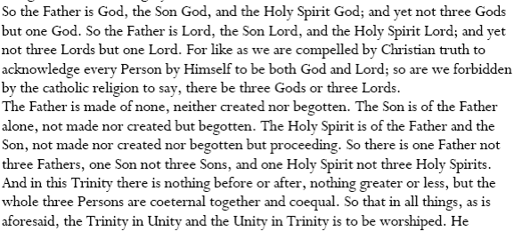

Slide 48
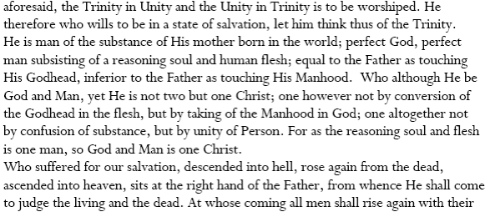


Slide 50
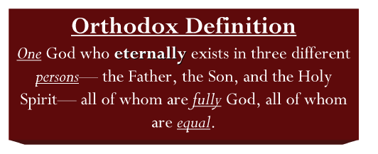

Slide 51
