Slide 1
Lesson 6
JSM Doctrinal Statement (Pt 1)
The objectives of Lesson 6 and 7 are to:
Understand the differences between creeds, dogma and doctrinal statements.
Examine the JSM Doctrinal Statement.
Understand the meaning of the Divine / Verbal plenary inspiration of Scripture in its original languages.
Learn what is meant by the Word of God as the supreme (only infallible) and final authority in faith and practice (Sola Scriptura).

Slide 2
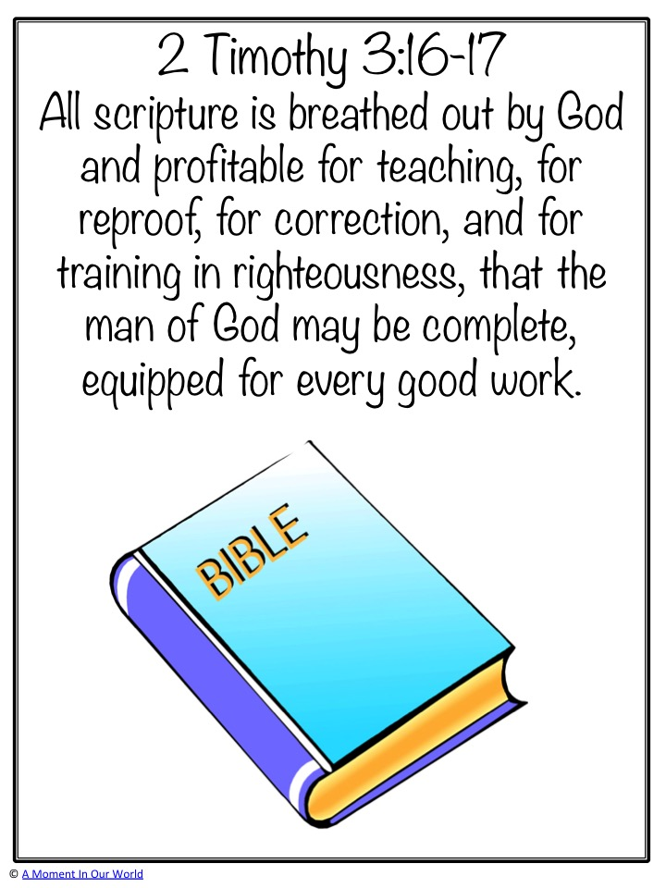
All Scripture is inspired by God and profitable for teaching, for reproof, for correction, for training in righteousness. That the man of God may be perfect, thoroughly furnished unto all good works
2 Timothy 3:16–17

Slide 3
Questions
1.What do we understand by Doctrinal Statements (Standards) and Creed?
2. What do we means by “The word of God as the supreme (only infallible) and final authority in faith and life (practices)? (Five Sola: Sola Scriptura, Sola Fide, Sola Gratia, Solus Christus, Soli Deo Gloria)
3. What is Verbal Plenary Inspiration of the Scriptures in its original language?
4. What exactly does it means when we declare that the word of God is inerrant and infallible?
5. Why do we profess that we believe in “The Triune God, Father, Son, and the Holy Spirit”. – Nicene Creed in 325 AD. Note that the Bible only canonised in about 400 AD.
6. What is the Apostles Creed?

Slide 4
Theology
Bible: God’s Inspired Infallible Words
Dogma: Core Doctrines
Doctrines: Truths of God’s Infallible Word
Theology: The study and explanation of Doctrine
Doctrines
Creeds: Apostles’ Nicene Athanasian
Doctrinal Standard: WestministerBelgic Heilderberg
Dogma
Bible
God’s Infallible
Word
Creeds
Doctrinal Standards
Doctrinal Books

Slide 5
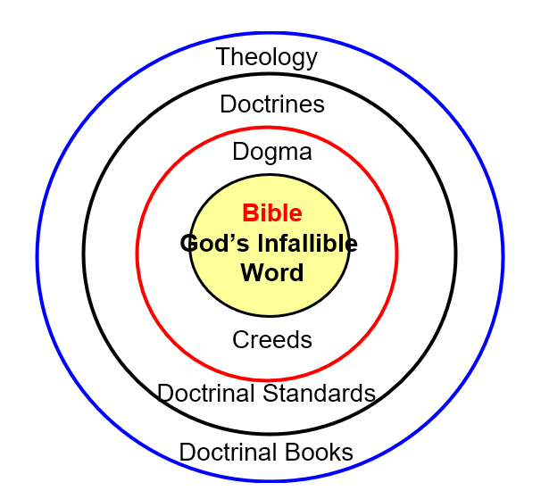
Dogma: Dogma refers to an authoritative doctrine or belief that is officially defined and regarded as essential truth by a religious body. In Christianity, dogmas are teachings considered divinely revealed and binding for believers.
  Considered non-negotiable truths
  Formally defined by church authority
  Believed to be rooted in divine revelation
  Essential to orthodox faith
The Trinity (Father, Son, Holy Spirit are one God)
The divinity of Jesus Christ
Salvation by grace

Slide 6
Doctrines / Theology
Scope of theology
The nature and attributes of God
Creation and humanity
Sin and salvation
Christ and His work
The Holy Spirit
The Church
Last things (end times)
Christian doctrines
The Trinity
Salvation by grace through faith
The resurrection of Christ
The authority of Scripture

Slide 7
Doctrines / Theology
How They Work Together
Christians study Scripture → Theology
The Church clarifies truth → Doctrine
Doctrine guides believers → shapes faith and practice
Illustration
  Theology asks: Who is Jesus?
  Doctrine answers: Jesus is fully God and fully man
Theology = the study of God.
Doctrine = the teachings that come from that study.

Slide 8
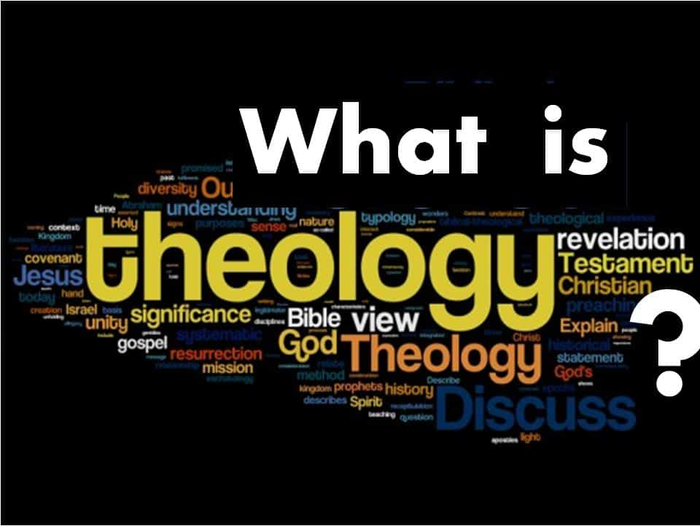
Systematic Theology
Paterology: God the Father
Christology: God the Son
Pneumatology: God the Holy Spirit
Biblilogy & Hermeneutics: Study of the Bible
Soteriology: Study on Salvation
Ecclesiology: Study of the Church
Eschatology: Study of end times
Angelogy: Study of Angel
Anthropology: Study of Human
Harmatiology: Study of Sin

Slide 9
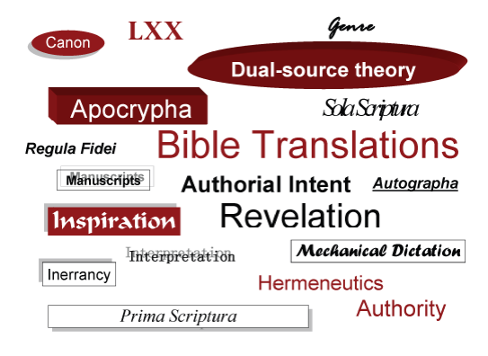
BIBLIOLOGY AND HERMENEUTICS

Slide 10
Creeds:
An official statement of core beliefs
.
To Confess: "What do you believe?" A well-written creedal statement is a helpful tool for summarizing and communicating the truths (doctrines) of Scripture to others, especially the most central truths (dogmas).
To Instruct: Church symbols compile, systematize, and summarize all scriptural references pertaining to a certain doctrine. As such, they serve as helpful, instructional tools for teaching others.
To Defend: A carefully-written, scripturally-based creedal statement can serve as an effective tool to refute man-made error and establish God-given truth.

Slide 11
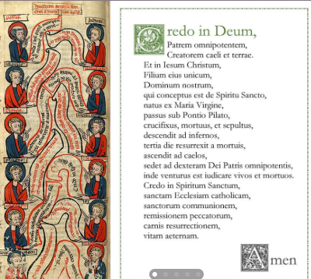
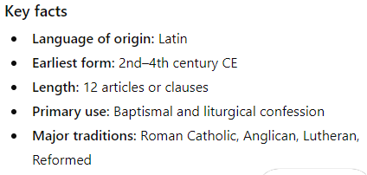
Creeds
Statement of Faith.
Creeds are formal summaries of Christian beliefs that articulate core doctrines.
Creeds
  Apostles' Creed
  Nicene Creed
  Athanasian Creed.

Slide 12
THE APOSTLES' CREED
Written in 2nd Century AD.
First leaders died. False teachers begin to bring in strange belief.
Practical need to for local Church to have basic statement of faith.
None of the Churches had all the New Testament.
Standard to judge whether teaching was truth or heresy.

Slide 13
THE APOSTLES' CREED
I believe in God the Father, Almighty, Maker of heaven and earth:
II. And in Jesus Christ, His only begotten Son, our Lord:
III. Who was conceived by the Holy Ghost, born of the Virgin Mary:
IV. Suffered under Pontius Pilate; was crucified, dead, and buried: He descended into hell:
V. The third day He rose again from the dead:
VI. He ascended into heaven, and sitteth at the right hand of God the Father Almighty:
VII. From thence He shall come to judge the quick and the dead:
VIII. I believe in the Holy Ghost:
IX. I believe an holy catholic church: the communion of saints:
X. The forgiveness of sins:
XI. The resurrection of the body:
XII. And the life everlasting. AMEN.

Slide 14
STATEMENTS
Type | Characteristics
1. Creeds | • Official "I believe..." statements • Concise statements containing little or no explanation Statements of scriptural dogma - core doctrines Profession of faith
2. Doctrinal Standards | • Official explanations • Statements and explanations of various scriptural doctrines • May be written in the form of a confession, catechism, or canon
3. Confessions | • Approved, comprehensive statements and explanations of scriptural doctrine covering most or all of its major aspects
4. Catechisms | • A confession written in question-and-answer format
5. Canons | • Approved statements and explanations pertaining to certain particular scriptural doctrines

Slide 15
Our Doctrinal Statement
We believe in:
1)The plenary Divine inspiration of the Scriptures in the original languages, their consequent inerrancy and infallibility, and the Word of God as the supreme and final authority in faith and life;
2) The Triune God, Father, Son, and Holy Spirit;
3)The essential Deity and the real and proper, but sinless, humanity of our Lord Jesus Christ;
4) His birth of the virgin Mary;
5) His substitutionary, expiatory death, in that He gave His life "a ransom for many";

Slide 16
Our Doctrinal Statement
We believe in:
6) His resurrection from the dead in the same body in which He was crucified and the second coming of the same Jesus in power and great glory;
7) Salvation, the effect of the sovereign grace of God in regeneration by the Holy Spirit and the Word, through faith, not of works;
8) The everlasting bliss of the saved, and the everlasting suffering of the lost;
9) The spiritual unity of all redeemed by His precious blood;
10) The necessity of maintaining, according to God's Word, the purity of the Church, in doctrine and life; and still believing the Apostles’ Creed to be statement of Scriptural truth, we therefore incorporate it in these articles of faith.

Slide 17

Question?
Is the Apostles’ Creed / JSM Doctrinal Statement True?
Is the Apostles’ Creed / JSM Doctrinal Statement Infallible?

Slide 18
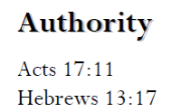
1)The plenary Divine inspiration of the Scriptures in the original languages, their consequent inerrancy and infallibility, and the Word of God as the supreme and final authority in faith and life;

Slide 19
Authority: Faith and practises
  What do we means by “The word of God as the supreme (only infallible) and final authority in faith and life (practices)?
  (Five Sola: Sola Scriptura, Sola Fide, Sola Gratia, Solus Christus, Soli Deo Gloria)
All Scripture is inspired by God and profitable for teaching, for reproof, for correction, for training in righteousness. That the man of God may be perfect, thoroughly furnished unto all good works
2 Timothy 3:16–17

Slide 20
Authority
  Biblical or Traditions?
  What are traditions of the Church?
    Things that are passed down
    Ways of doing things
    Good Traditions (e.g. Sunday School)
    Extra Biblical Traditions (Christmas tree, Easter eggs)
    Need to be careful on extra Biblical Traditions that become “infallible”.

Slide 21
Authority
  Five Primary Views
  Sola Ecclesia
  Prima Scriptura
  Regula Fidei
  Sola Scriptura
  Solo Scriptura

Slide 22
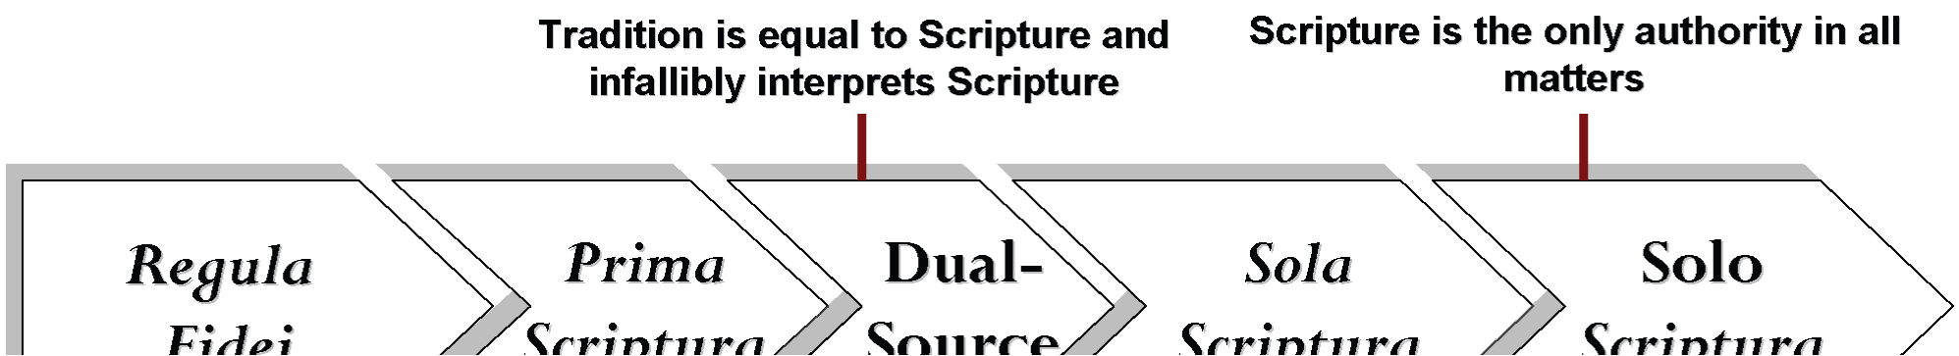
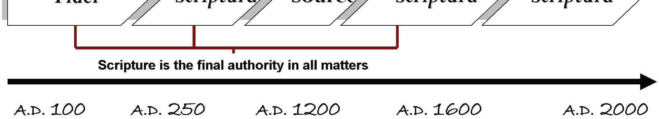

Slide 23
Ye are the light of the world. A city that is set on an hill cannot be hid.
Neither do men light a candle, and put it under a bushel, but on a candlestick; and it giveth light unto all that are in the house.
Let your light so shine before men, that they may see your good works, and glorify your Father which is in heaven.
Matthew 5:14-16

Slide 24
Sola scriptura was the rallying cry of the Protestant Reformation. For centuries the Roman Catholic Church had made its traditions superior in authority to the Bible. This resulted in many practices that were in fact contradictory to the Bible.
Some examples are prayer to saints and/or Mary, the immaculate conception, transubstantiation, infant baptism, indulgences, and papal authority.

Slide 25
Five “Solas” of the Protestant Reformation
Reformed Understanding | Sola Scriptura | Sola Christus | Sola Gratia | Sola Fide | Sola deo Gloria
Meaning | The “Scripture alone” contains primary authority to dictate the lives of believers. | The work of “Christ alone” is the basis for justification. | Justification is by means of God’s “grace alone.” | “Faith alone” is the only instrumental cause of justification. | All is done for “God’s glory alone.”
Notes:
Presentation Notes:
This will be covered more in Soteriology.

Slide 26
Question: "What is sola scriptura?"
Answer: The phrase sola scriptura is from the Latin: sola having the idea of “alone,” “ground,” “base,” and the word scriptura meaning “writings”—referring to the Scriptures. Sola scriptura means that Scripture alone is authoritative for the faith and practice of the Christian.
The Bible is complete, authoritative, and true. “All Scripture is God-breathed and is useful for teaching, rebuking, correcting and training in righteousness” (2 Timothy 3:16).

Slide 27
Sola Scriptura
Sola scriptura (Latin ablative, "by scripture alone") is the doctrine that the Bible contains all knowledge necessary for salvation and holiness
Our Roman opponents maintain that the Scripture by itself is insufficient as the authority of the people of God, and that tradition and the teaching authority of the church must be added to the Scripture.
The Roman church has declared that we Protestants are accursed (“anathematized”) for taking away the Word of God as found in tradition.
We Protestants have declared that the Roman church is a false church for adding human traditions to the Word of God.
Romans 3:10-12, Hebrews 4:15

Slide 28
Three things this passage teaches us
All Scripture is inspired by God and profitable for teaching, for reproof, for correction, for training in righteousness. That the man of God may be perfect, thoroughly furnished unto all good works
2 Timothy 3:16–17
  Scriptures are sufficient for salvation.
  Scriptures are sufficient for sanctification.
  Scriptures are uniquely God-breathed (theopnoustos).

Slide 29
What sola Scriptura does not mean?
That there are no other sources of authority in the life of a Christian.
That each Christian is an autonomous interpreter of the Scriptures, being independent of the interpretive community of the body of Christ.
That Tradition is not valuable for understanding matters of faith and practice.
That there is no institutional authority at all to which believers must submit.

Slide 30
What is Verbal Plenary Inspiration of the Scriptures in its original language?
1)The plenary Divine inspiration of the Scriptures in the original languages, their consequent inerrancy and infallibility, and the Word of God as the supreme and final authority in faith and life;

