Slide 1
Jesus Saves Mission
Baptismal Class
Lesson 5

Slide 2
Lesson 5 : Living For Christ – Service & Witness
Objectives :
We have been saved from damnation; therefore, we must now live our lives for Christ. Every believer is gifted by God to serve the Body of Christ. Serving is not optional – It is a vital part of our calling in the Church. Every believer is also called to be a witness for Christ – sharing the gospel, making disciples, and living as a light in the world until He returns.
Understand that all believers are called to serve. We are saved to serve, not to sit and do nothing.
Discover what the Bible teaches about spiritual gifts and learn to use such gifts in the local church.
Understand the Biblical command to witness.
Be encouraged to take personal steps to reach out to others.

Slide 3


Slide 4
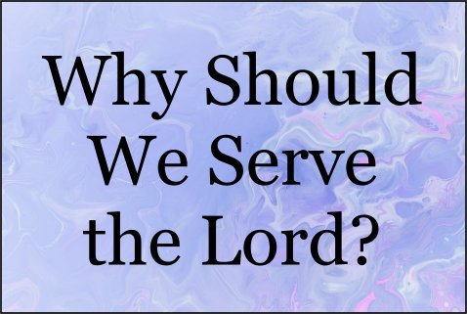

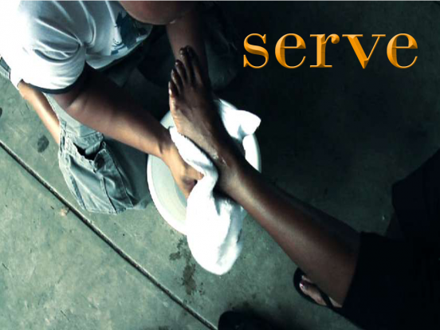

1. Why We Serve?
Serving is a command . It is part of discipleship.
- Galatians 5 :13 “… by love serve one another.”
- Romans 12:11 “Not slothful in business; fervent in spirit; serving the Lord;”
- 1 Peter 4:10 “As every man hath received the gift, even so minister the same one to
another, as good stewards of the manifold grace of God.”

Slide 5

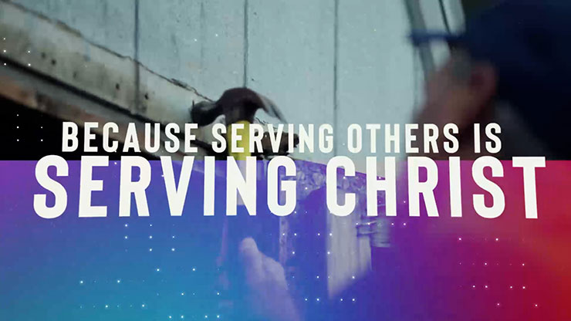



Slide 6
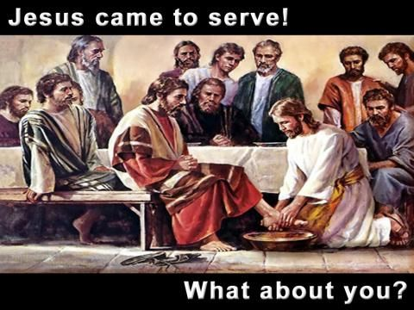
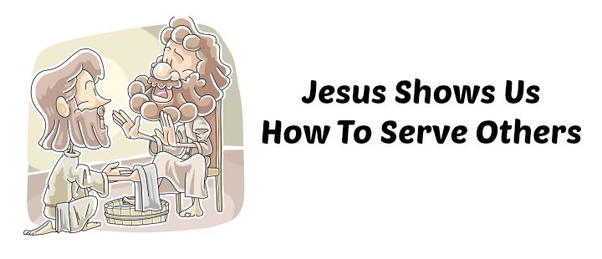
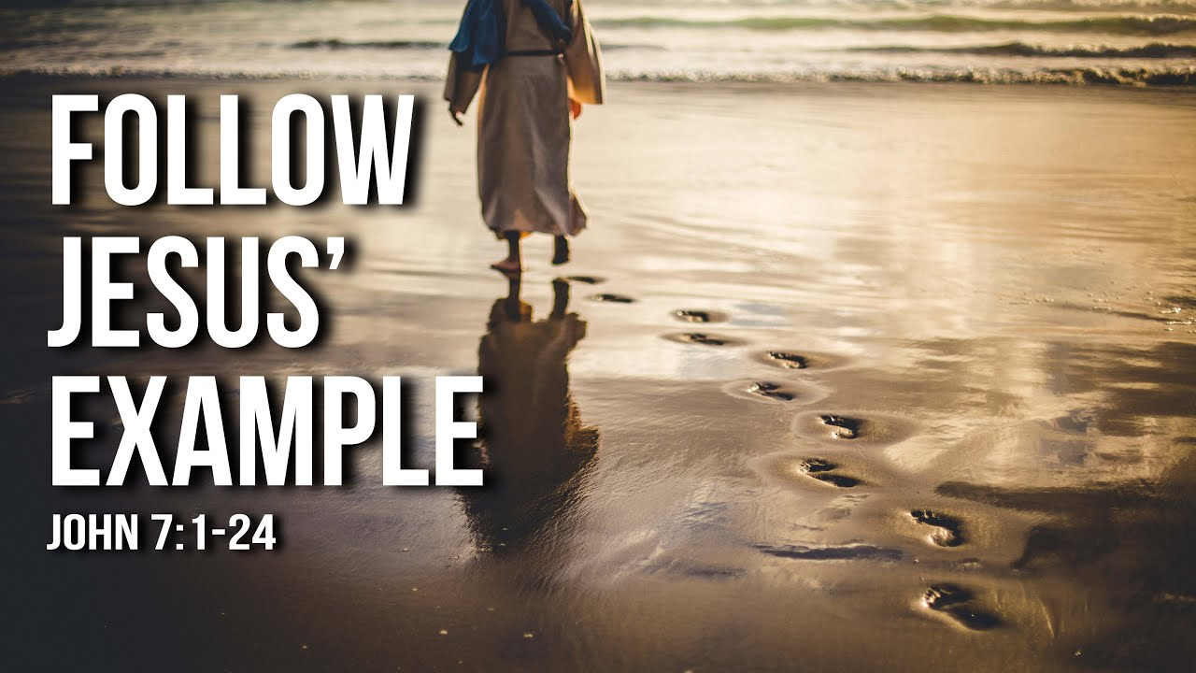
1. Why We Serve?
Jesus came to serve. He is our example.
- Mark 10:45 “For even the Son of man came not to be
ministered unto, but to minister …”
- John 13:14-15 “If I then, your Lord and Master, have washed your feet; ye also
ought to wash one another's feet. For I have given you an example,
that ye should do as I have done to you.”

Slide 7

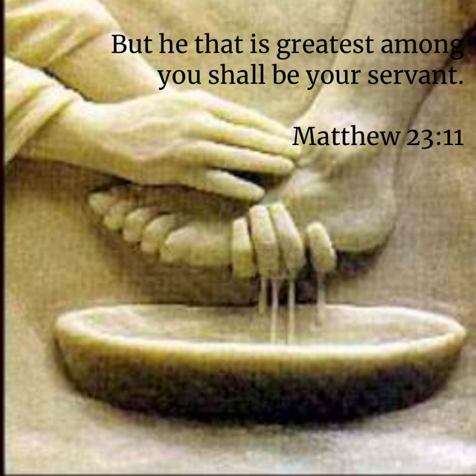
1. Why We Serve?
We are saved to serve.
- Luke 1:74 “That he would grant unto us, that we being delivered out of the
hand of our enemies might serve him without fear,”
True greatness is found in serving others.
- Matthew 23:11 “But he that is greatest among you shall be your servant.”

Slide 8
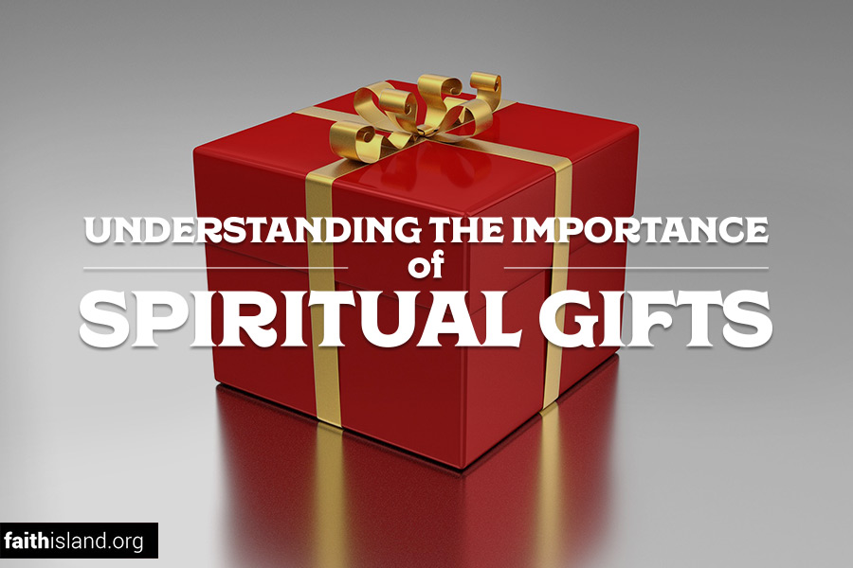

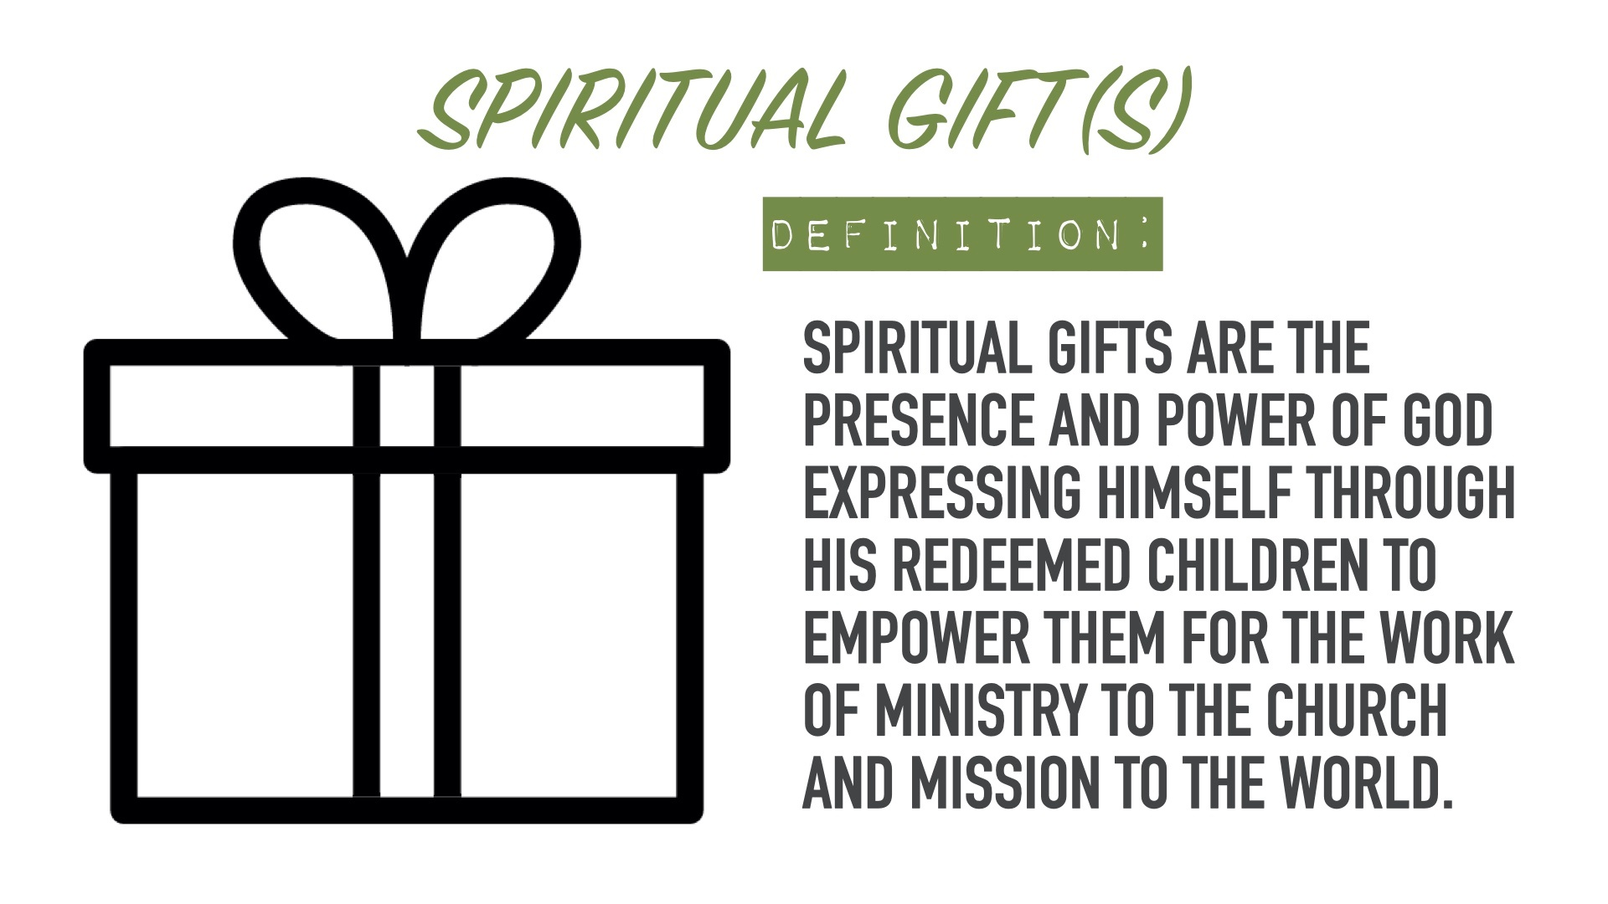
2. What Are Spiritual Gifts?
God has not left believers to use their own talents / skills to serve Him and His Church. He has equipped believers with spiritual gifts.
Spiritual gifts are divinely empowered abilities given to believers by the Holy Spirit. The Holy Spirit gives different gifts to all.

Slide 9


2. What Are Spiritual Gifts?
- 1 Corinthians 12:4-7 “Now there are diversities of gifts, but the same Spirit … But the manifestation of the Spirit is given to every man to profit withal.”
They are not natural talents (though God may use those too).

Slide 10
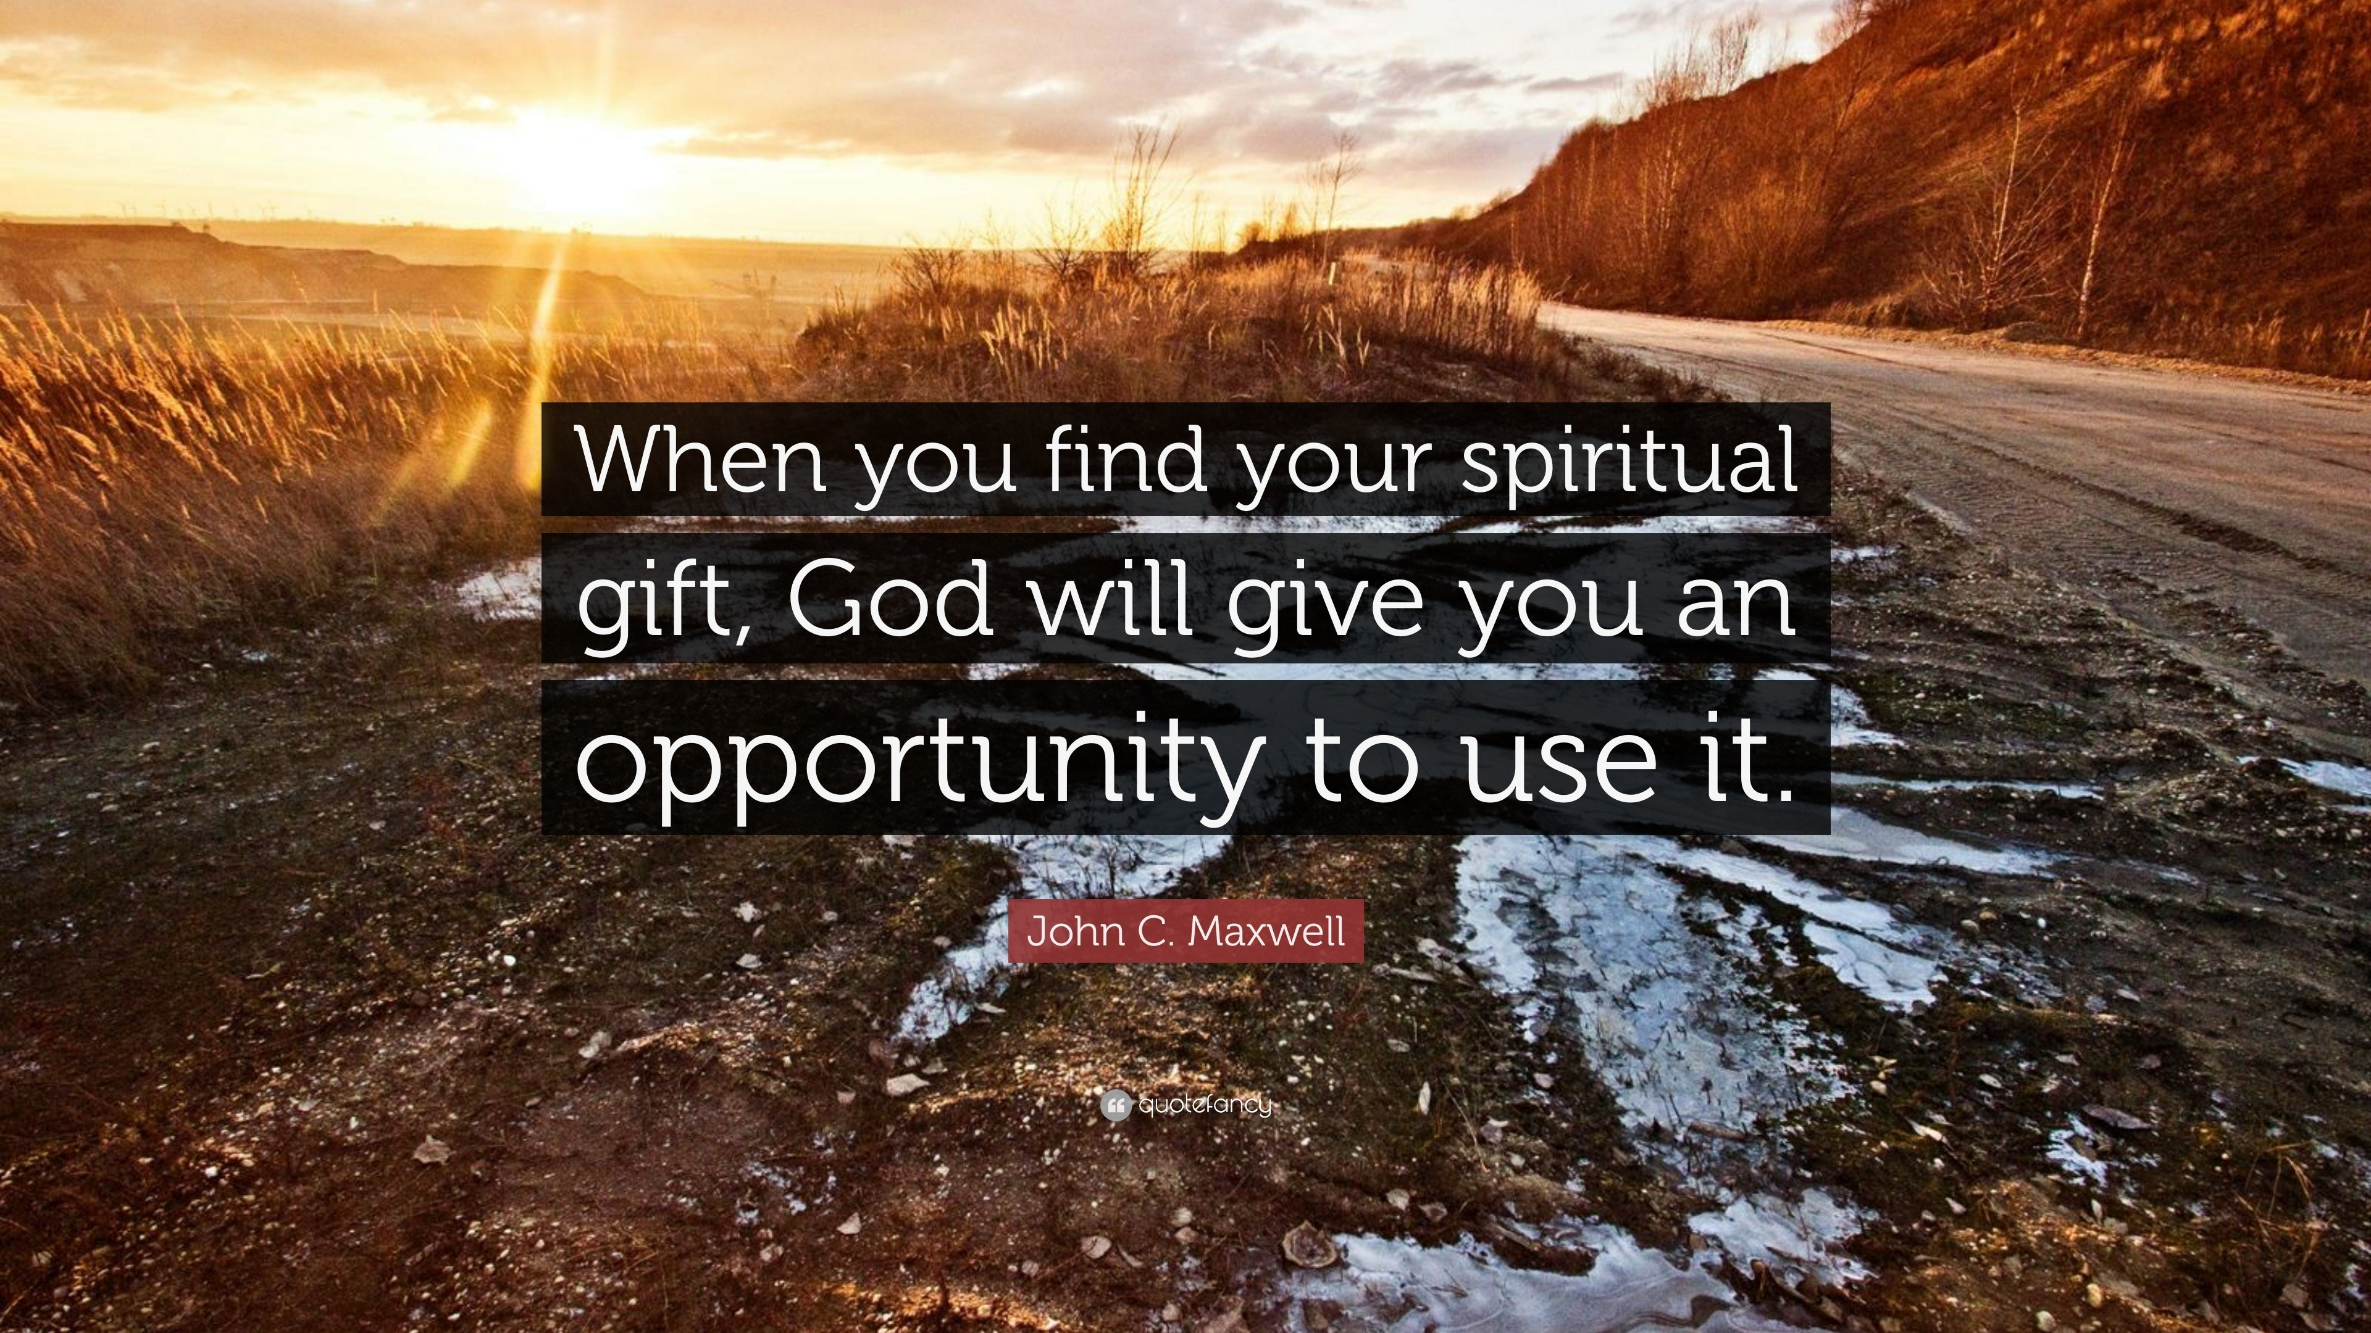

2. What Are Spiritual Gifts?
They are given for the ministry, not for personal glory. Gifts are for building up the Body of Christ.
- Ephesians 4:11-12 “And he gave some, apostles; and some, prophets; and some, evangelists; and some, pastors and teachers; For the perfecting of the saints, for the work of the ministry, for the edifying of the body of Christ:”

Slide 11
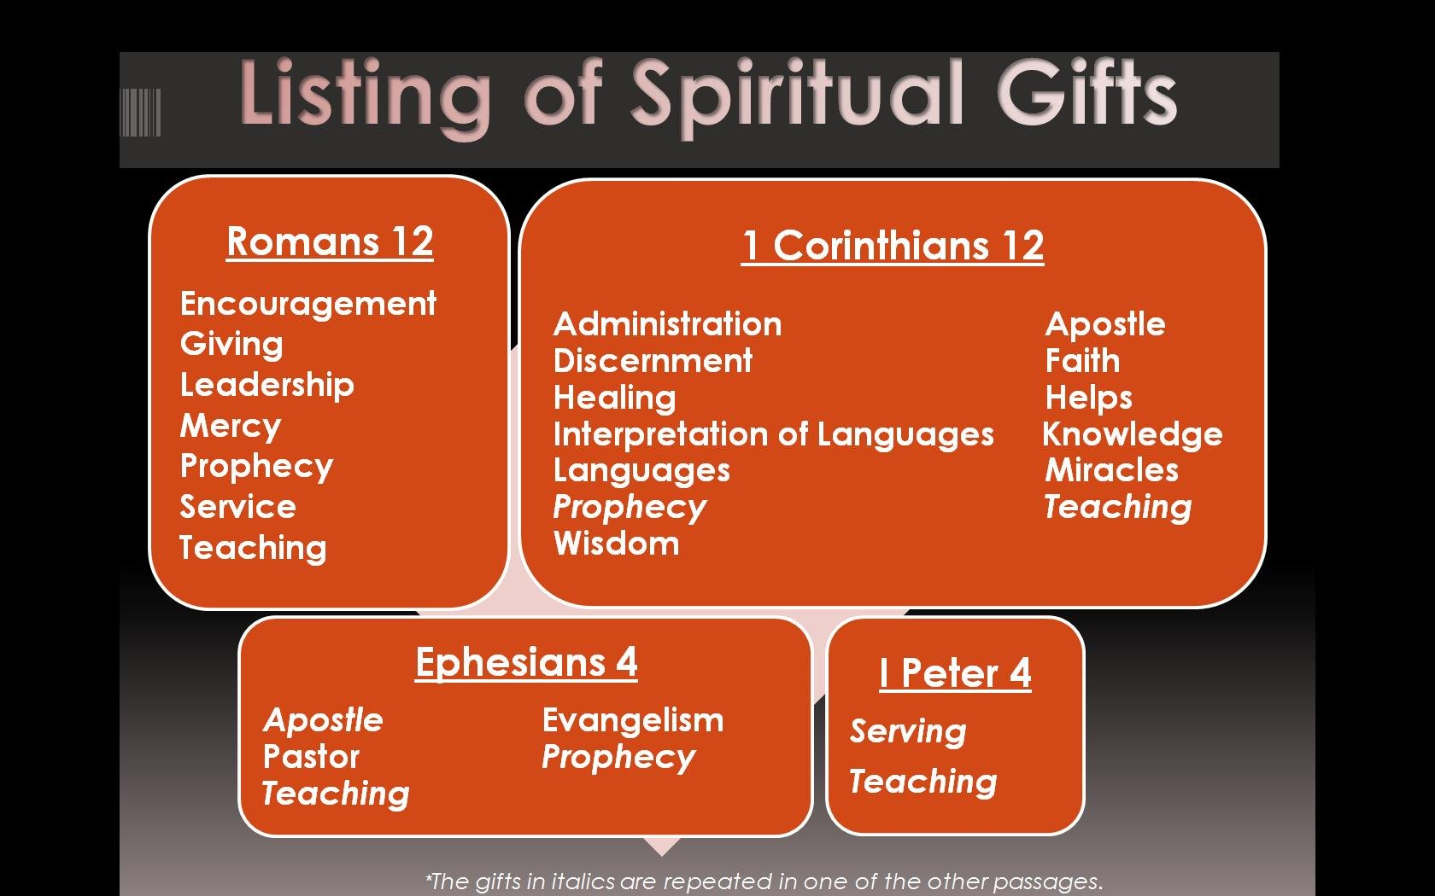

Slide 12
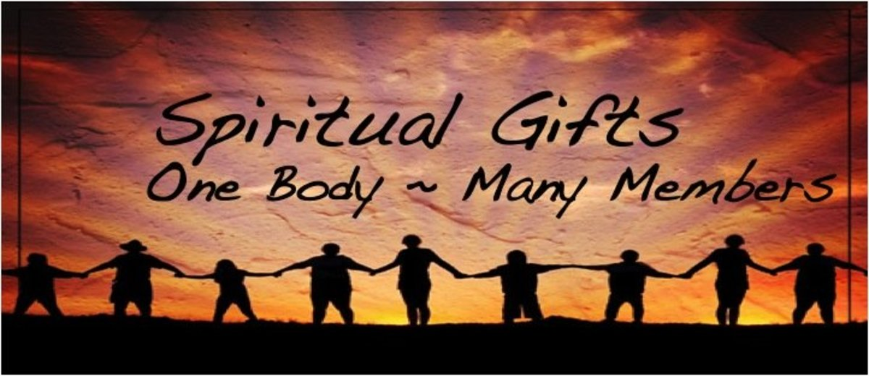

2. What Are Spiritual Gifts?
Every Christian is a “member” (part) of Christ’s body and has a unique function (office) – one body, many members, various gifts. Romans 12:6-8 provides a non-exhaustive list of spiritual gifts.
Reflection : Which of these gifts do you see in yourself?
Which ones have others noticed in you?

Slide 13
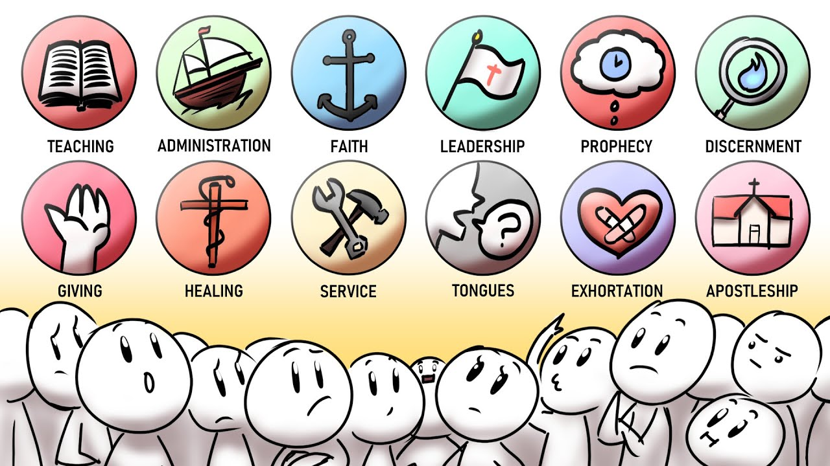

Slide 14
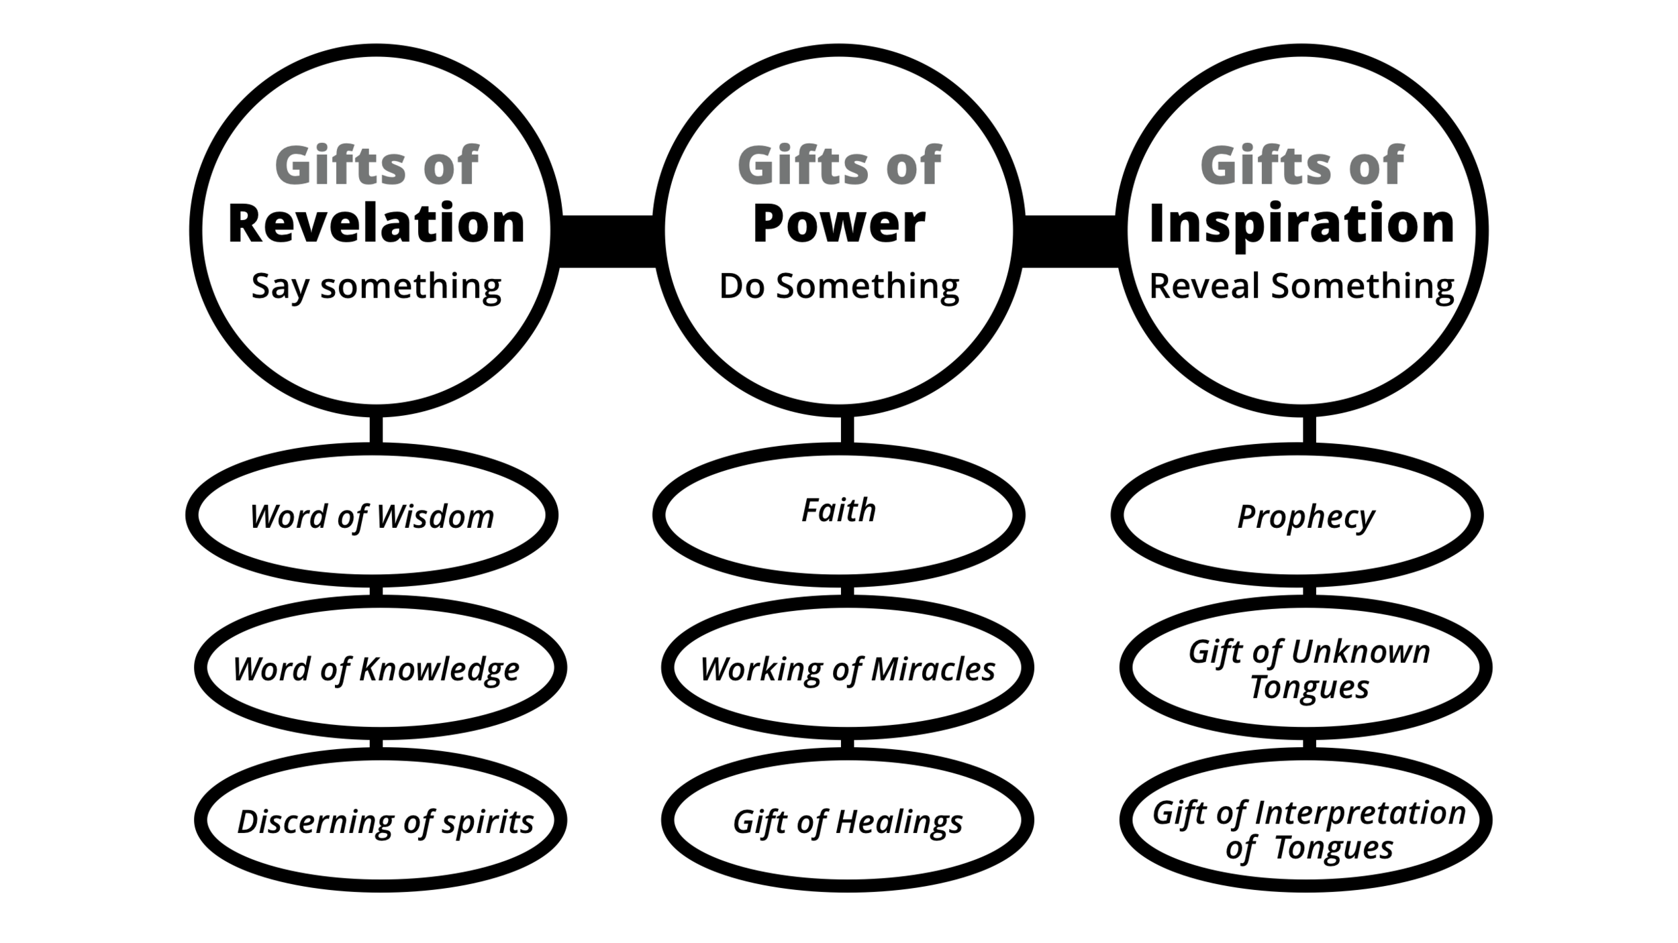
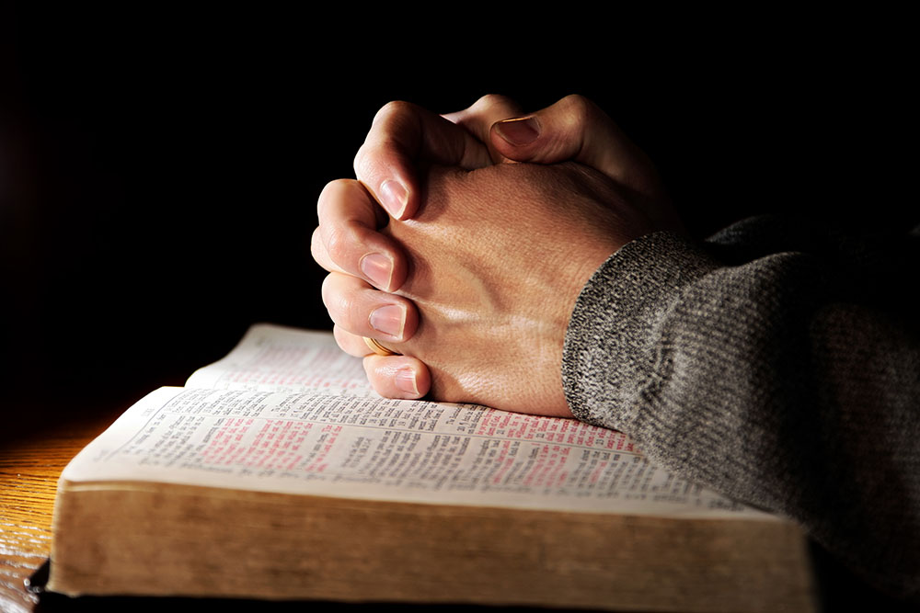
3. How To Discover Your Gifts?
Pray for God to reveal how He wants you to serve.

Slide 15


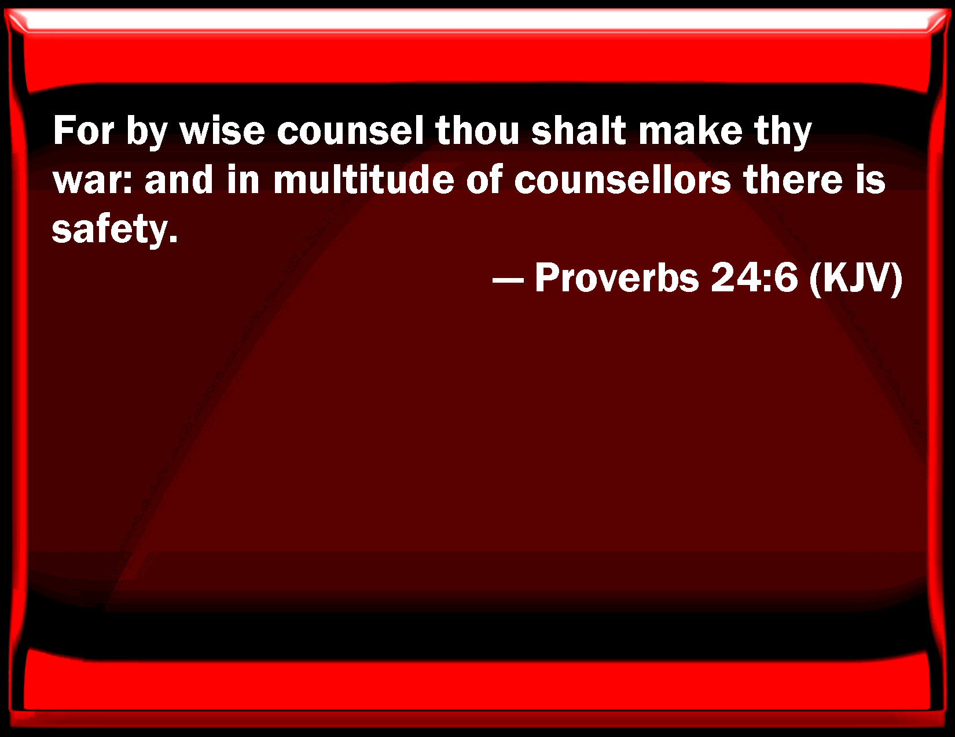
3. How To Discover Your Gifts?
Ask trusted believers or
leaders for input.

Slide 16
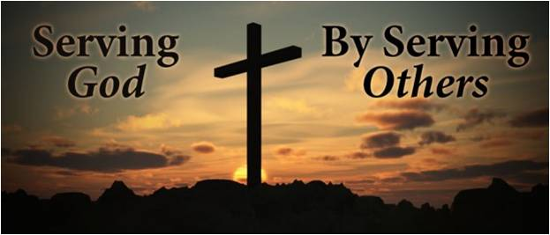

3. How To Discover Your Gifts?
Start serving – God often shows our gifts as we step out in faith.

Slide 17
Discovering Spiritual Gifts
The best way to discover your spiritual gifts is by obeying God when He asks you to do something.
Obedience leads to Enlightenment “If any man will do his will, he shall know of the doctrine, whether it be of God, or whether I speak of myself.” (John 7:17)
Until you are actually involved in serving, it will be difficult to know what you are good at.
Other believers will confirm your gifting.

Slide 18

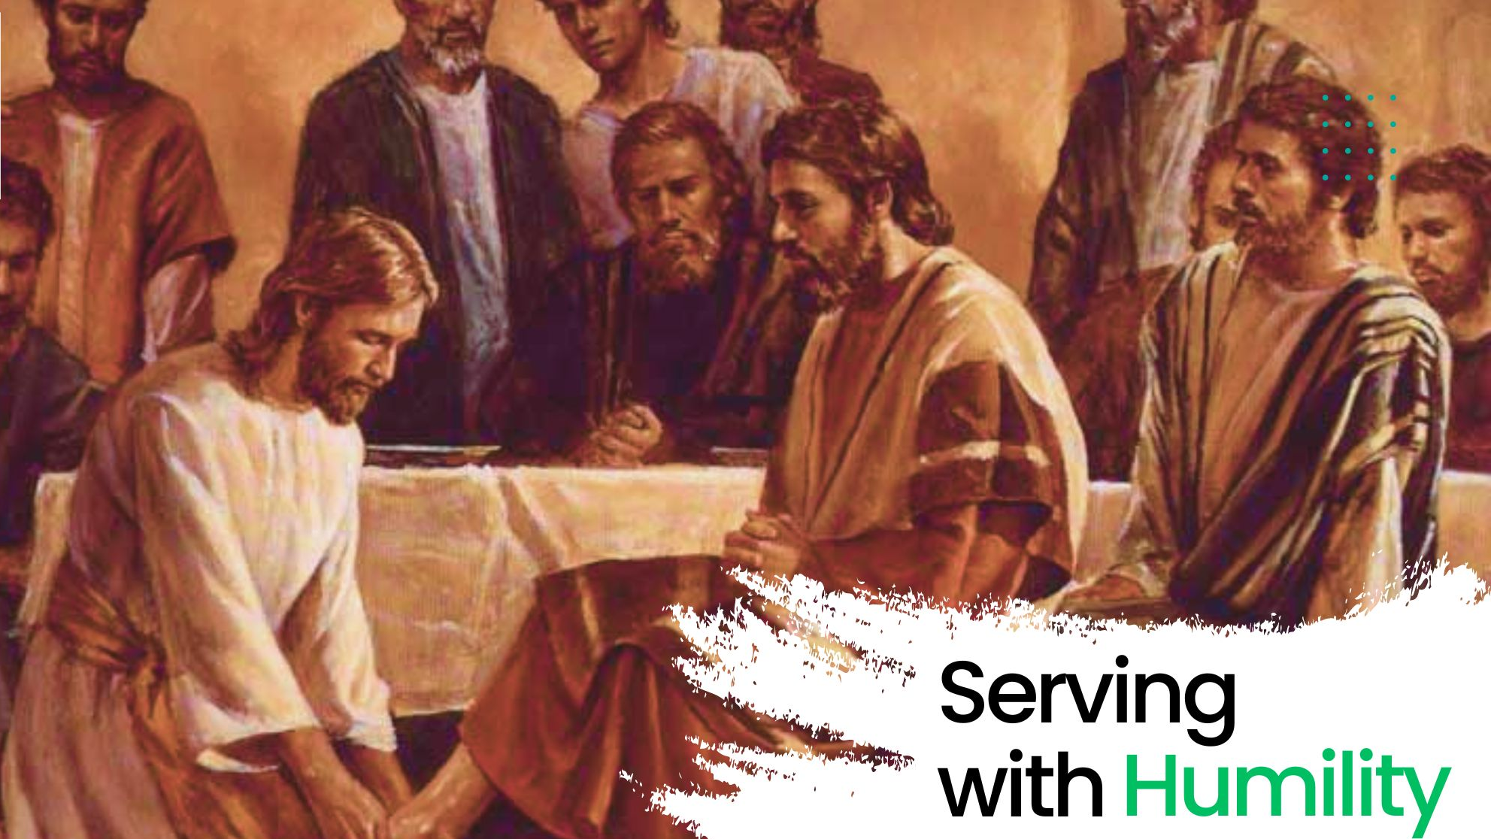
3. How To Discover Your Gifts?
Stay humble – It’s about helping others, not being recognised.

Slide 19

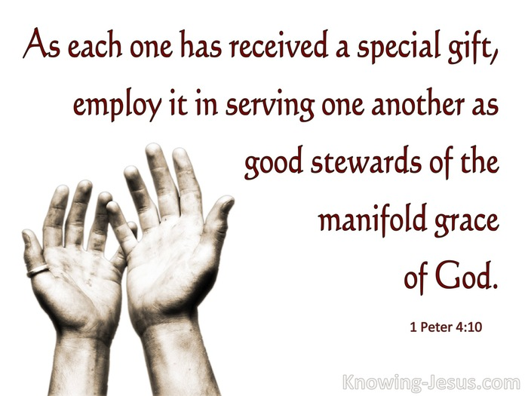

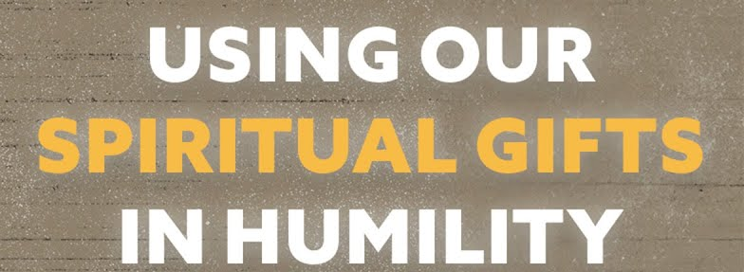

Slide 20
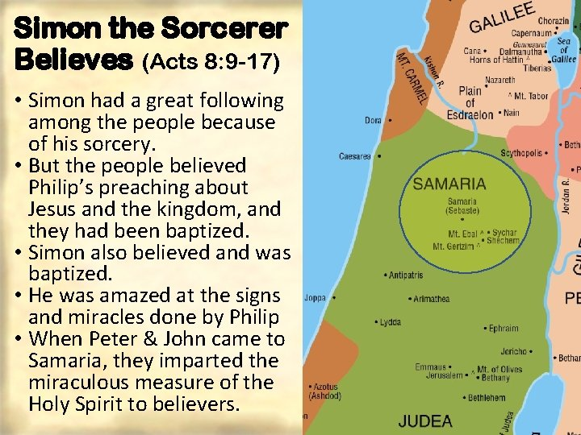
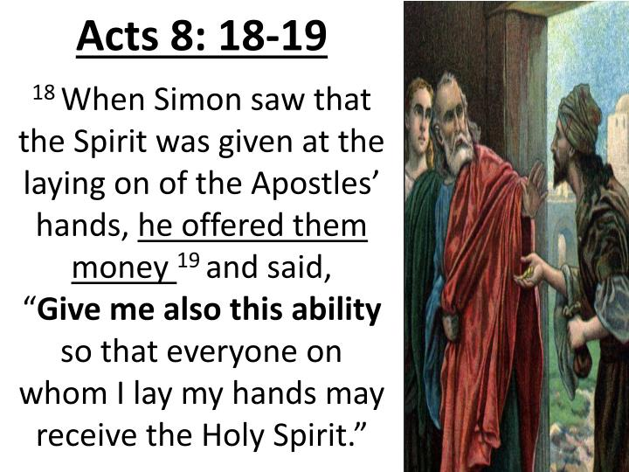
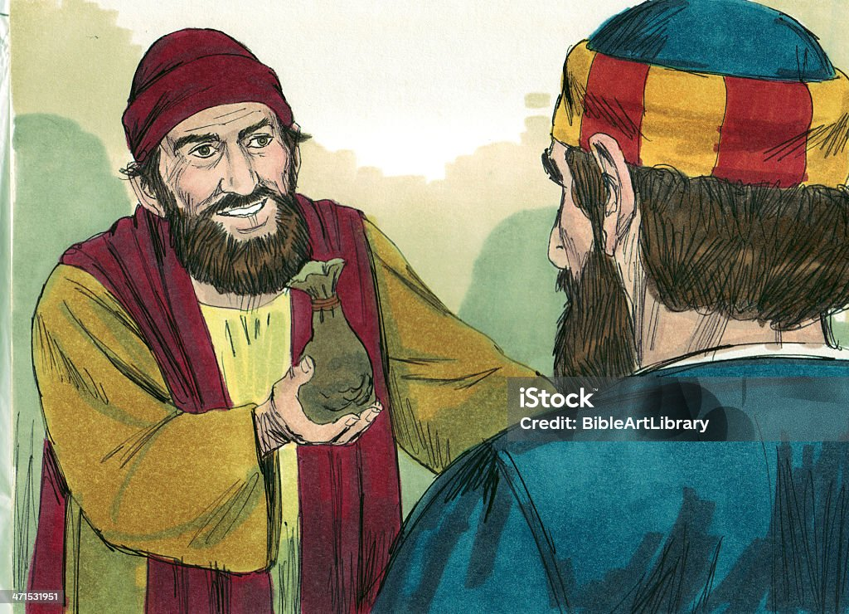
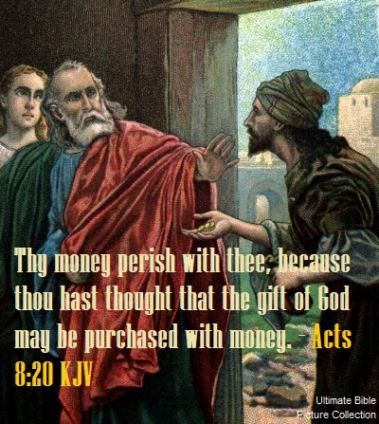
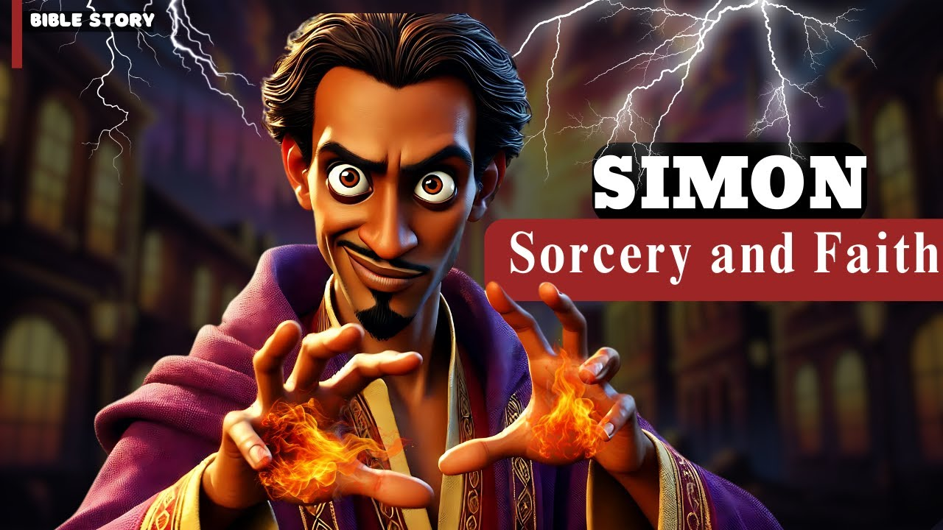


Slide 21



4. Serve With The Right Heart
Serve With Love (1 Corinthians 13 ;1-2)
“Though I speak with the tongues of men and of angels, and have not charity, I am become as sounding brass, or a tinkling cymbal. And though I have the gift of prophecy, and understand all mysteries, and all knowledge; and though I have all faith, so that I could remove mountains, and have not charity, I am nothing.”

Slide 22



4. Serve With The Right Heart
Serve With Humility (Philippians 2:3)
“Let nothing be done through strife or vainglory; but in lowliness of mind let each esteem other better than themselves.”

Slide 23

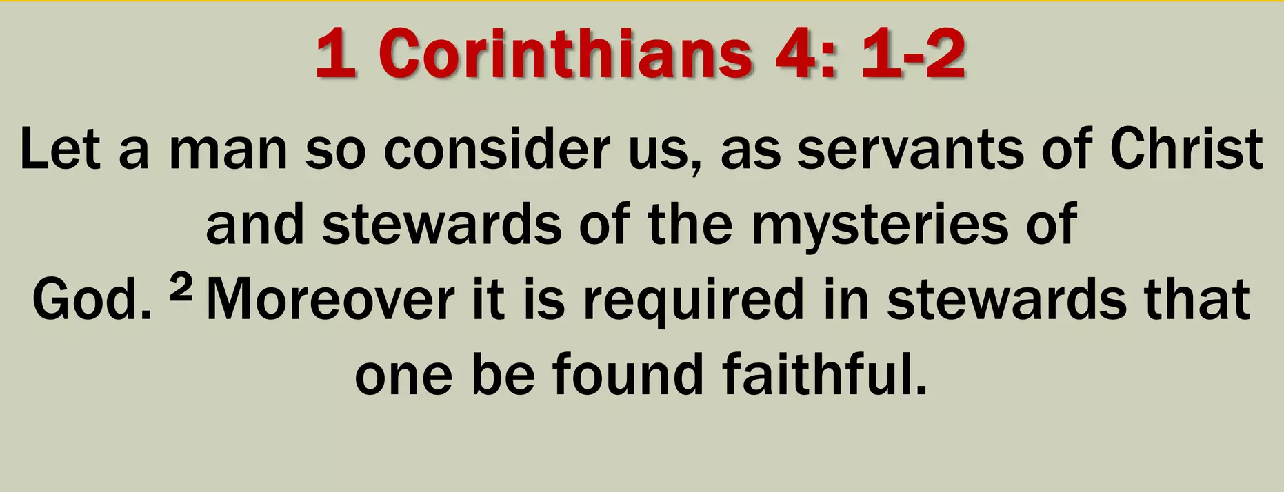

4. Serve With The Right Heart
Serve With Faithfulness (Colossians 3:23-24)
“And whatsoever ye do, do it heartily, as to the Lord, and not unto men; Knowing that of the Lord ye shall receive the reward of the inheritance: for ye serve the Lord Christ.”

Slide 24
4. Serve With The Right Heart
Reflection :
We should use our gifts in love, humility and faithfulness.
Do not feel obliged to serve. False humility is actually pride.
Do not turn down opportunities to serve lightly (even if you do not think you are ready / equipped for the ministry).

Slide 25
5. Discussion Questions
Why do you think God give spiritual gifts to (all) believers?
How do you feel about the idea that every believer is called to serve?
Have you ever experienced joy or fulfillment when helping others? What happened?
Do you see yourself as having something valuable to contribute to the church ? Why or why not?
What fears or hesitations might hold you back from serving the church?
What is one small way you can serve in the church – even if it is behind the scene?

Slide 26
6. The Mission Of Every Believer : To Be A Witness
Jesus commands all His followers to make disciples – To be His representatives / ambassadors, to be His witness. This is NOT just for pastors and missionaries – It is for ALL believers.
- Matthew 28:19-20 “Go ye therefore, and teach (GK : disciple)
all nations, baptizing them in the name of the Father, and of the
Son, and of the Holy Ghost: Teaching them to observe all things
whatsoever I have commanded you: and, lo, I am with you
always, even unto the end of the world. Amen.”
2 Corinthians 5:20 “Now then we are ambassadors for Christ …”

Slide 27
6. The Mission Of Every Believer : To Be A Witness
A witness simply shares what they have seen, heard, and experienced.
Acts 1:8 “Ye shall receive power … and ye shall be witnesses unto me …”
We are to share the gospel any time. However, we don’t need to know everything before we can be a witness – We just need to share what Jesus has done for us.
1 Peter 3:15 “But sanctify the Lord God in your hearts: and be ready always to give an answer to every man that asketh you a reason of the hope that is in you with meekness and fear:”
We are to share the gospel wherever we are. We don’t need to go overseas to live on mission – Our mission field is wherever God has placed you – at home, at work, at school, at our neighbourhood, etc.
Reflection : Why do you think Jesus gave this mission to every believer?

Slide 28
7. How Do I Share My Faith?
Pray – Ask God for boldness and open doors.
Live it – Let your life reflect Christ (Philippians 2:15)
- “That ye may be blameless and harmless, the sons of God, without
rebuke, in the midst of a crooked and perverse nation, among whom ye
shine as lights in the world;”
People may see Christ in us before they hear about Him from anyone else.

Slide 29
7. How Do I Share My Faith?
Speak it – Tell others the gospel clearly (Romans 10:14)
“How then shall they call on him in whom they have not believed? and how
shall they believe in him of whom they have not heard? and how shall they
hear without a preacher?”
Invite – Bring people to church for Worship Service or Bible Study groups.
Show Love – Be a consistent example of Christ’s compassion
Be Bold – Be not ashamed of the gospel (Romans 1:16)
“For I am not ashamed of the gospel of Christ: for it is the power of God
unto salvation to every one that believeth; to the Jew first, and also to the
Greek.”

Slide 30
8. Discussion & Reflection
What does it mean to be a “witness” for Jesus? (Acts 1:8)
“But ye shall receive power, after that the Holy Ghost is come upon
you : and ye shall be witnesses unto me both in Jerusalem, and in
all Judaea, and in Samaria, and unto the uttermost part of the earth.”
Have you ever shared your faith with someone? What was that like?
Why do you think some Christians are afraid or hesitant to witness?
What are some natural ways you could share your faith in daily life?

Slide 31
8. Discussion & Reflection
How can your personal testimony (story) be used to point someone to Jesus? (Read John 4:28-30) – The Samaritan woman at the well shared her story to her neighbours in the village.
“The woman then left her waterpot, and went her way into the
city, and saith to the men, Come, see a man, which told me all
things that ever I did: is not this the Christ? Then they went out
of the city, and came unto him.” (John 4:28-30)

Slide 32
8. Discussion & Reflection
Many consider the testimony (the way we live) of a believer as the 5thgospel. What do you think?
(Note: While we should live godly before men, that in itself is NOT
sufficient – The gospel must still be proclaimed.)
Who in your life needs to hear about Jesus?
(eg. Family, friends, colleagues, classmates, etc.)
What’s one step you can take to be a witness?
How can you support global missions even if you don’t travel?
(eg. Giving, prayer, encouraging missionaries, etc.)

Slide 33
8. Discussion & Reflection
Do you feel “sent” by God to a specific place, group or calling?
What might that look like?
How can the church help you grow in confidence as a witness and mission-minded believer?

