Slide 1
Jesus Saves Mission
Baptismal Class
Lesson 4

Slide 2
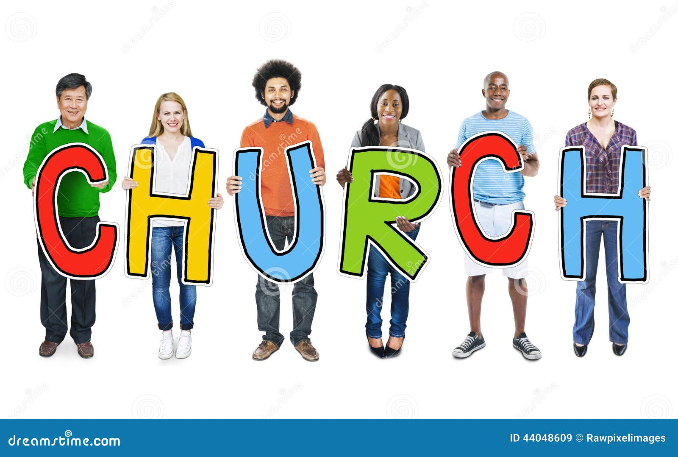


Slide 3
OBJECTIVES
It is crucial for a believer to be a member of a local church which is the Body of Christ.
We are saved to be part of a larger community of believers, to have fellowship with one another, to grow together and to serve together.
Understand what the Bible teaches about the Church.
Recognise the need to belong to a local church.
Appreciate the role of Christian fellowship in growth and accountability.
Be encouraged to actively engage in the life of the Church.

Slide 4


Slide 5
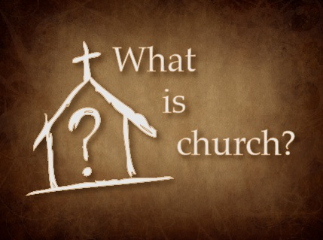

Slide 6

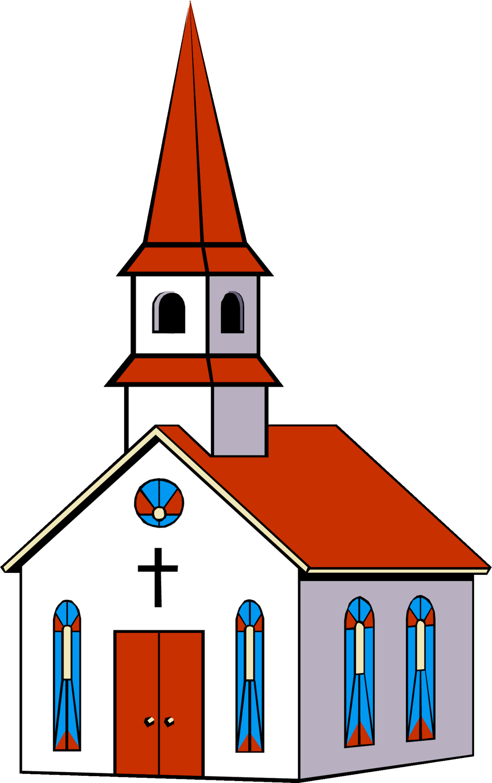
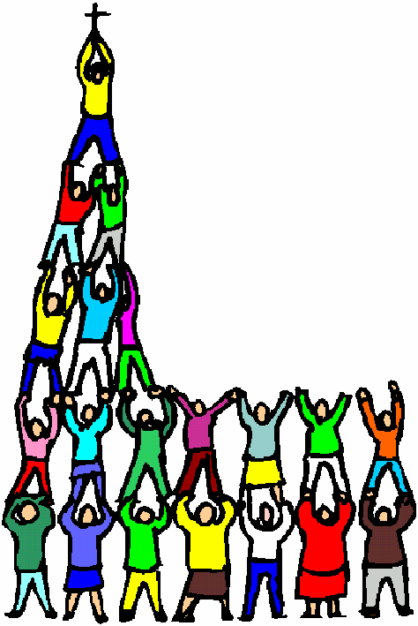
‘Church’ ??? What is it?

Slide 7
What Is The Church?
CHURCH (Ecclesia in Greek) – “to call out from” (Ek + Kaleo)
Christians are called out from the world system to be “in Christ”.
1 Cor 1:2 “Unto the church of God which is at Corinth … called to be saints”.
The word CHURCH can refer to the Church Local (local believers).
Philem 2 “… and to the church in thy house”.
Col 4:15 “Salute the brethren which are in Laodecia, and Nymphas, and the church which is in his house”.
The word CHURCH can also mean the Church Universal
1 Cor 15:9 “For I am … not meet to be called an apostle, because I persecuted the church of God”.

Slide 8
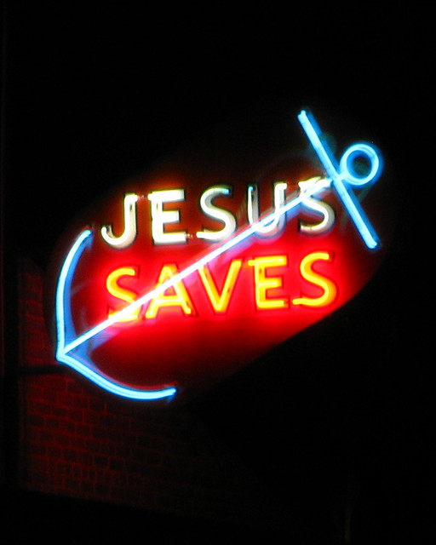


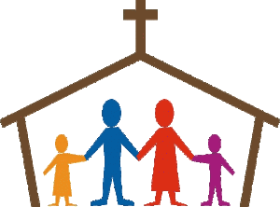
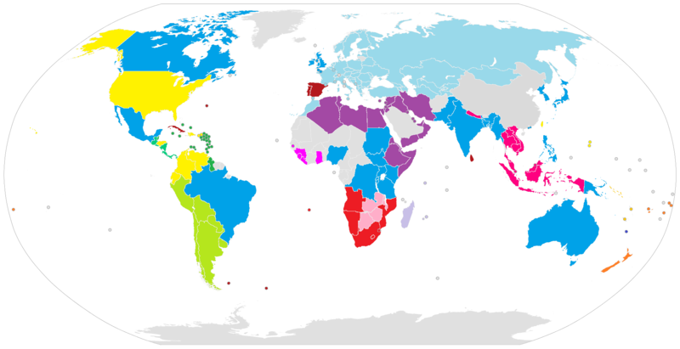
… Other Distinctions of The Church
LOCAL
UNIVERSAL

Slide 9

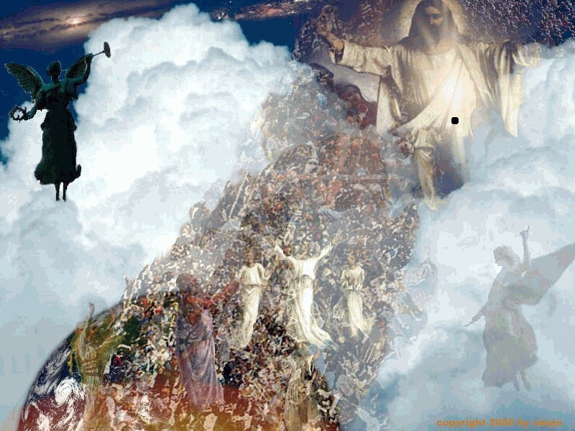
…Other Distinctions of The Church
Visible Church
Invisible Church
Local Church Membership Rolls
All earthly denominations and sects
Good, bad & indifferent
Church Versus Kingdom (Matt 13)
The Kingdom comprised of both saved and the unsaved.
Made up of those whose names are written in the Lamb’s Book Of Life (Rev 20 :15; 21:27)
Rev 20 : 15 “And whosever was not found written in the book of life was cast into the lake of fire”.

Slide 10
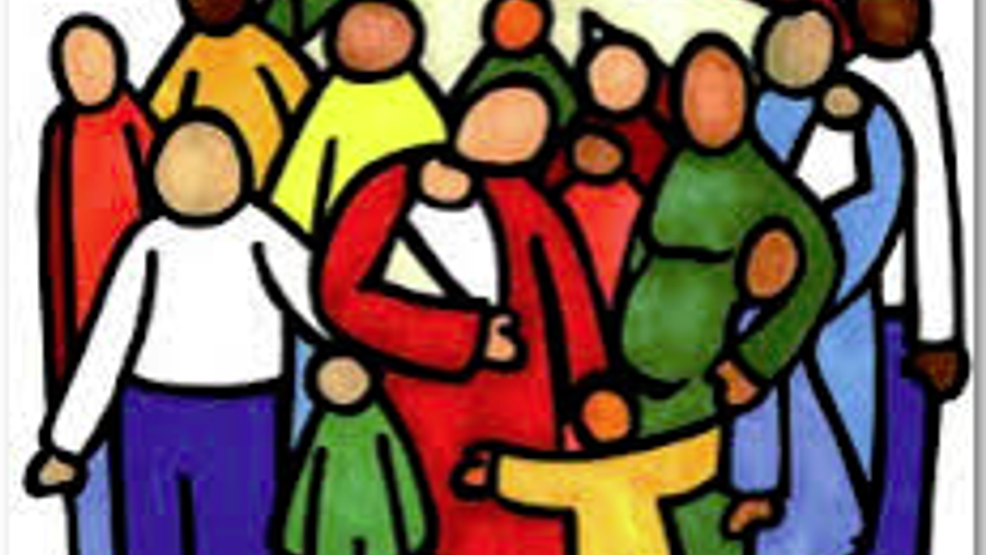
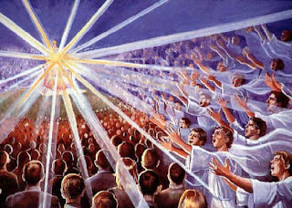
…Other Distinctions of The Church
Actual & Real
Ideal
Imperfect yet striving after perfection through Christ.
Made up of those who have already gone to heaven and are perfect now.

Slide 11
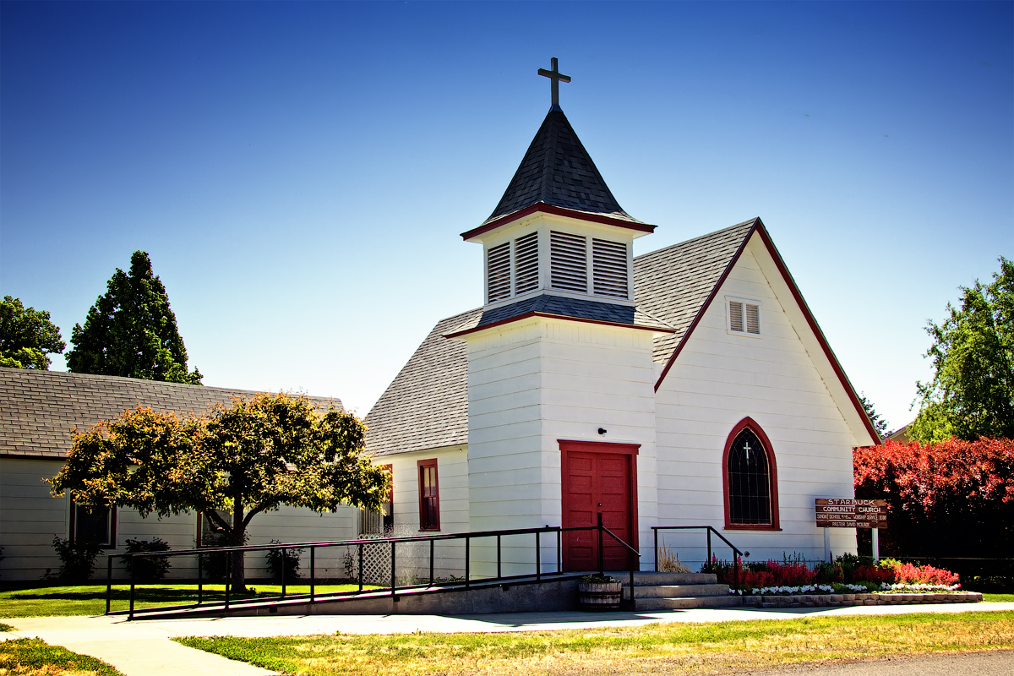
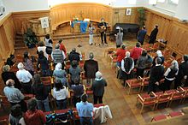
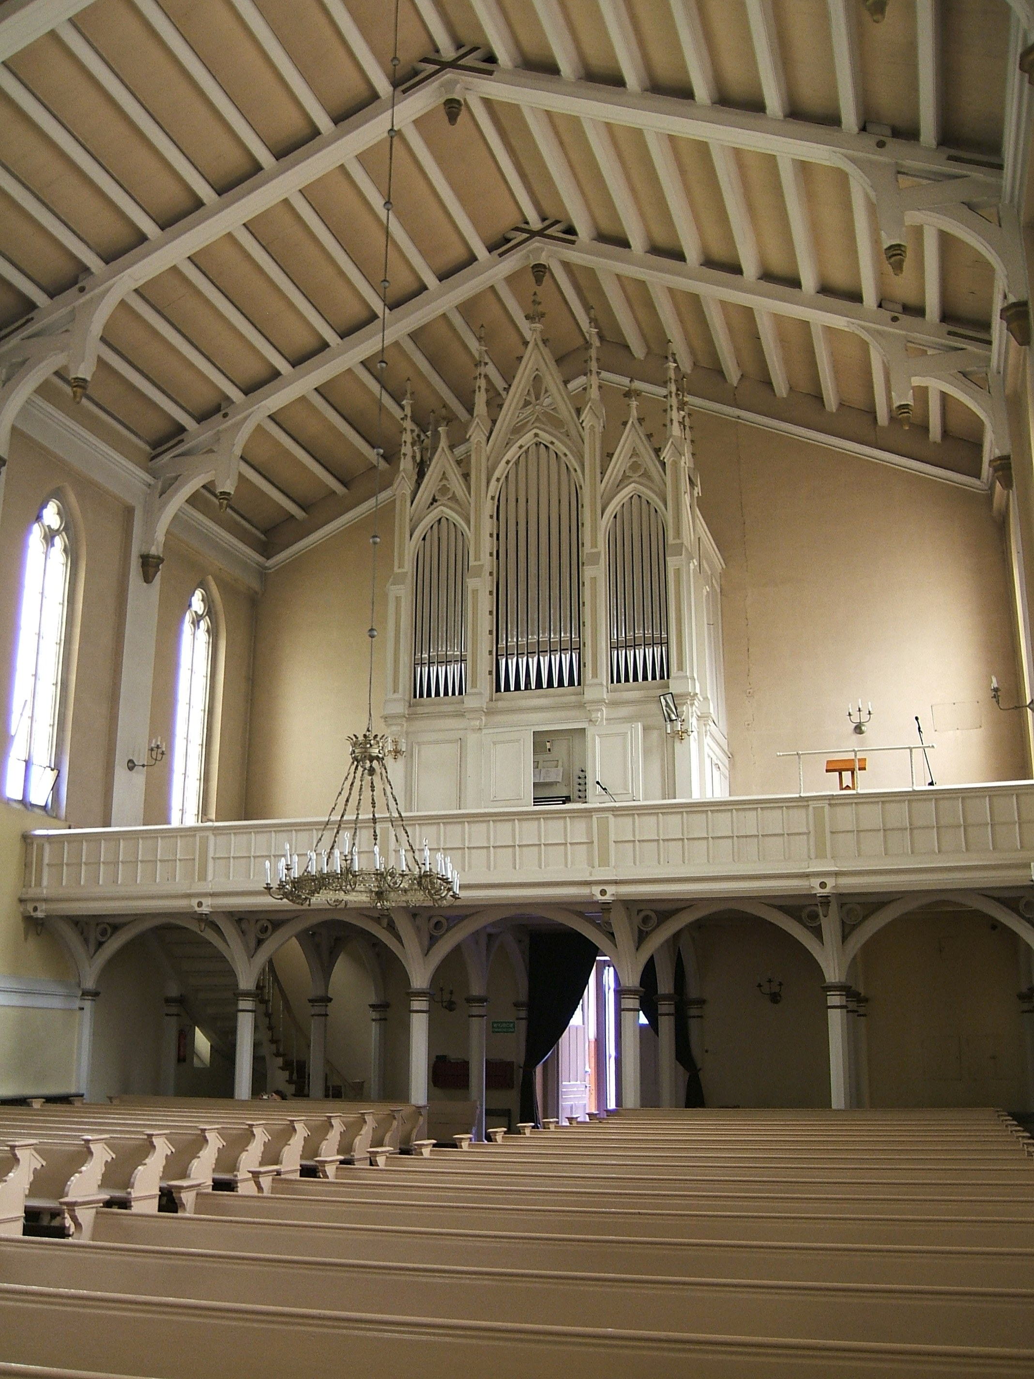
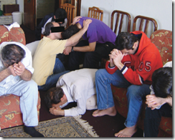
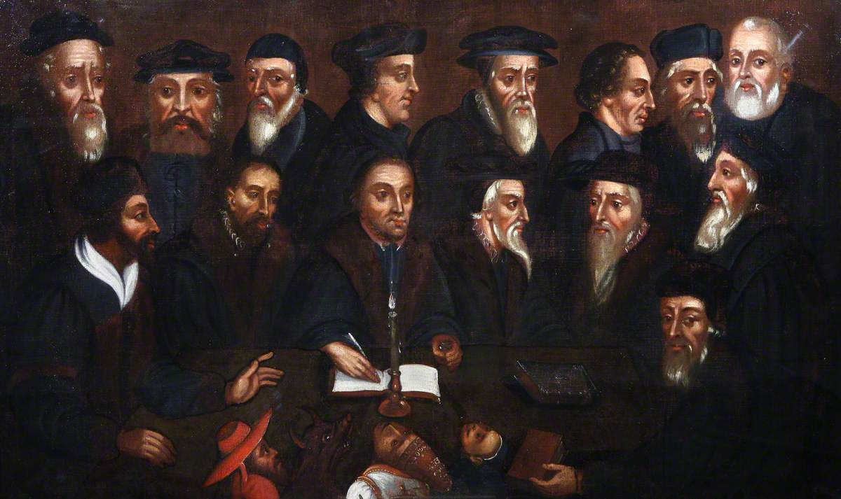
This Photo by Unknown Author is licensed under CC BY-SA
This Photo by Unknown Author is licensed under CC BY-SA
This Photo by Unknown Author is licensed under CC BY-SA

Slide 12
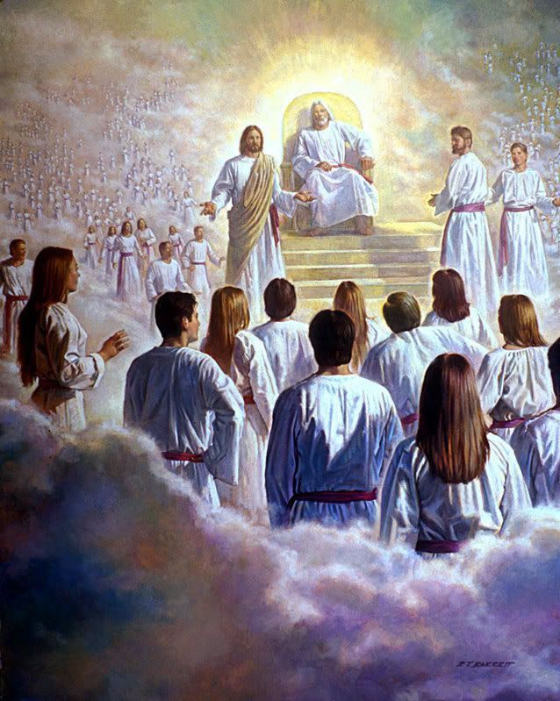
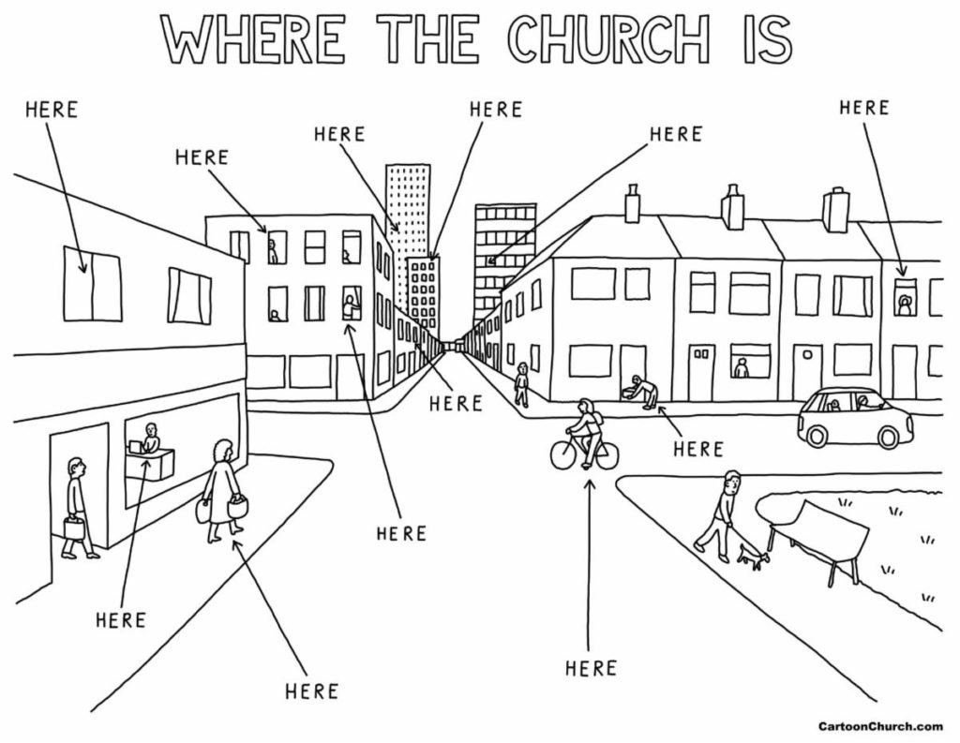
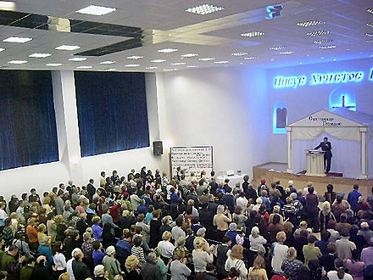
This Photo by Unknown Author is licensed under CC BY-SA
This Photo by Unknown Author is licensed under CC BY-SA

Slide 13
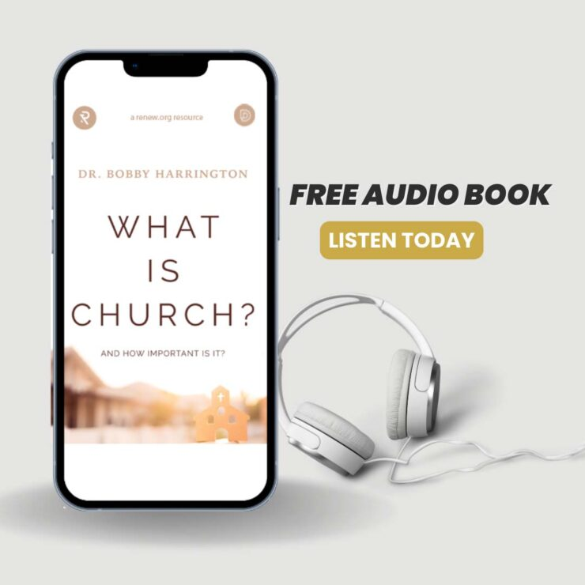
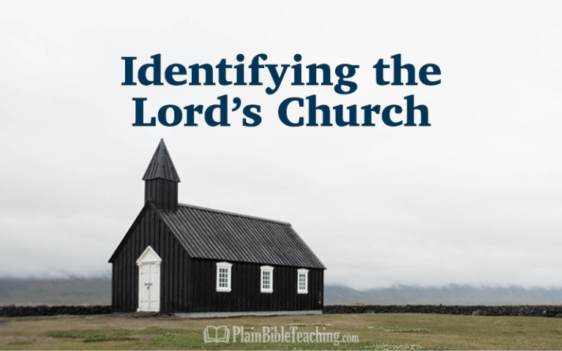

Slide 14
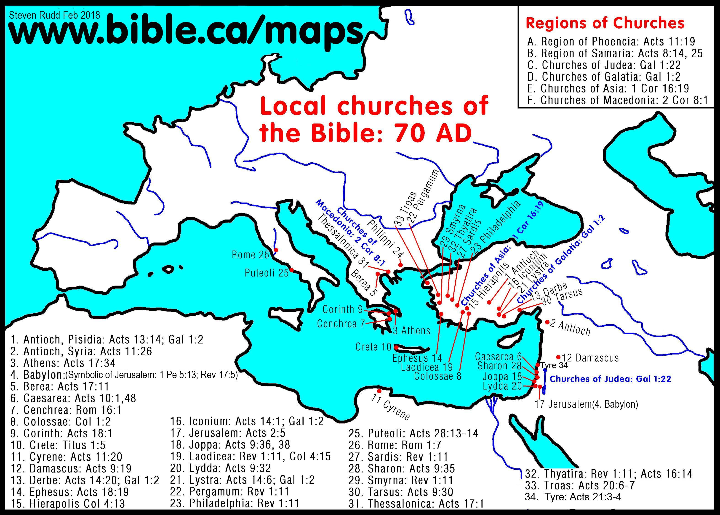

Slide 15
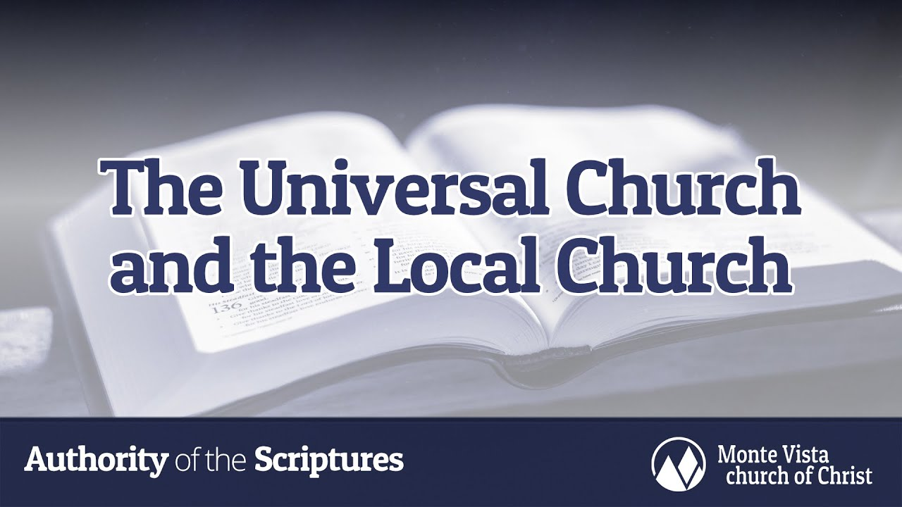

Slide 16
Summary : What Is The Church?
The Church is NOT a building, but the people of God.
The word “church” (Greek : ekklesia) means “called out ones”.
Two aspects of the Church :
- Universal Church – All true believers in Christ (Past, Present, Future).
- Local Church - A community of believers who meet regularly to worship,
fellowship and serve.
Biblical Pictures of the Church :
- The Body of Christ – “Now ye are the body of Christ, and members in
particular.” (1 Corinthians 12:27)
- The Family of God - “Now therefore ye are no more strangers and foreigners,
but fellow citizens with the saints, and of the household of God;”
(Ephesians 2:19)

Slide 17
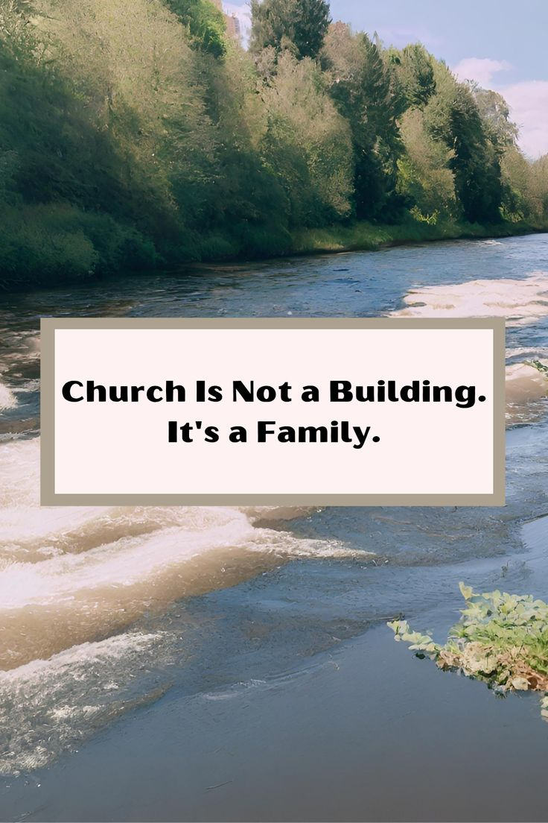
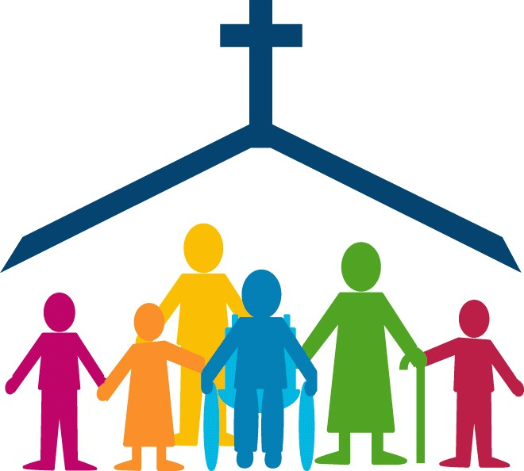
Church & Fellowship

Slide 18
Church & Fellowship

Slide 19
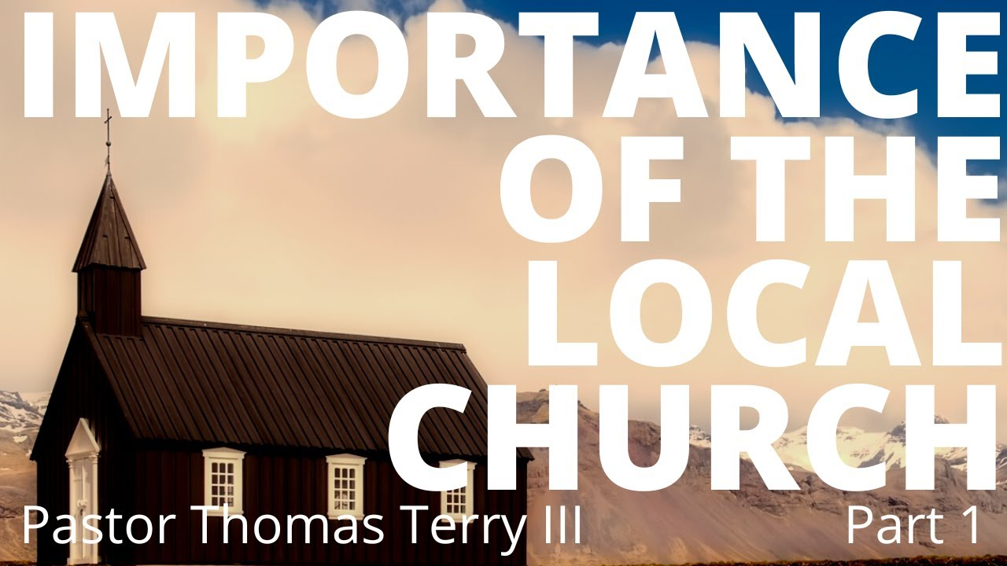
2. The Purpose Of The Local Church

Slide 20
2. The Purpose Of The Local Church
Worship God - “And they, continuing daily with one accord in the temple, and breaking bread from house to house, did eat their meat with gladness and singleness of heart, Praising God, and having favour with all the people. And the Lord added to the church daily such as should be saved.” (Acts 2:46-47)
Fellowship - “And they continued steadfastly in the apostles' doctrine and fellowship, and in breaking of bread, and in prayers.” (Acts 2:42)
Discipleship & Teaching - “Teaching them to observe all things whatsoever I have commanded you: and, lo, I am with you alway, even unto the end of the world. Amen.” (Matthew 28:20)
Service & Ministry – “For the perfecting of the saints, for the work of the ministry …” (Ephesians 4:12)
Evangelism & Mission – “Ye shall be witnesses unto me …” (Acts 1:8)

Slide 21
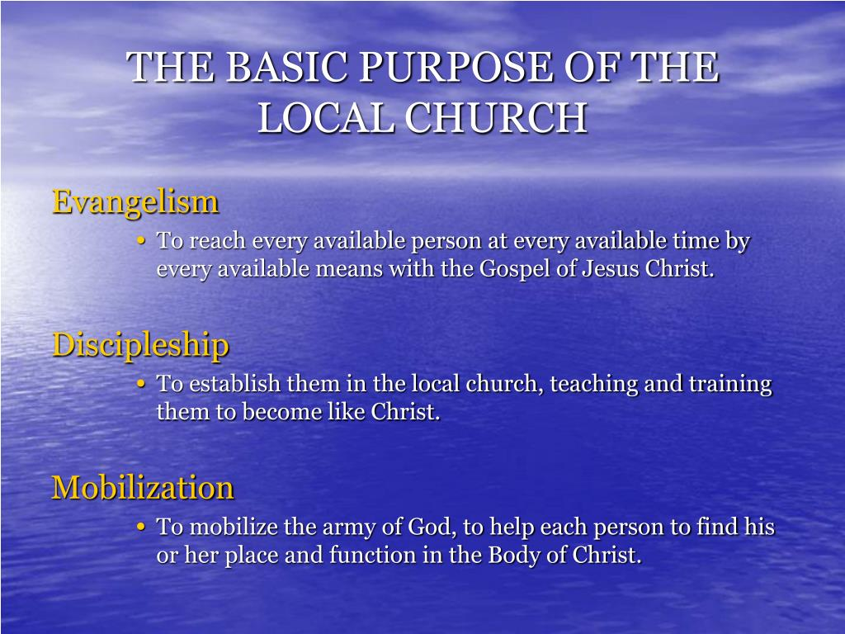
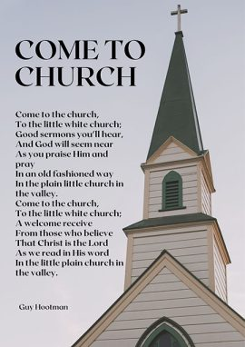

Slide 22
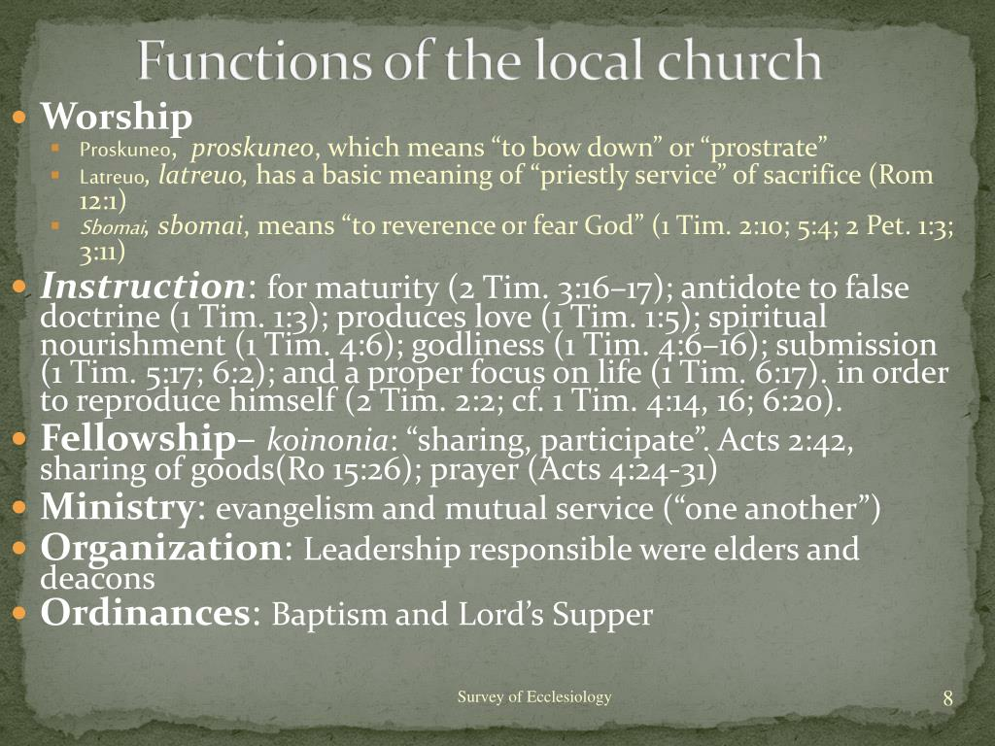

Slide 23
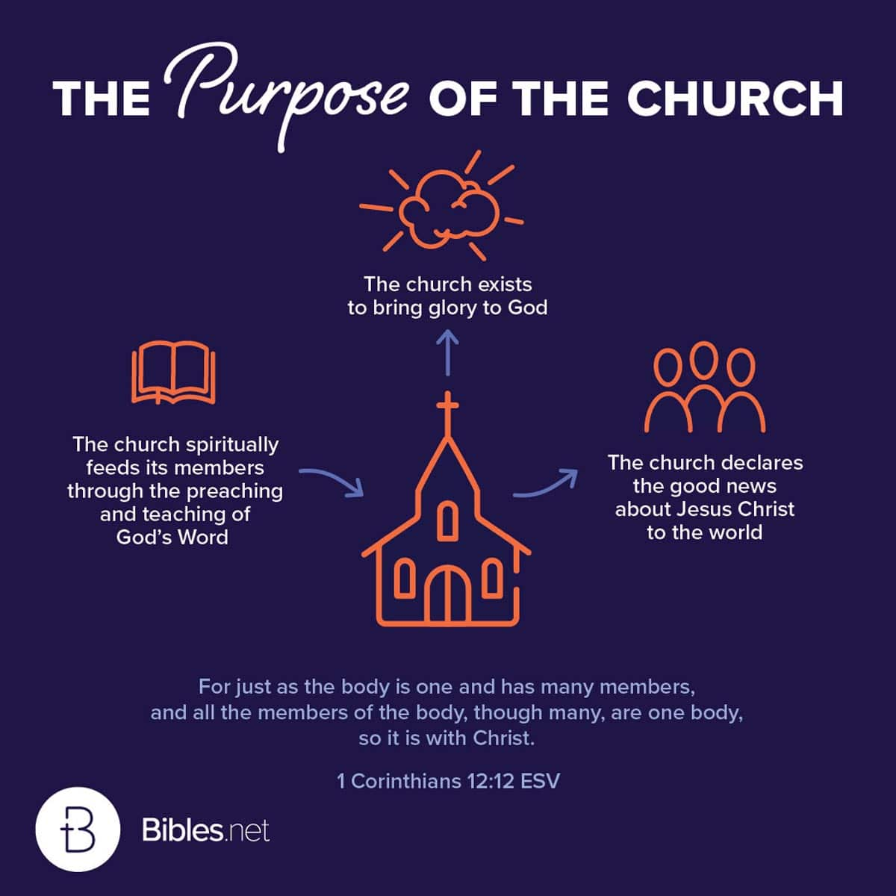
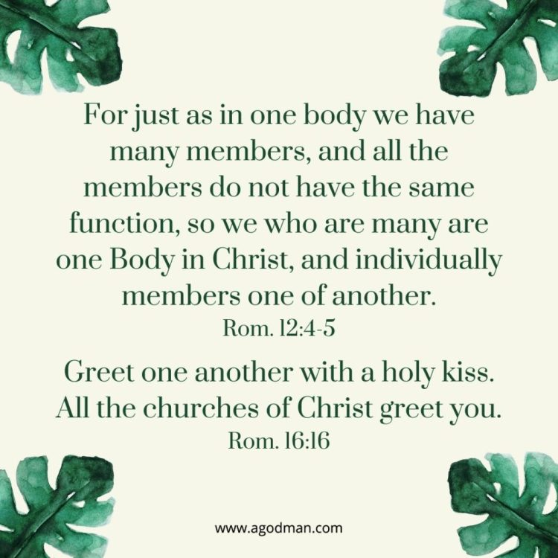
Title and Content Layout with Chart
1 Corinthians 12:12

Slide 24
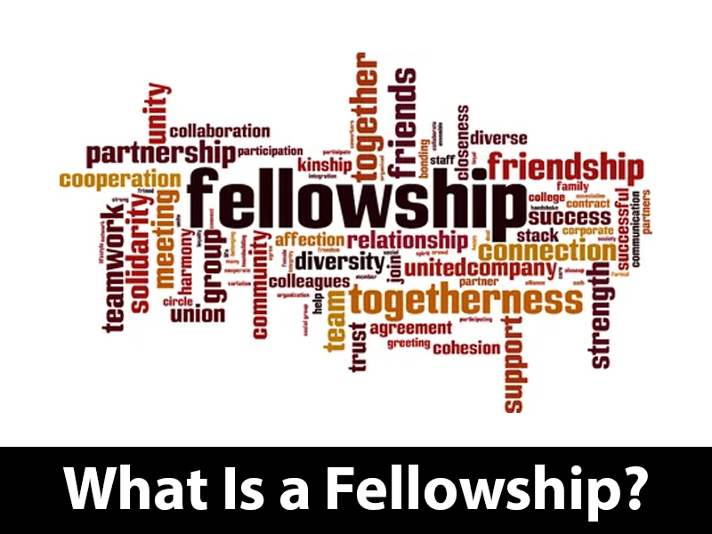

3. Why Fellowship Matters?

Slide 25

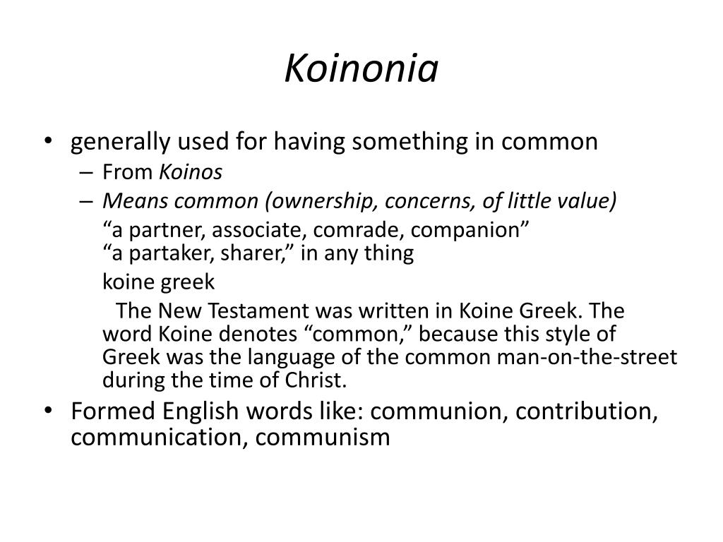
3. Why Fellowship Matters?

Slide 26

3. Why Fellowship Matters?

Slide 27
3. Why Fellowship Matters?
Christian fellowship is more than just casual friendship. It is a spiritual bond in Christ.
Fellowship is NOT optional, It is part of Christianity.
Fellowship provides :
- Encouragement & Accountability (Hebrews 10:24-25)
“And let us consider one another to provoke unto love and to good works: Not forsaking the assembling of ourselves together, as the manner of some is; but exhorting one another: and so much the more, as ye see the day approaching.” (Hebrews 10:24-25)
Spiritual Growth Through Community (Ephesians 4:16)
“From whom the whole body fitly joined together …maketh increase of the body …” (Ephesians 4:16)
Shared Burdens & Joys
Galatians 6:2 “Bear ye one another’s burdens …”
Roamns 12:15 “Rejoice with them that do rejoice, and weep with them that weep.”

Slide 28
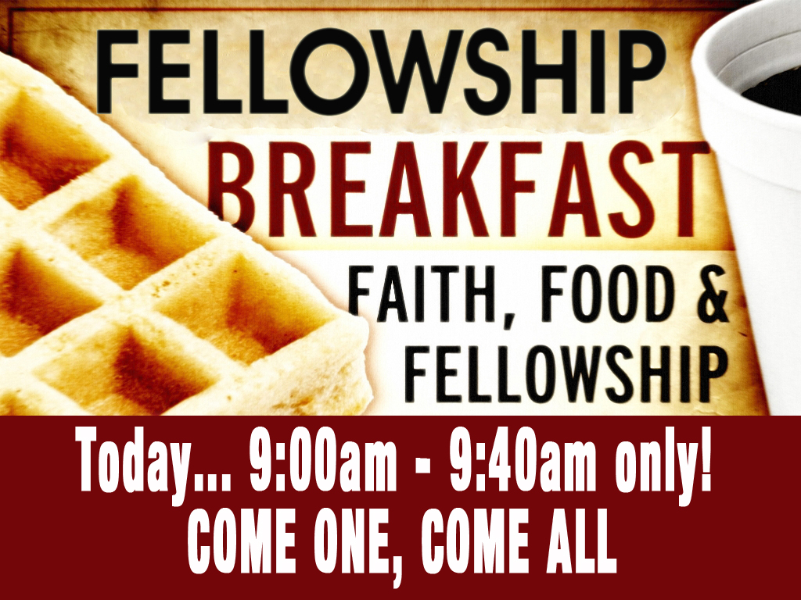


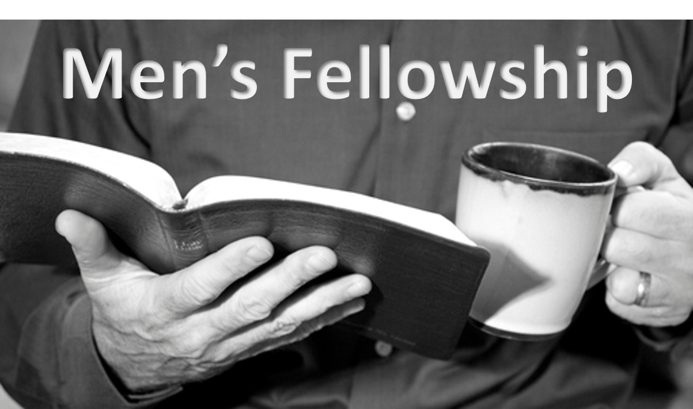



Slide 29
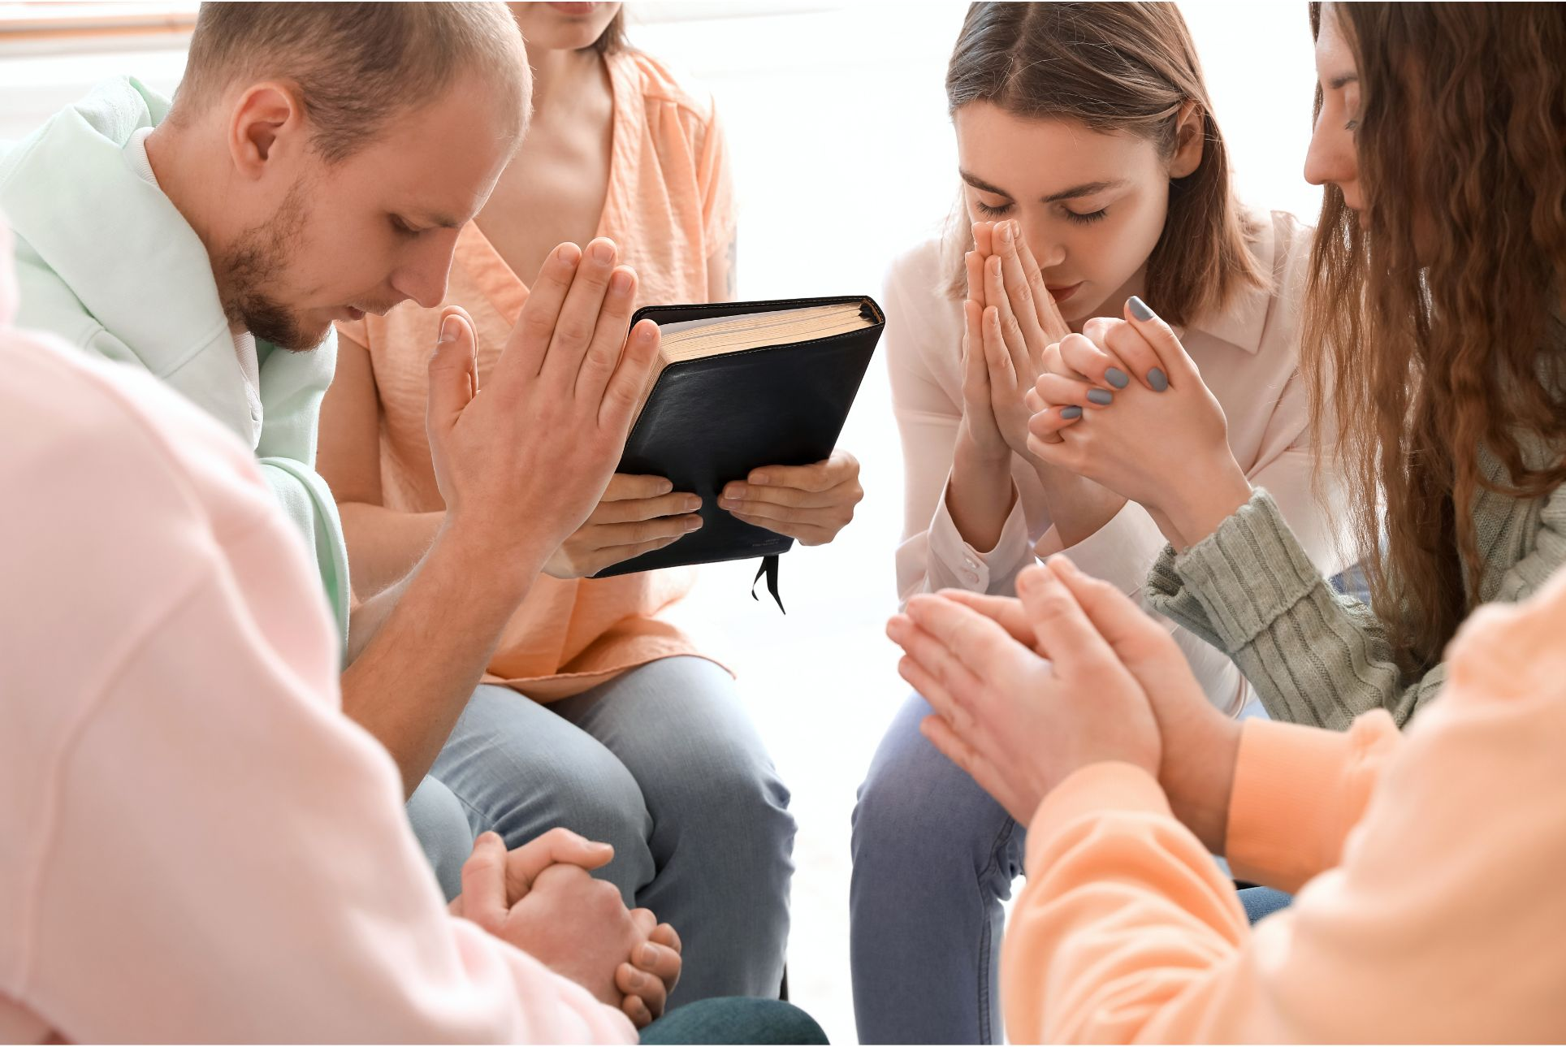




Slide 30
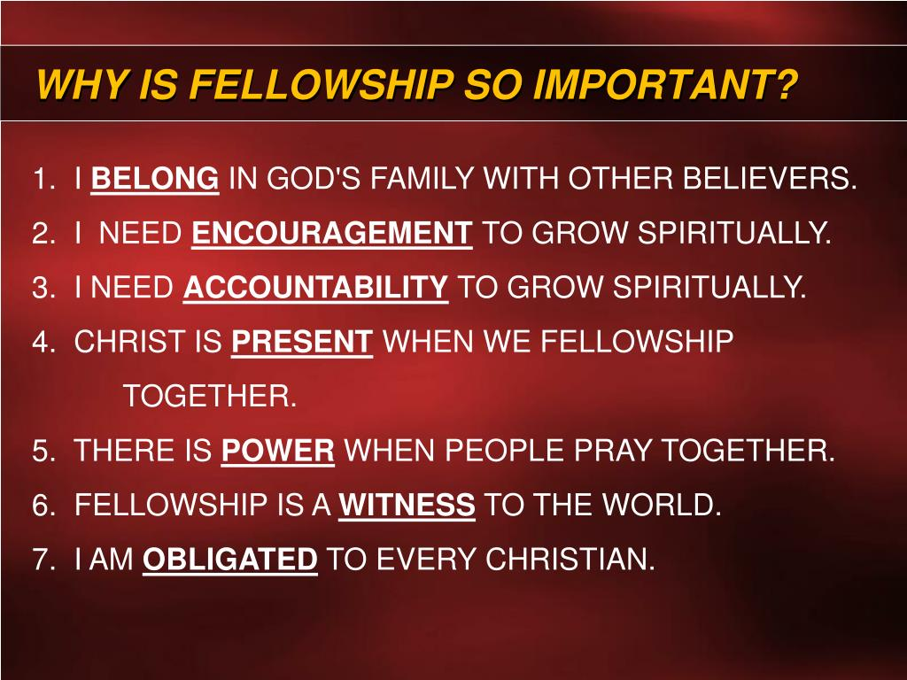
Add a Slide Title - 2

Slide 31


Slide 32

Add a Slide Title - 3

Slide 33


Slide 34
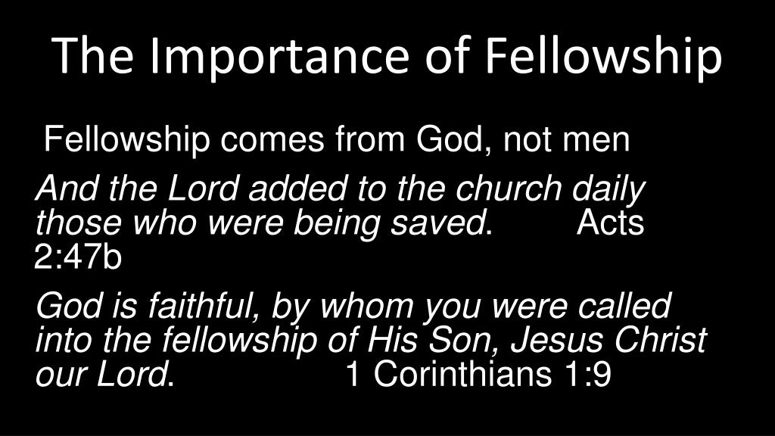
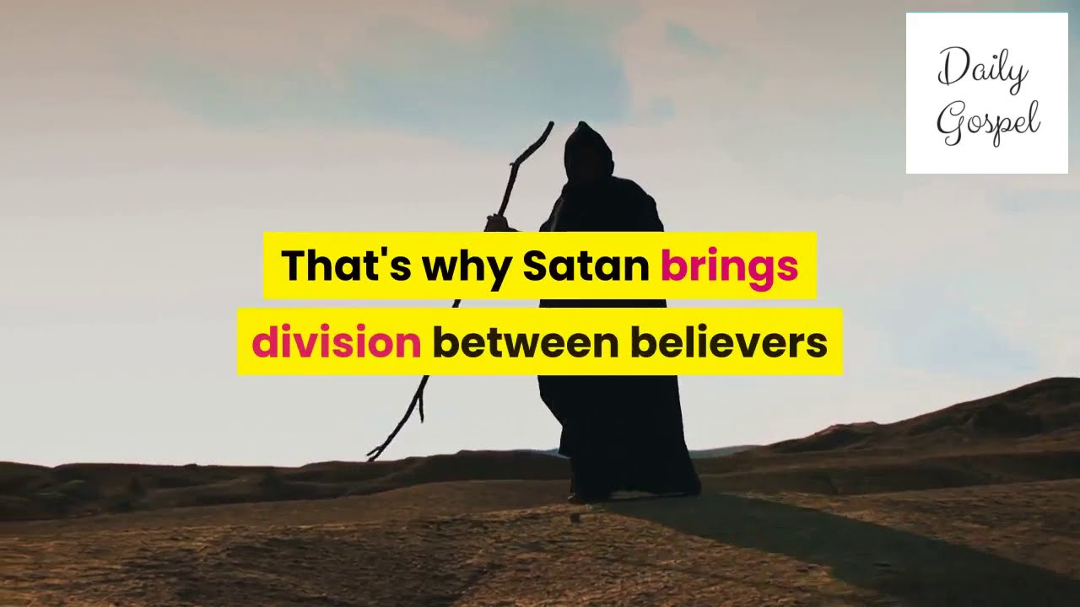
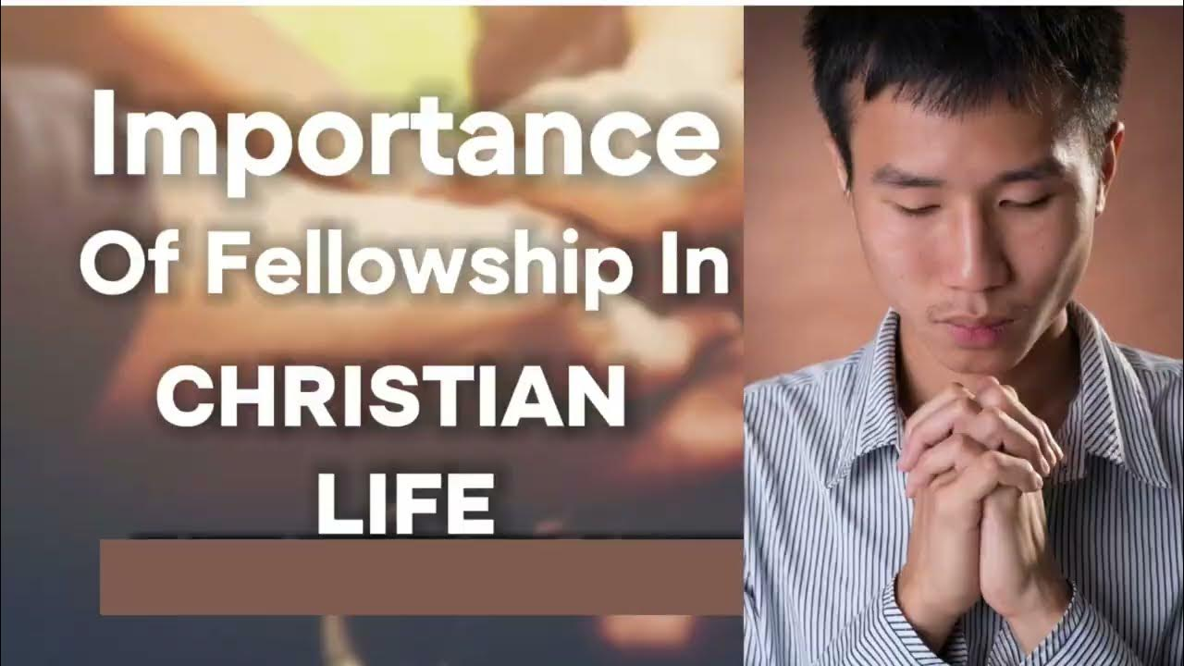
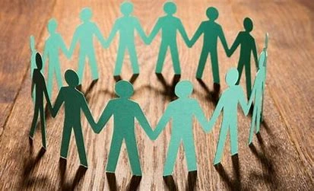

Slide 35
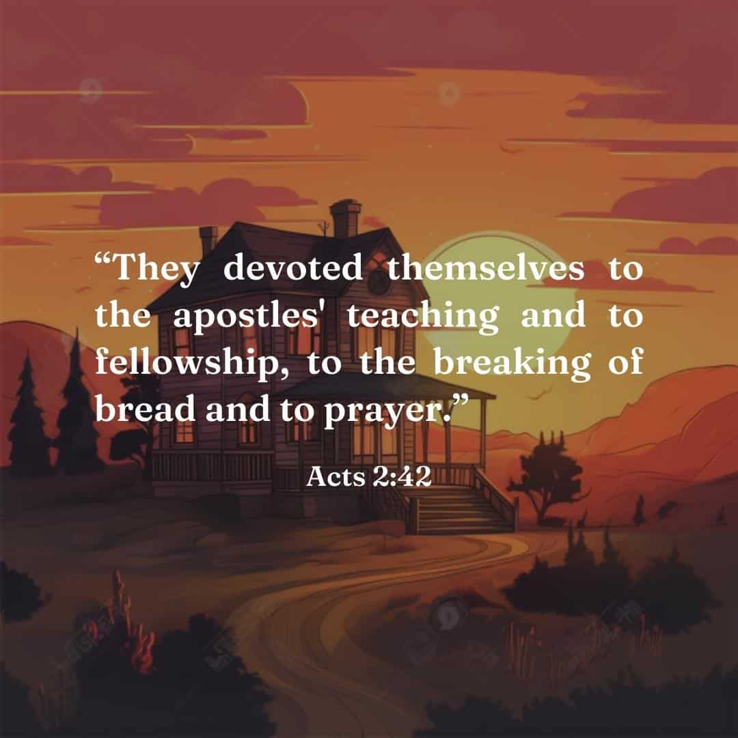

Slide 36
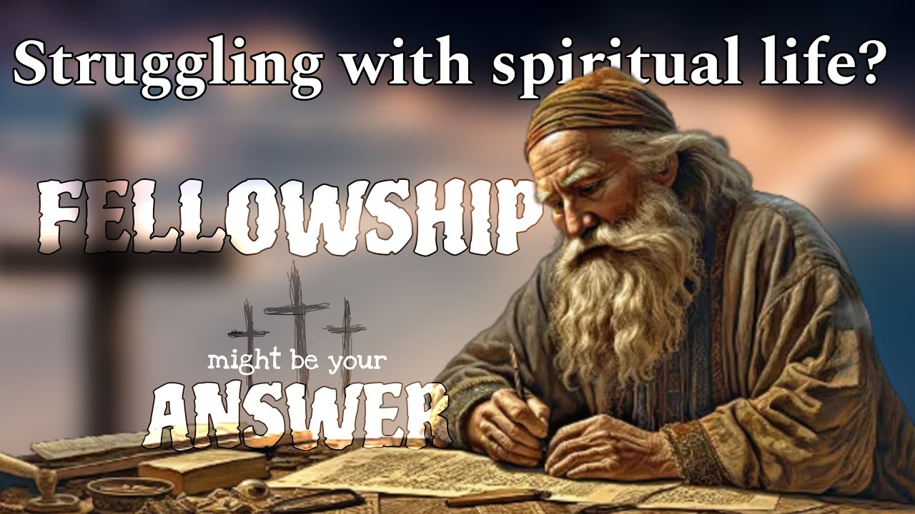
Add a Slide Title - 4

Slide 37
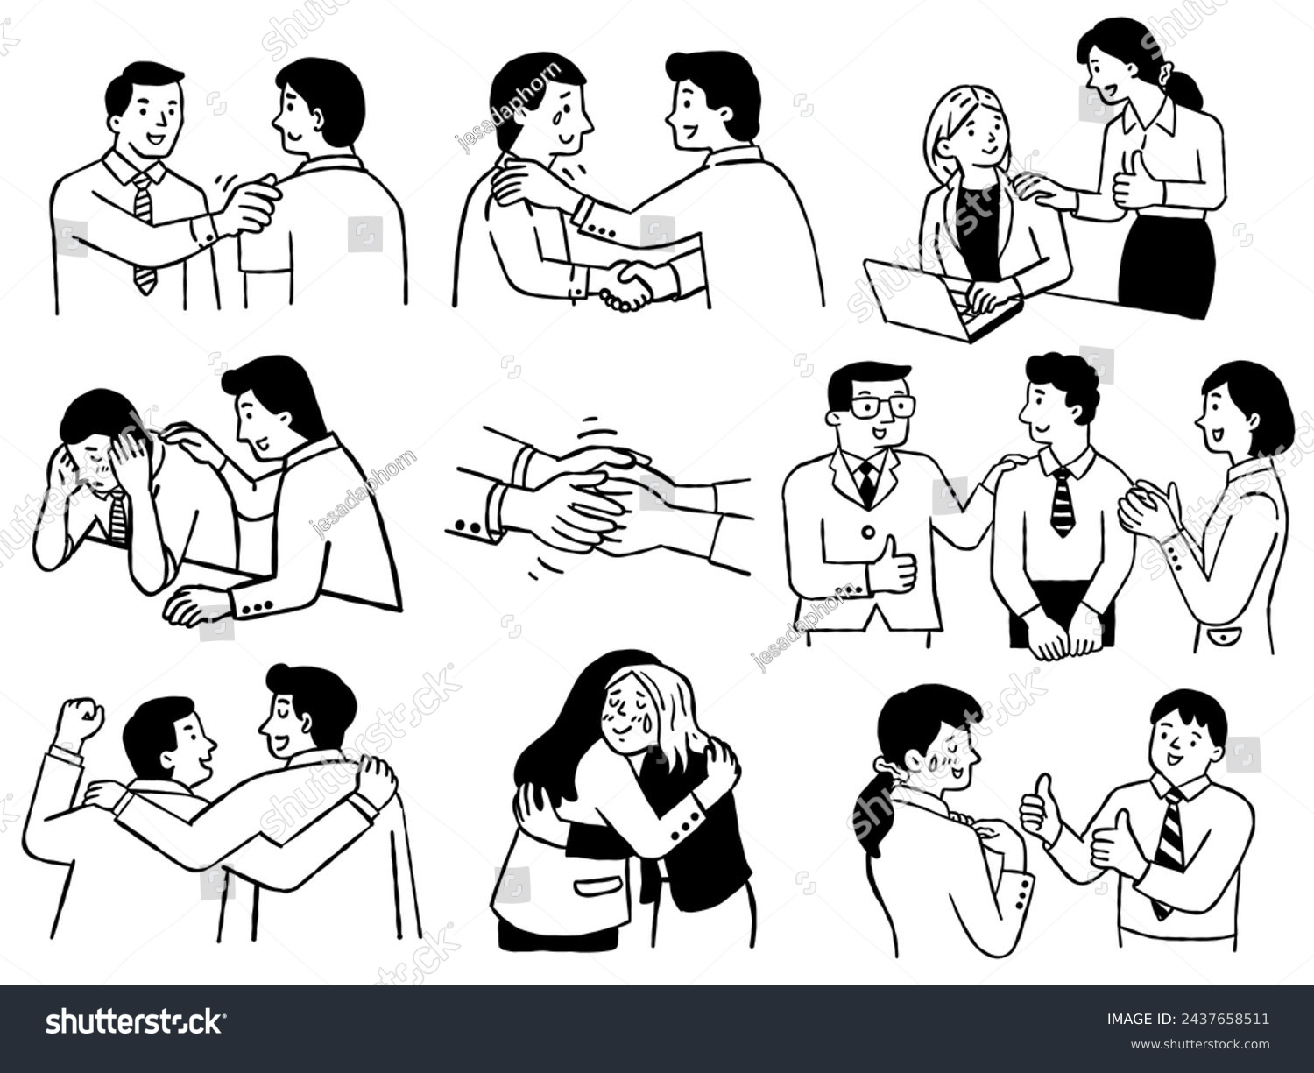


Slide 38
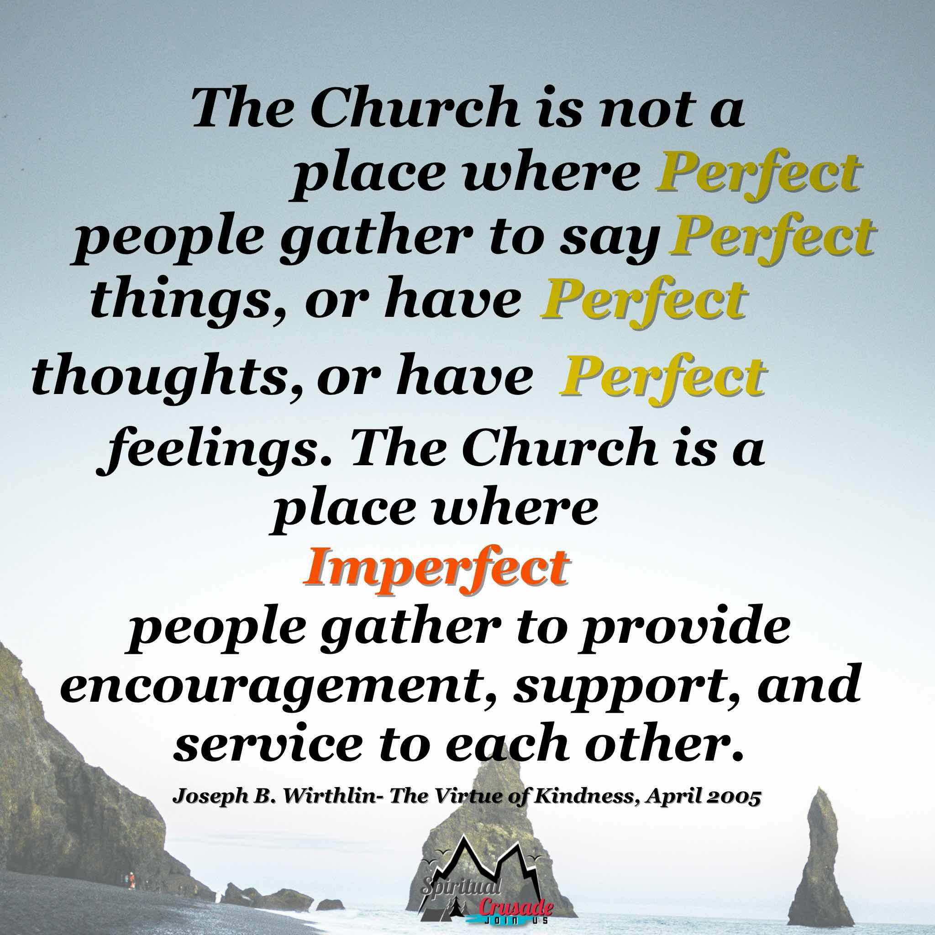
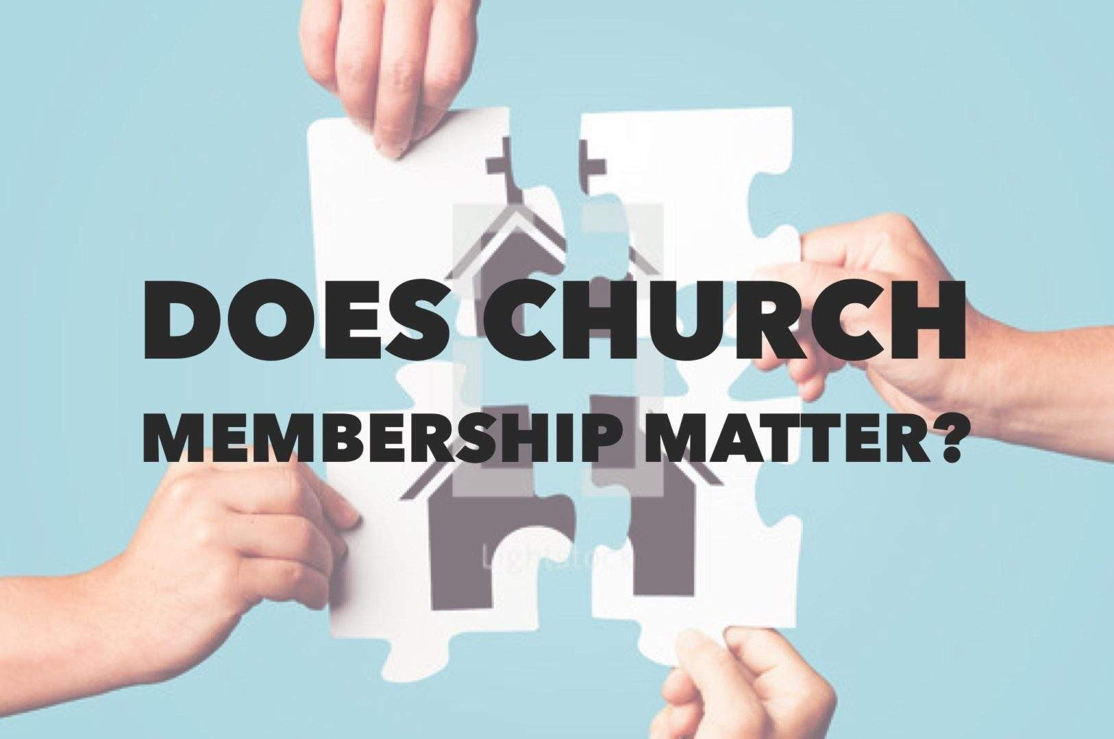
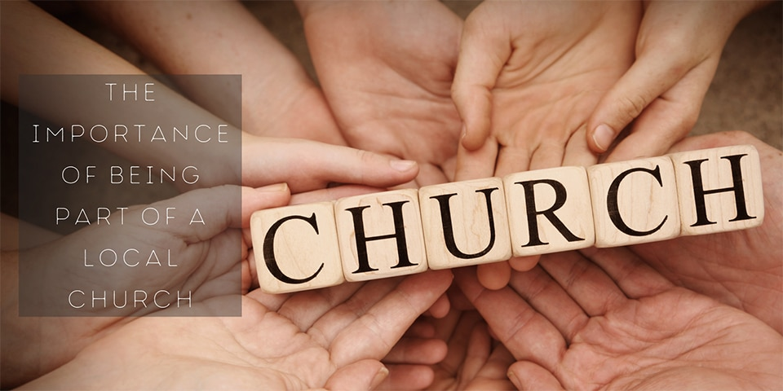

Slide 39
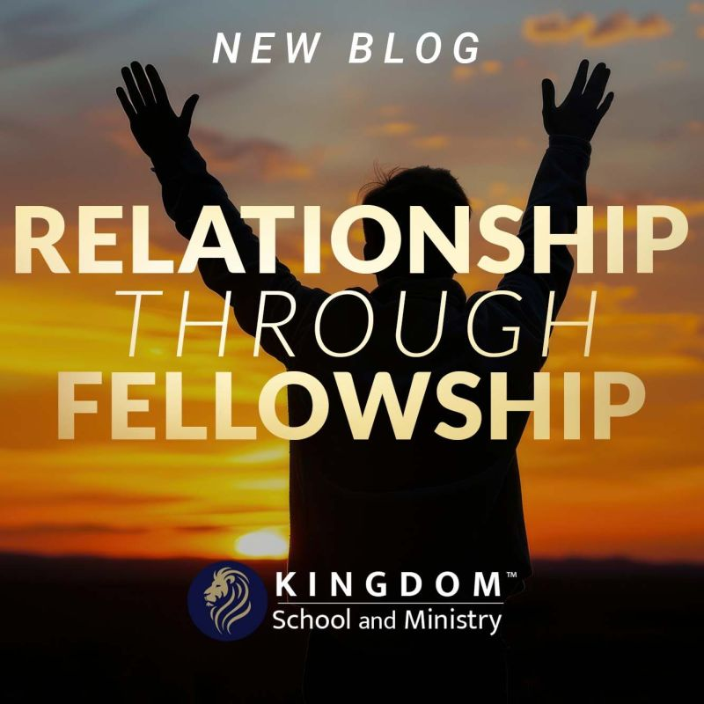

Slide 40
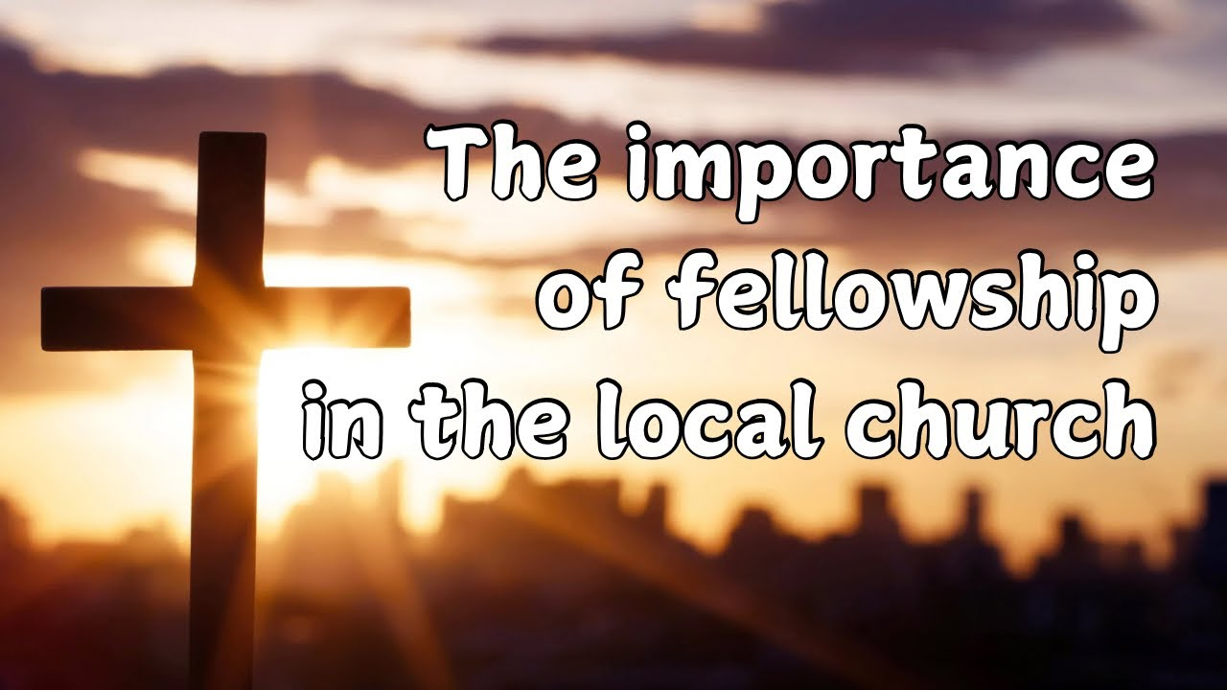

Slide 41
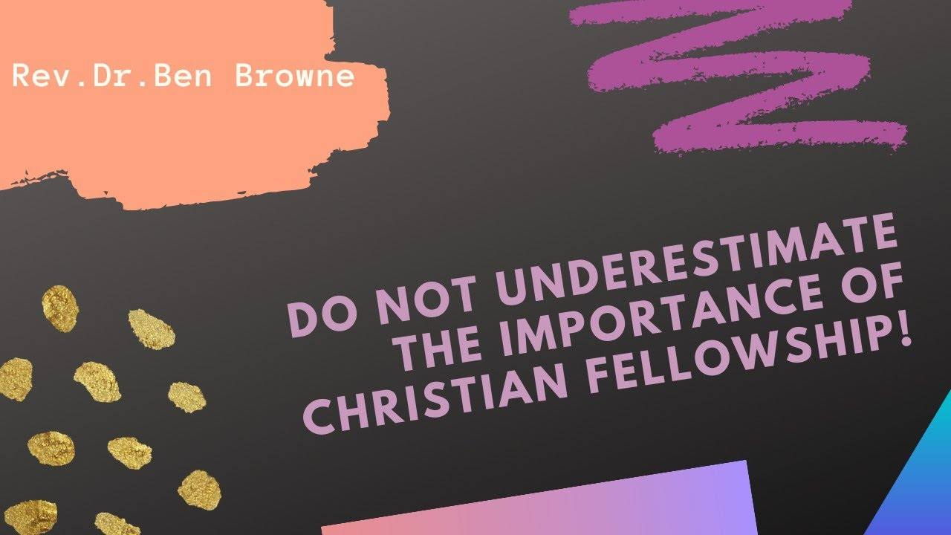

Slide 42

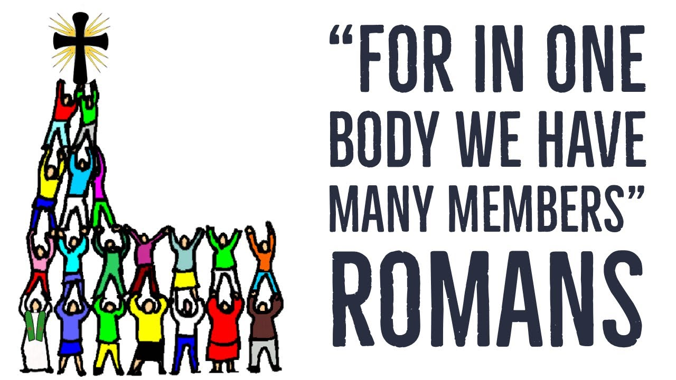
4. The Church As The Body Of Christ

Slide 43


4. The Church As The Body Of Christ

Slide 44


Slide 45

4. The Church As The Body Of Christ
Pentecost - Holy Spirit descended. Believers were baptized into Christ’s Body.
NT Church – More than an earthly organisation…it is Christ’s Body.
At conversion, believers are baptized into Christ’s Body.
Believers form the members of the Body of Christ just like the Human Body.
All Christians play a part in this Body. Some more significant than others but everyone is equally important.
If one member is damaged, the whole Body suffers.

Slide 46
4. The Church As The Body Of Christ
Unity In Diversity
“For as the body is one, and hath many members, and all the members of that one body, being many, are one body: so also is Christ.” (1 Corinthians 12:12)
“And the eye cannot say unto the hand, I have no need of thee: nor again the head to the feet, I have no need of you. Nay, much more those members of the body, which seem to be more feeble, are necessary:” (1 Corinthians 12:21-22)
There is no ‘Lone Ranger” Christianity.

Slide 47






Slide 48



4. The Church As The Body Of Christ

Slide 49


4. The Church As The Body Of Christ

Slide 50



4. The Church As The Body Of Christ

Slide 51




4. The Church As The Body Of Christ

Slide 52


Slide 53

5. Commitment To The Local Church

Slide 54

5. Commitment To The Local Church
Believers are called not only to believe in Jesus, but to belong to His Body.
Membership & belonging not just in attendance but in serving, too.

Slide 55


Slide 56




Slide 57

TO THE
LOCAL CHURCH

Slide 58




Slide 59
5. Commitment To The Local Church
Commitment involves :
Regular Gathering - “Not forsaking the assembling of ourselves together…” (Hebrews 10:25)
Praying for the Church & Leaders - “Finally, brethren, pray for us, that the word of the Lord may have free course, and be glorified, even as it is with you: And that we may be delivered from unreasonable and wicked men: for all men have not faith.” (2 Thessalonians 3:1-2)
Serving One Another - “Be kindly affectioned one to another with brotherly love; in honour preferring one another;” (Romans 12:10)
Giving Generously - “Distributing to the necessity of saints; given to hospitality.” (Romans 12:13)
Believers need to be more connected and committed to the local church.

Slide 60

RIGHT / WRONG? OR GOOD / BAD?

Slide 61


Slide 62





Slide 63



Slide 64
6. Discussion & Reflection
Why do you think God designed the Christian life to be lived in community rather than alone?
In what ways is the Church like a body or a family?
Read Acts 2:42-47. What activities did the early Church devote themselves to? Which of these do you see practiced in your church today?
Can you think of a time when fellowship with other believers encouraged or challenged your faith?
What spiritual gifts or strengths do you think God may have given you to serve others?
What are some ways you can contribute to your local church, even before being baptized?
What steps can you take to become more connected and involved in the church?
Do you believe that God has called you to be an active part of His Church? Why or why not?
What is one specific way you can serve or grow in fellowship with your church this week?
JSM has our own membership handbook that describes our doctrinal stand and policies. Baptismal candidates should be given a copy to look at, and should subscribe to our doctrinal stand.

