Slide 1
Jesus Saves Mission
Baptismal Class
Lesson 3

Slide 2
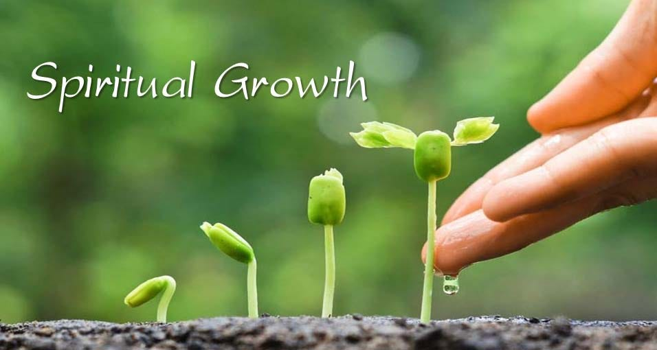

Slide 3
Lesson 3 : Spiritual Growth
Objectives :
Salvation is the beginning of a new (and transformed) life.
Baptism is the public declaration of that new life.
Like a new-born baby, a believer needs to grow spiritually.
Understand the importance of growing spiritually
Understand the means of spiritual growth – through the Word of God, prayer, obedience, fellowship, resisting temptations and sharing the faith
Understand the role of the Holy Spirit

Slide 4
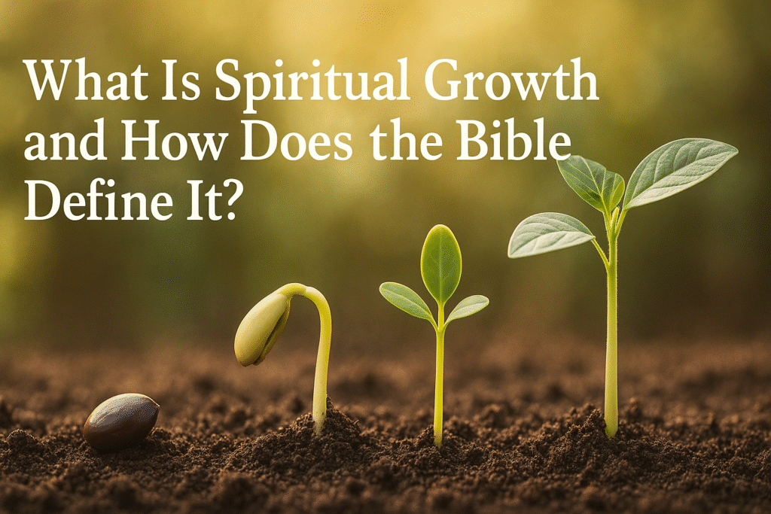

Slide 5
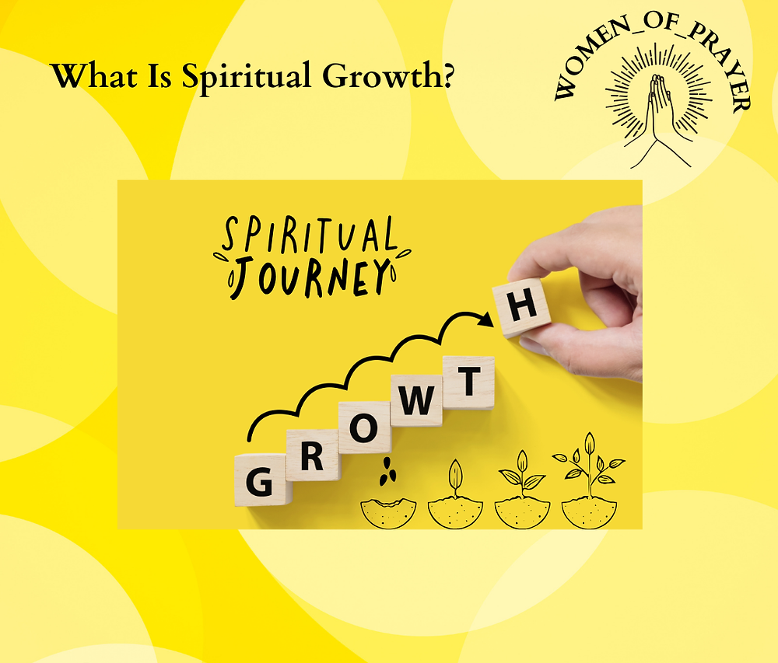
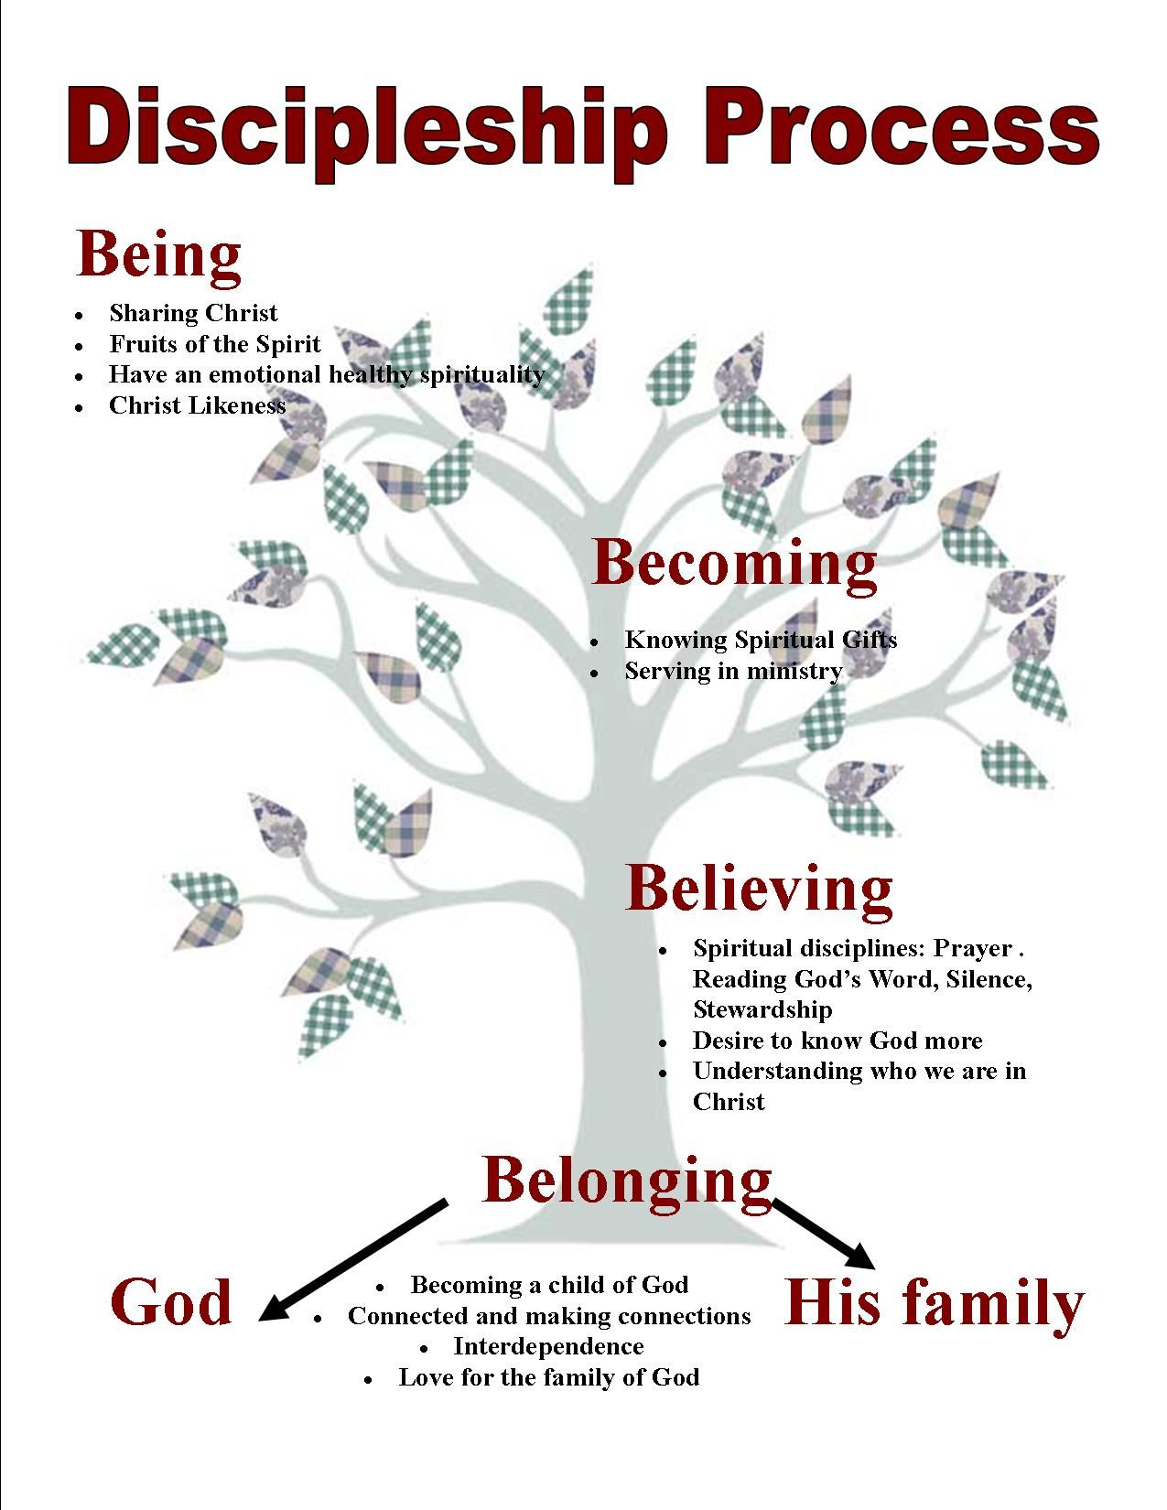

1. What Is Spiritual Growth?

Slide 6
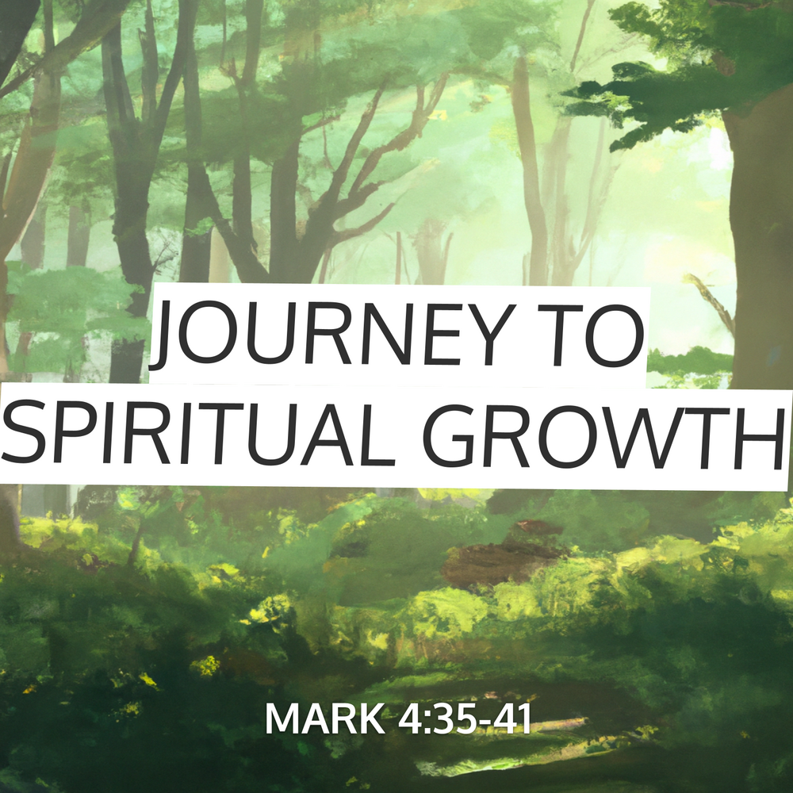

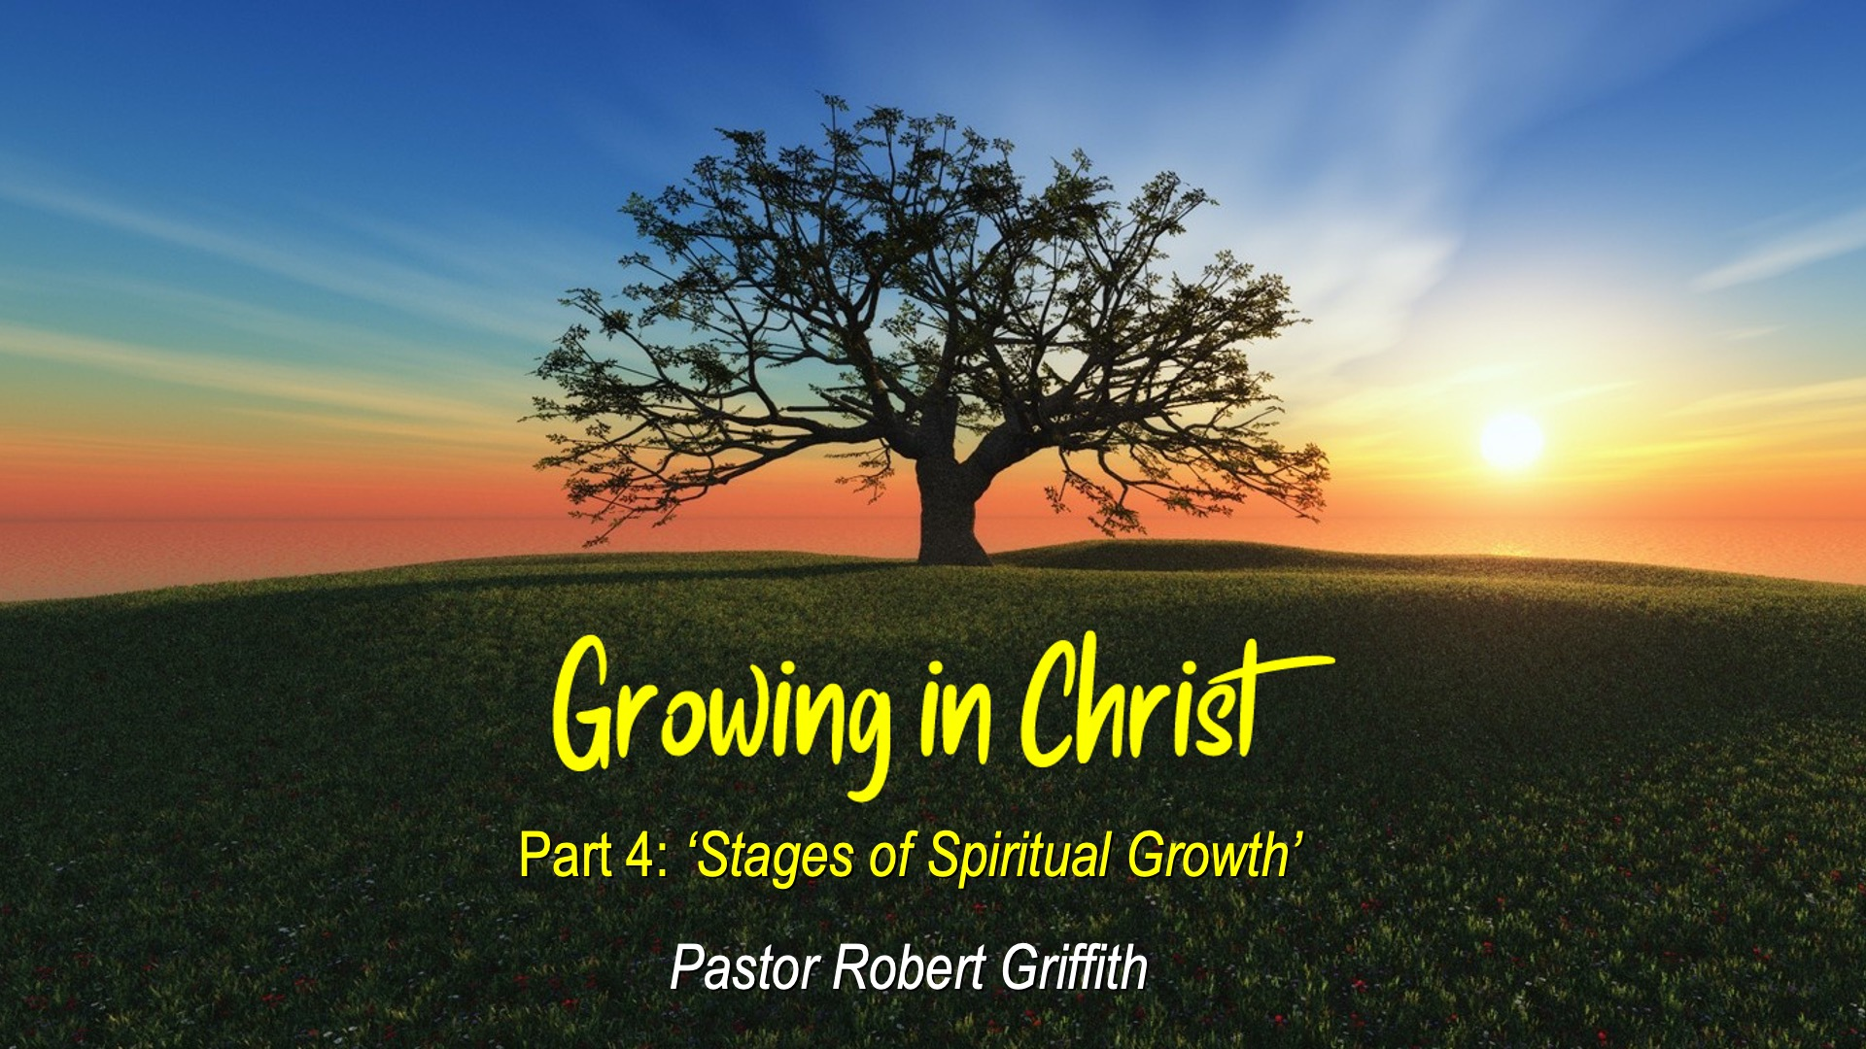
Title and Content Layout with List
Add your first bullet point here
Add your second bullet point here
Add your third bullet point here

Slide 7
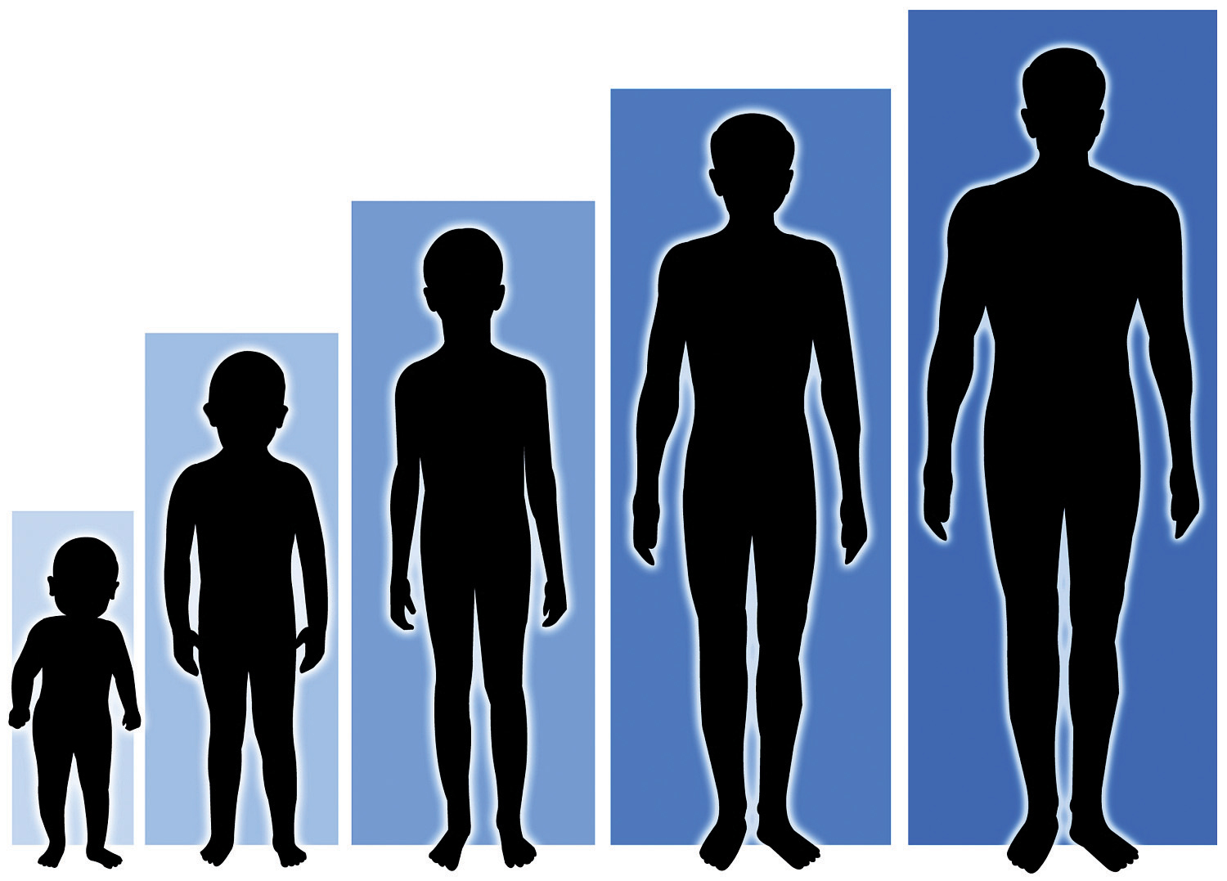
Spiritual Growth Is A Journey
This journey brings us to a closer and stronger relationship with Jesus and becoming more like Him.
What does it mean to grow as a Christian?
What has helped your faith grow so far?

Slide 8
1. What Is Spiritual Growth?
Spiritual growth is the ongoing process of becoming more like Jesus Christ through the work of the Holy Spirit, obedience to God’s Word, and having active faith.
2 Peter 3:18 “But grow in grace, and in the knowledge of our Lord and Saviour Jesus Christ. To him be glory both now and for ever. Amen.”
Romans 12:2 “And be not conformed to this world: but be ye transformed by the renewing of your mind, that ye may prove what is that good, and acceptable, and perfect, will of God.”

Slide 10
2. Why Is Spiritual Growth Important?
Evidence of true faith – We grow because we are alive in Christ.
Helps us overcome sin and temptation – Growth strengthens spiritual muscles.
Brings glory to God – Our changed life points others to Christ.
Prepares us for service and fruitfulness.
John 15:5 “I am the vine, ye are the branches: He that abideth in me, and I in him, the same bringeth forth much fruit: for without me ye can do nothing.”
Philippians 1:6 “Being confident of this very thing, that he which hath begun a good work in you will perform it until the day of Jesus Christ:”

Slide 11
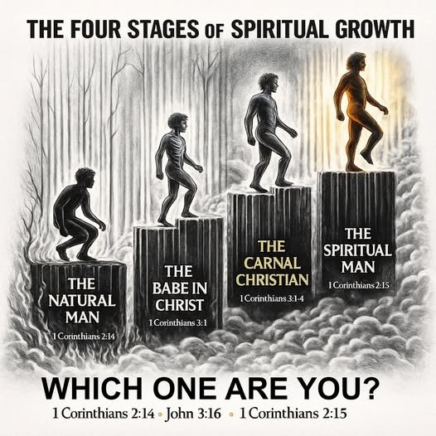



Slide 12
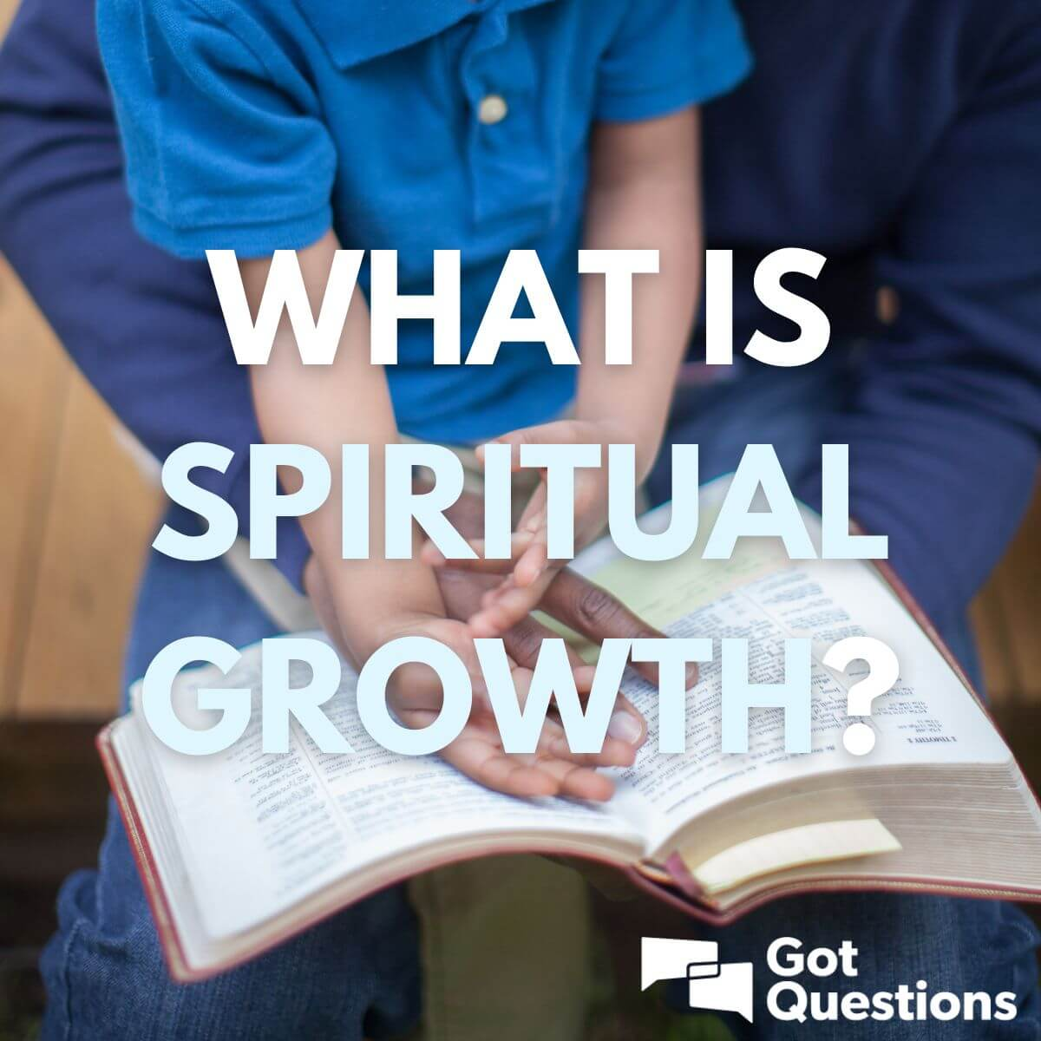

3. How Do We Grow Spiritually?
Here are 4 main practices :
Read and Obey God’s Word
The Bible is spiritual food.
Reading it daily feeds your soul.
Obedience to the Word brings maturity.
1 Peter 2:2 “As newborn babes, desire
the sincere milk of the word,
that ye may grow thereby:”
Study the Bible daily, regularly, systematically NOT
randomly, selectively BUT entirely.

Slide 13


3. How Do We Grow Spiritually?
B. Pray Daily & Regularly
Prayer is conversation with God.
Prayer includes praise, confession,
thanksgiving & requests.
Prayer builds intimacy with God.
1 Thess 5:17 “Pray without ceasing.”

Slide 14

3. How Do We Grow Spiritually?
C. Walk In The Spirit
Depend on the Holy Spirit daily.
Ask for strength, wisdom, conviction & guidance
Galatians 5:16 “This I say then, Walk in the
Spirit, and ye shall not fulfil the lust of the
flesh.”
Grow in the fruit of the Spirit is a sign of
spiritual maturity.
Galatians 5:22-23 “But the fruit of the Spirit is love, joy, peace, longsuffering,
gentleness, goodness, faith, meekness, temperance: against such there is no law.”

Slide 15
3. How Do We Grow Spiritually?
D. Resist Temptations
Temptation is the invitation or enticement to sin – to disobey God’s will.
Being tempted is NOT sin, but giving in to temptation is.
James 1:14-15 “But every man is tempted, when he is drawn away of his own lust, and enticed. Then when lust hath conceived, it bringeth forth sin: and sin, when it is finished, bringeth forth death.”
Temptation comes from various sources :
- Our own sinful desires (James 1:14)
- Satan, the tempter (Matthew 4:1)
- The world’s influence (1 John 2:16)
“For all that is in the world, the lust of the flesh, and the lust of the eyes, and the pride of life, is not of the Father, but is of the world.” (1 John 2:16)

Slide 16
3. How Do We Grow Spiritually?
Jesus was tempted in the wilderness (Matthew 4:1-11). He resisted every time by
quoting the Scripture.
“But he answered and said, It is written, Man shall not live by bread alone, but by every word
that proceedeth out of the mouth of God.” (Matthew 4:4)
Key Lesson : The Word of God is a powerful weapon in spiritual battle. That’s why we need
to study the Bible.
We can resist temptations through :
- Watching & praying (Matthew 26:41)
“Watch and pray, that ye enter not into temptation: the spirit indeed is willing, but the flesh
is weak.” (Matthew 26:41)
- Hiding God’s Word in our heart (Psalm 119:11)
“Thy word have I hid in mine heart, that I might not sin against thee.” (Psalm 119:11)

Slide 17
3. How Do We Grow Spiritually?
Resisting the Devil (James 4:7)
“Submit yourselves therefore to God. Resist the devil, and he will flee from you.”
Fleeing Sinful Situations (2 Timothy 2:22)
“Flee also youthful lusts: but follow righteousness, faith, charity, peace, with them
that call on the Lord out of a pure heart.”
Choosing The Right Company / Friends (1 Cor 15:33)
“Be not deceived: evil communications corrupt good manners.”
Remembering God’s Faithfulness (1 Cor 10:13)
“There hath no temptation taken you but such as is common to man: but
God is faithful, who will not suffer you to be tempted above that ye are able; but
will with the temptation also make a way to escape, that ye may be able to bear it.”

Slide 18
4. Discussion & Reflection
Which part of spiritual growth do you feel strongest & weakest in?
How has God already begun changing your heart since you believed?
What’s one habit you want to start this week to grow closer to God?
How can you prepare for temptation before it comes?
Who can you talk to for accountability and prayer support?
What makes it hard to grow spiritually?
How can you support one another?

Slide 19



Slide 20
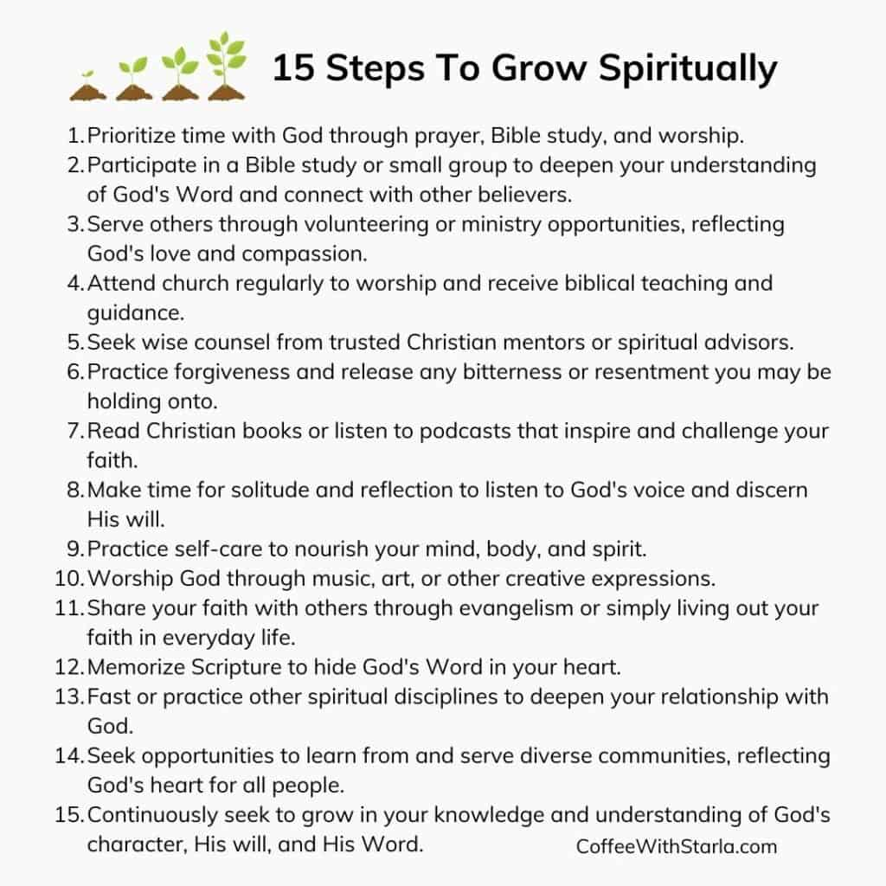
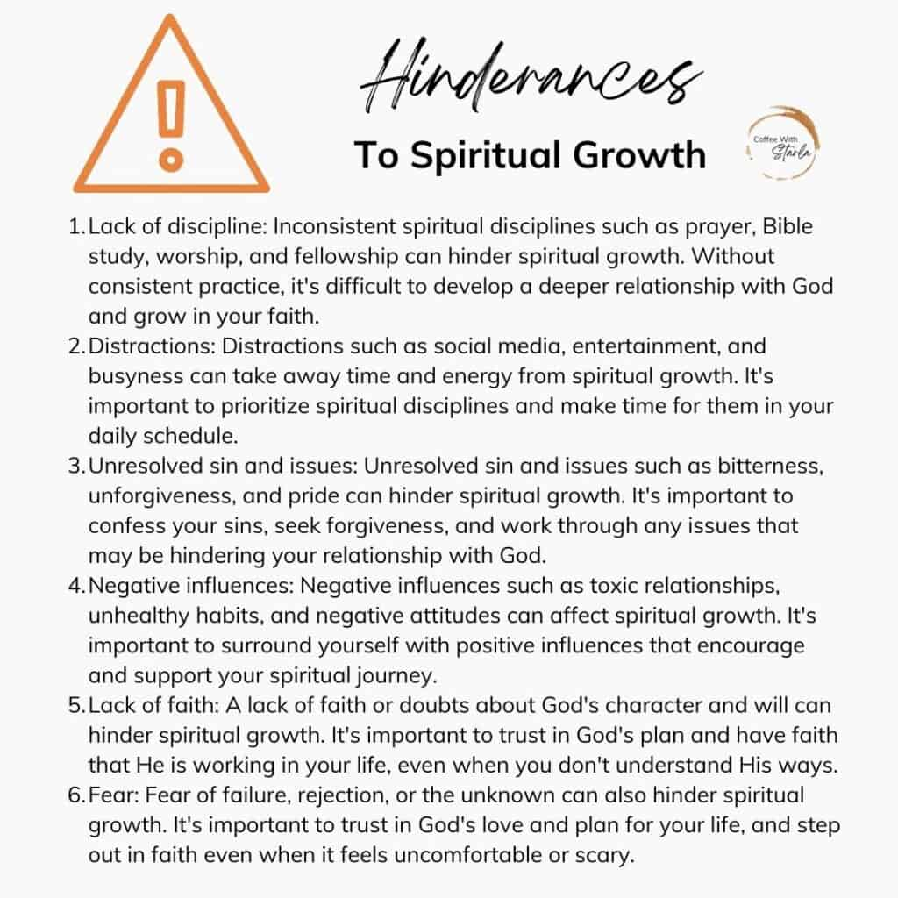

Slide 21
