Slide 1
Jesus Saves Mission
Baptismal Class
Lesson 2

Slide 2
Lesson 2 : Understanding Baptism
Objectives
Baptism is one of the two main ordinances of the church. In the great commission, we are commanded to not only teach but to “baptise” believers. It is therefore important for us to learn this subject.
Understand the meaning and importance of baptism
Learn the biblical foundation for baptism
Be prepared for what baptism means personally and practically

Slide 3

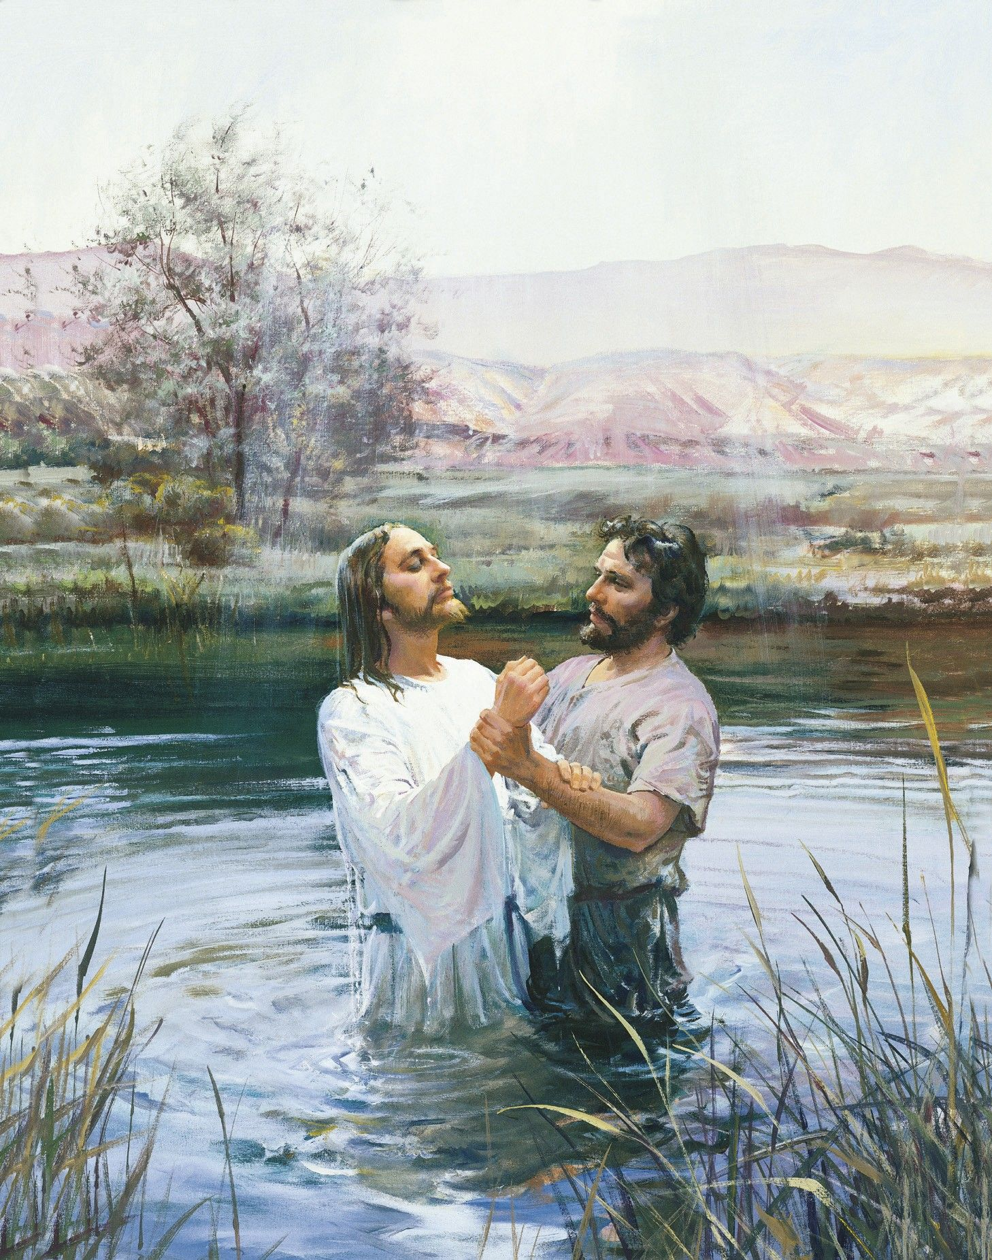
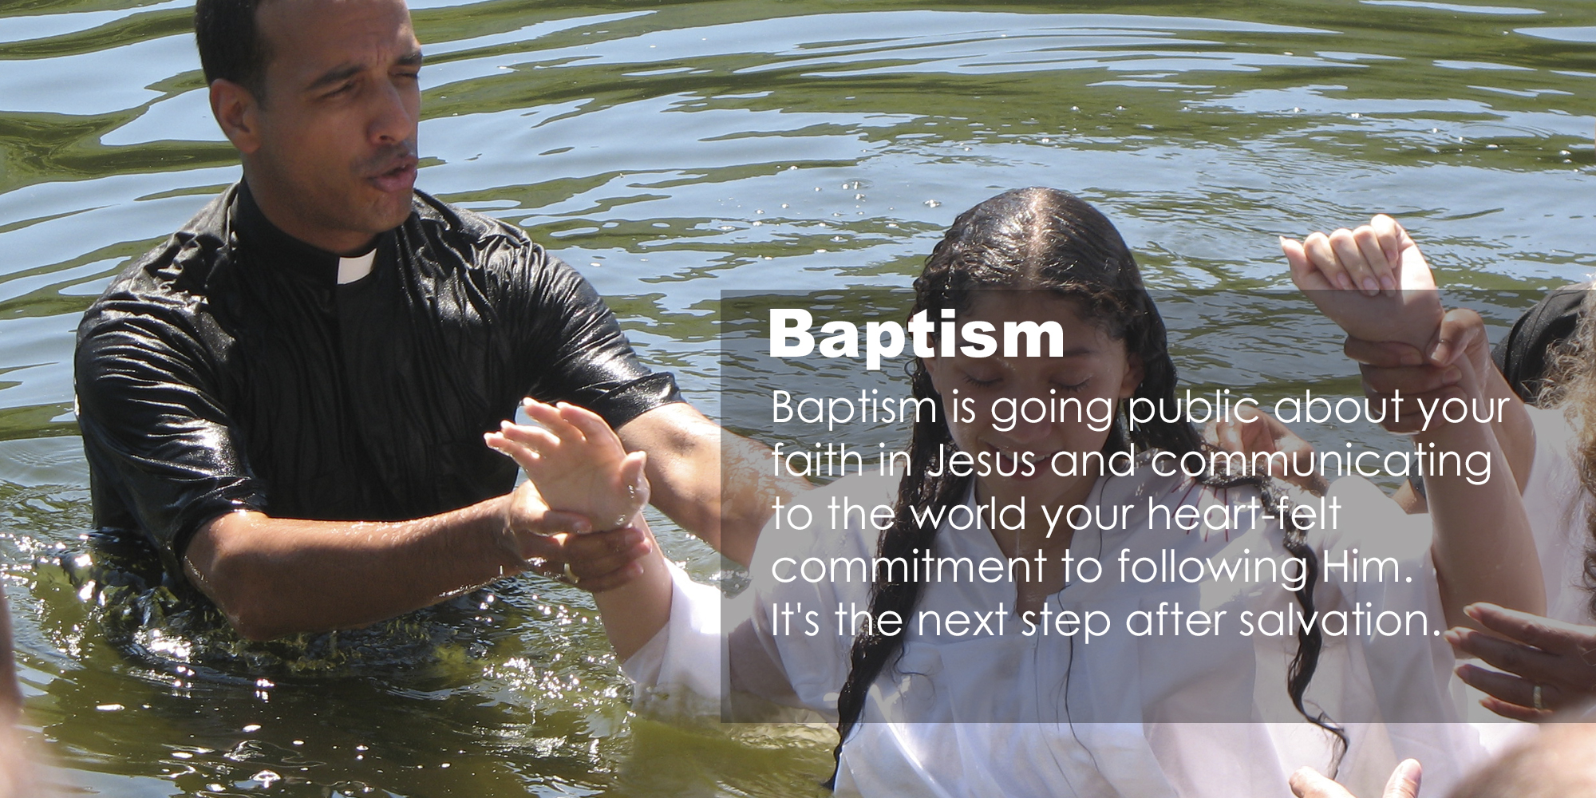


Have You Ever Witnessed A Baptism?
What Stood Out To You?

Slide 4



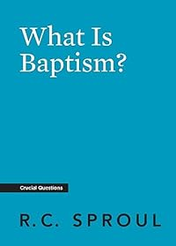
1. Basis Of Baptism

Slide 5


Slide 6


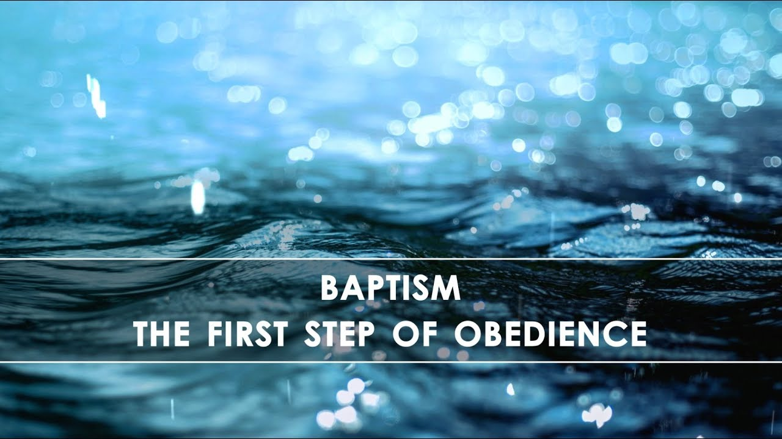

Slide 7
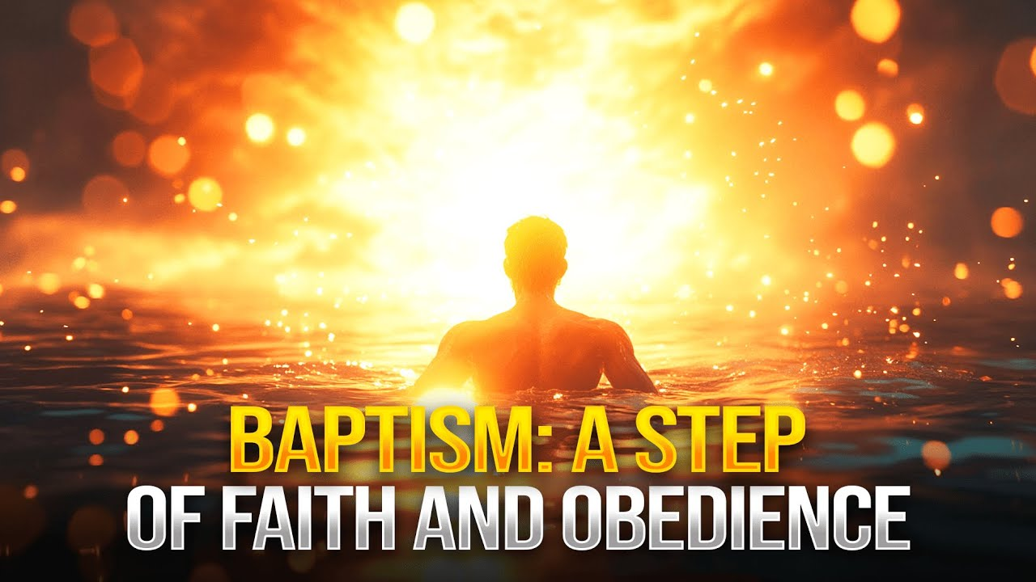

Slide 8
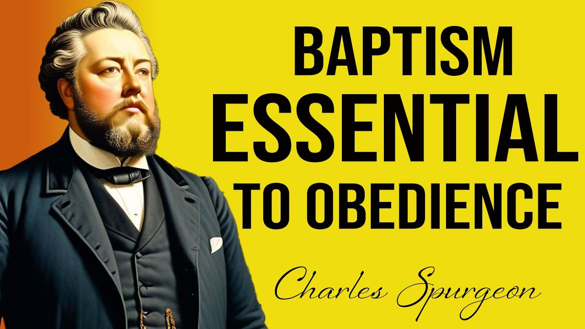

Slide 9


Slide 10
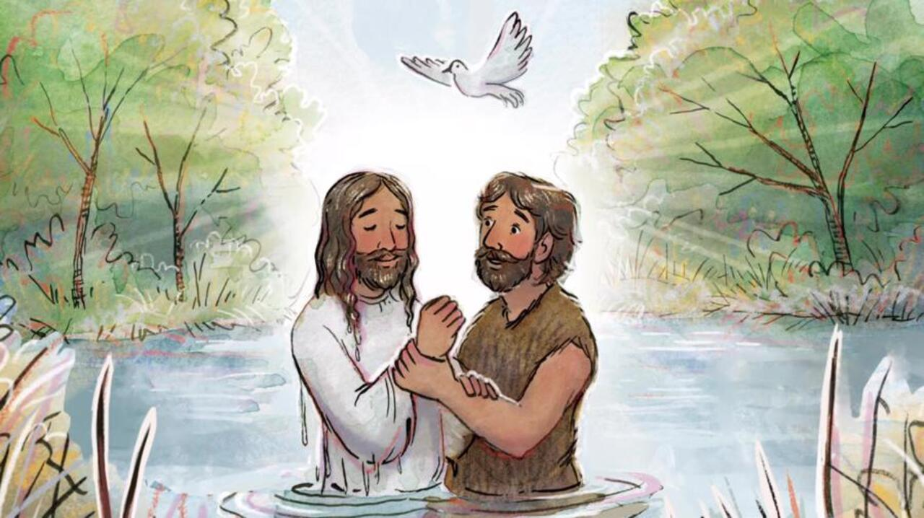

Slide 11
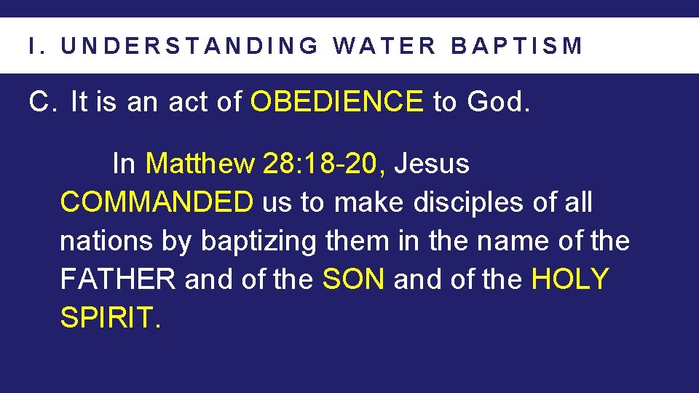
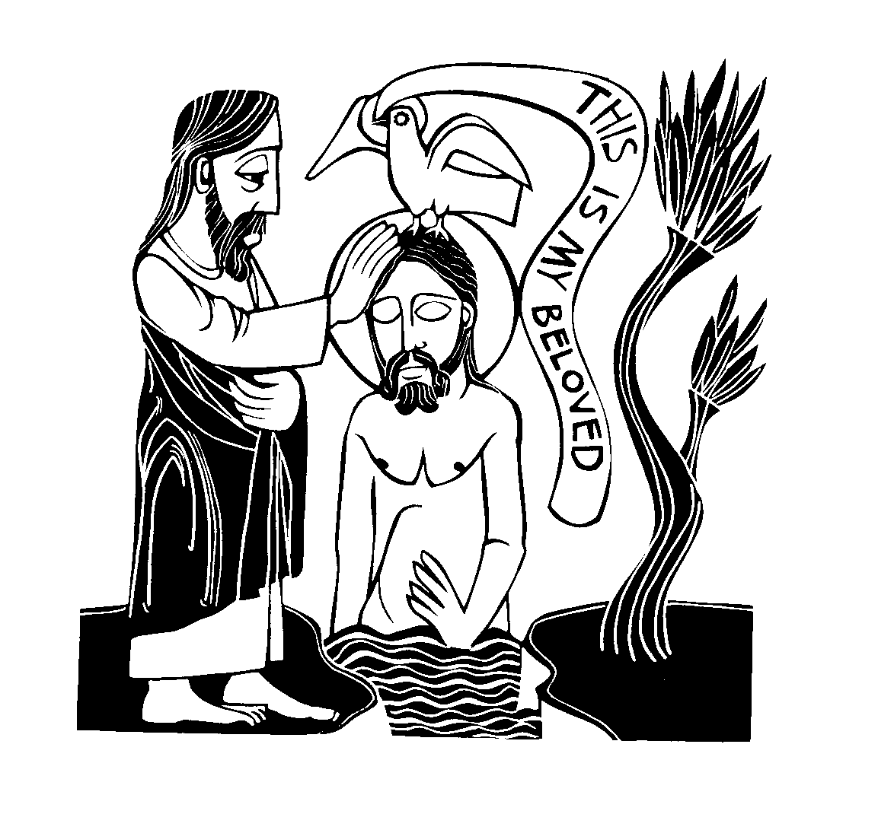
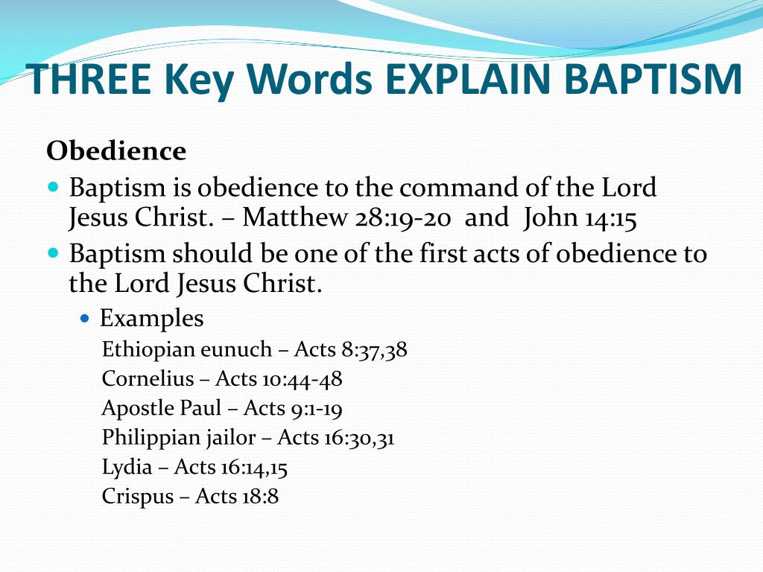

Slide 12


Slide 13
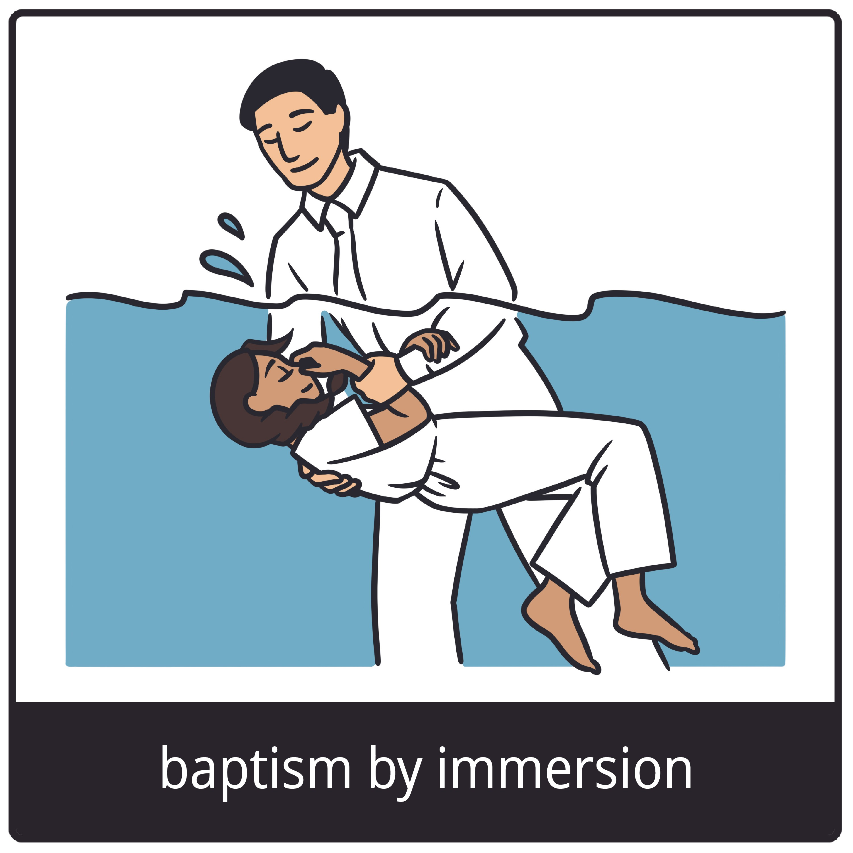
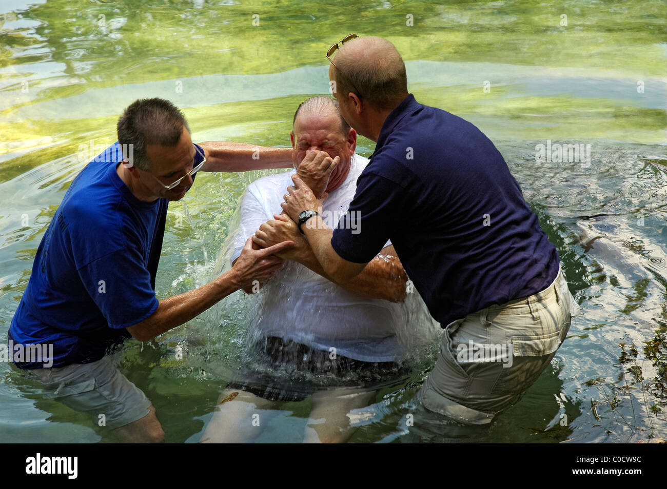
2. What Is Baptism?
The word “baptize” (from Greek baptize) means to immerse.
Baptism is a public testimony
(an outward expression of an inward faith)
that one has believed in Jesus Christ
as his Lord and personal Saviour.
“Go ye therefore, and teach all nations, baptizing them in the name of the Father, and of the Son, and of the Holy Ghost: Teaching them to observe all things whatsoever I have commanded you: and, lo, I am with you alway, even unto the end of the world. Amen.” (Matthew 28:19 – 20)
“Then Peter said unto them, Repent, and be baptized every one of you in the name of Jesus Christ for the remission of sins, and ye shall receive the gift of the Holy Ghost.” (Acts 2:38)

Slide 14
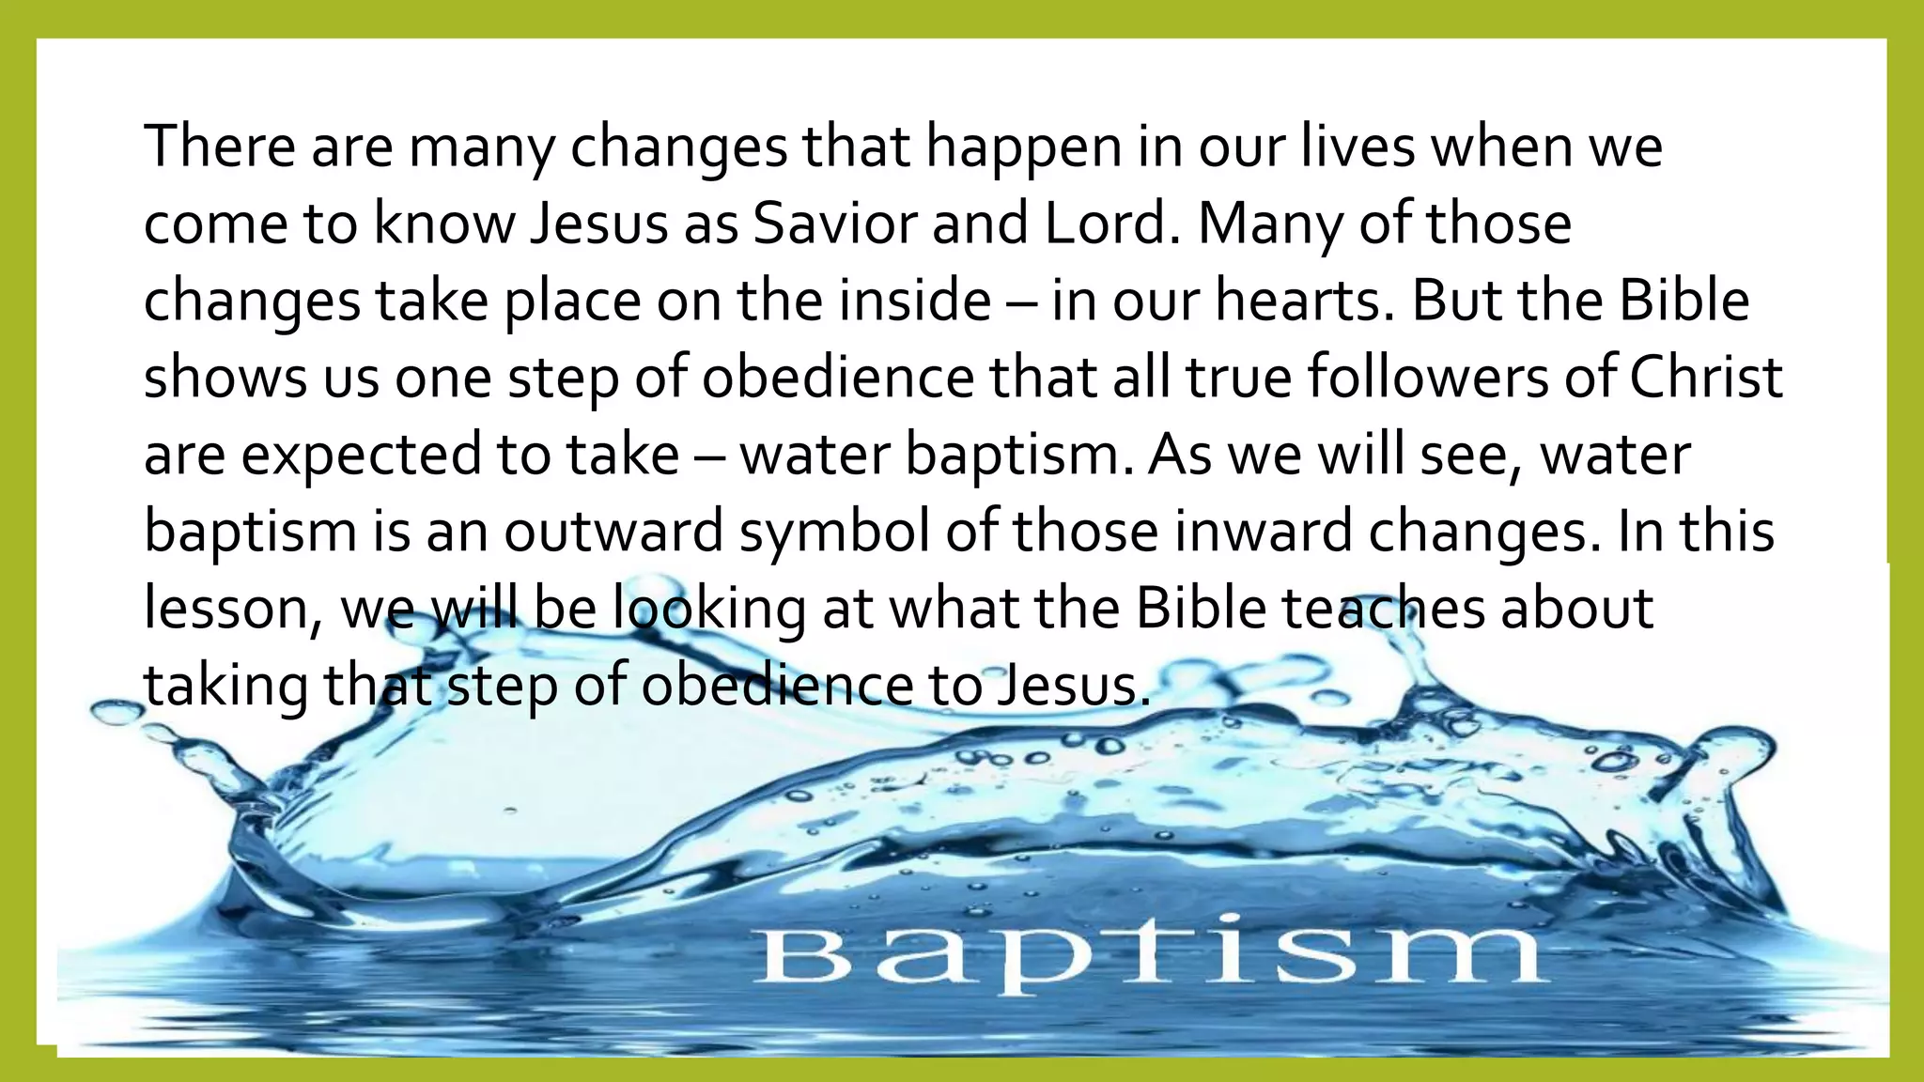

Slide 15


Slide 16
3. Why Should We Be Baptised?
Jesus commanded it (Matthew 28:19 - 20)
“Go ye therefore, and teach all nations, baptizing them in the name of the Father, and of the
Son, and of the Holy Ghost: Teaching them to observe all things whatsoever I have commanded
you: and, lo, I am with you alway, even unto the end of the world. Amen.” (Mt 28:19 – 20)
Early believers obeyed it (Acts 8:36 – 38)
“And as they went on their way, they came unto a certain water: and the eunuch said, See, here
is water; what doth hinder me to be baptized? And Philip said, If thou believest with all thine
heart, thou mayest. And he answered and said, I believe that Jesus Christ is the Son of God. And
he commanded the chariot to stand still: and they went down both into the water, both Philip
and the eunuch; and he baptized him.” (Acts 8:36 – 38)

Slide 17
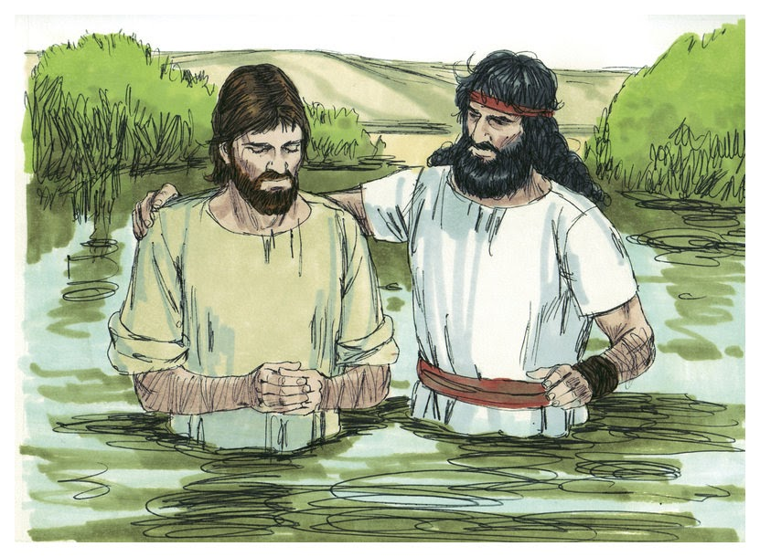
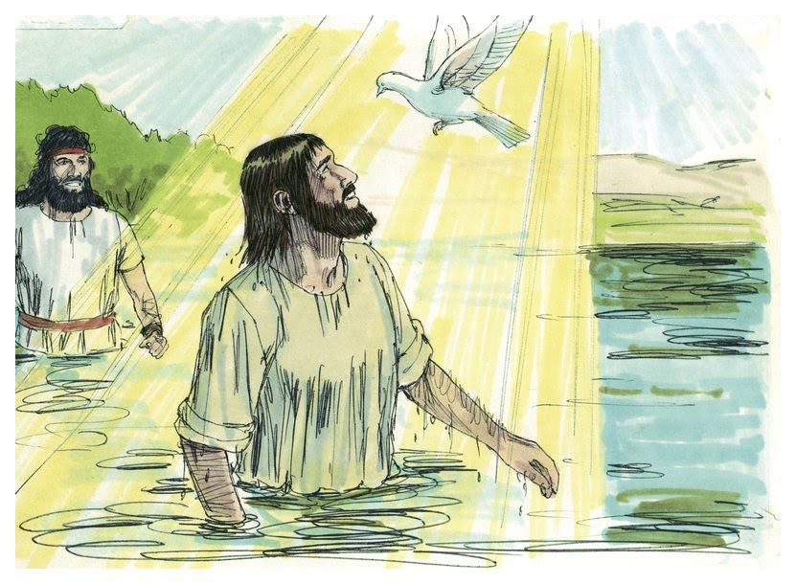


Slide 18
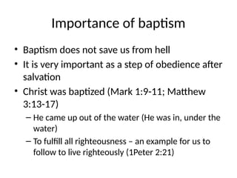


Slide 19
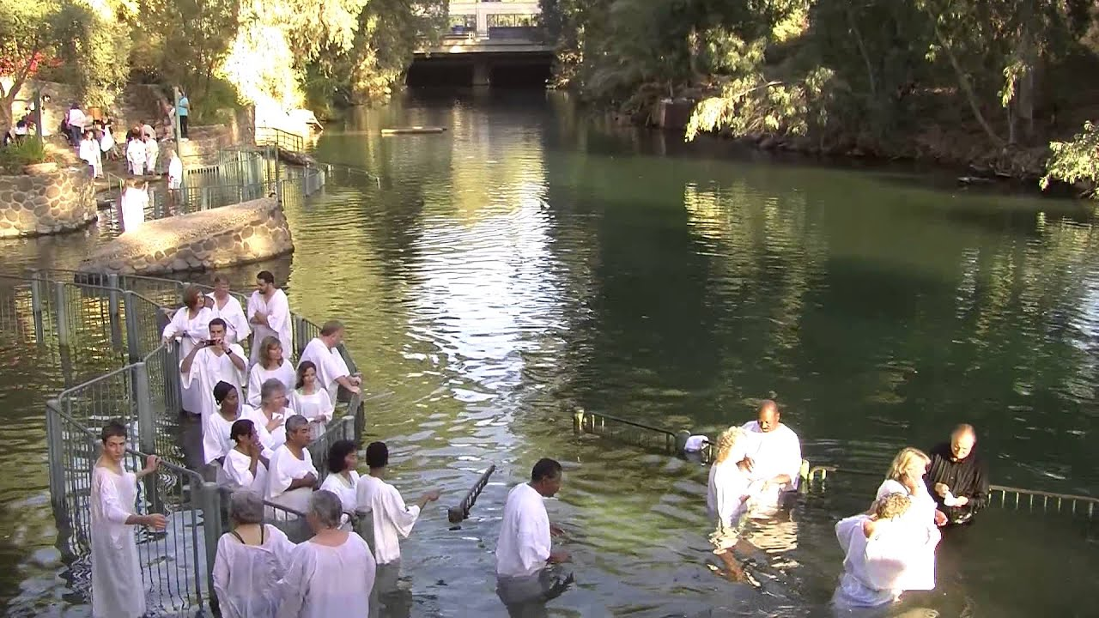

Slide 20
3. Why Should We Be Baptised?
It Identifies Us With Christ’s Death & Resurrection (Romans 6:14)
“Therefore we are buried with him by baptism into death: that like as Christ was
raised up from the dead by the glory of the Father, even so we also should walk in
newness of life.”
It Testifies Of Our Salvation To Others (Acts 2:41)
“Then they that gladly received his word were baptized: and the same day there were
added unto them about three thousand souls.”
Important : Baptism does NOT save you. It is a response of obedience after salvation.
“For by grace are ye saved through faith; and that not of yourselves: it is the gift of God:
Not of works, lest any man should boast.” (Ephesians 2:8 – 9)

Slide 21
4. What Does Baptism Symbolise?
Death to sin, burial & resurrection in Christ (Rom 6 : 4)
“Therefore we are buried with him by baptism into death: that like as Christ was
raised up from the dead by the glory of the Father, even so we also should walk
in newness of life.” (Romans 6 :4)
A New Life in Christ – Union with Christ’s Death & Resurrection
Cleansing & Washing away sin (symbolically)
“And now why tarriest thou? arise, and be baptized, and wash away thy sins
calling on the name of the Lord.” (Acts 22:16)
Joining the Body of Believers
“For as many of you as have been baptized into Christ have put on Christ.” (Galatians 3:27)

Slide 22
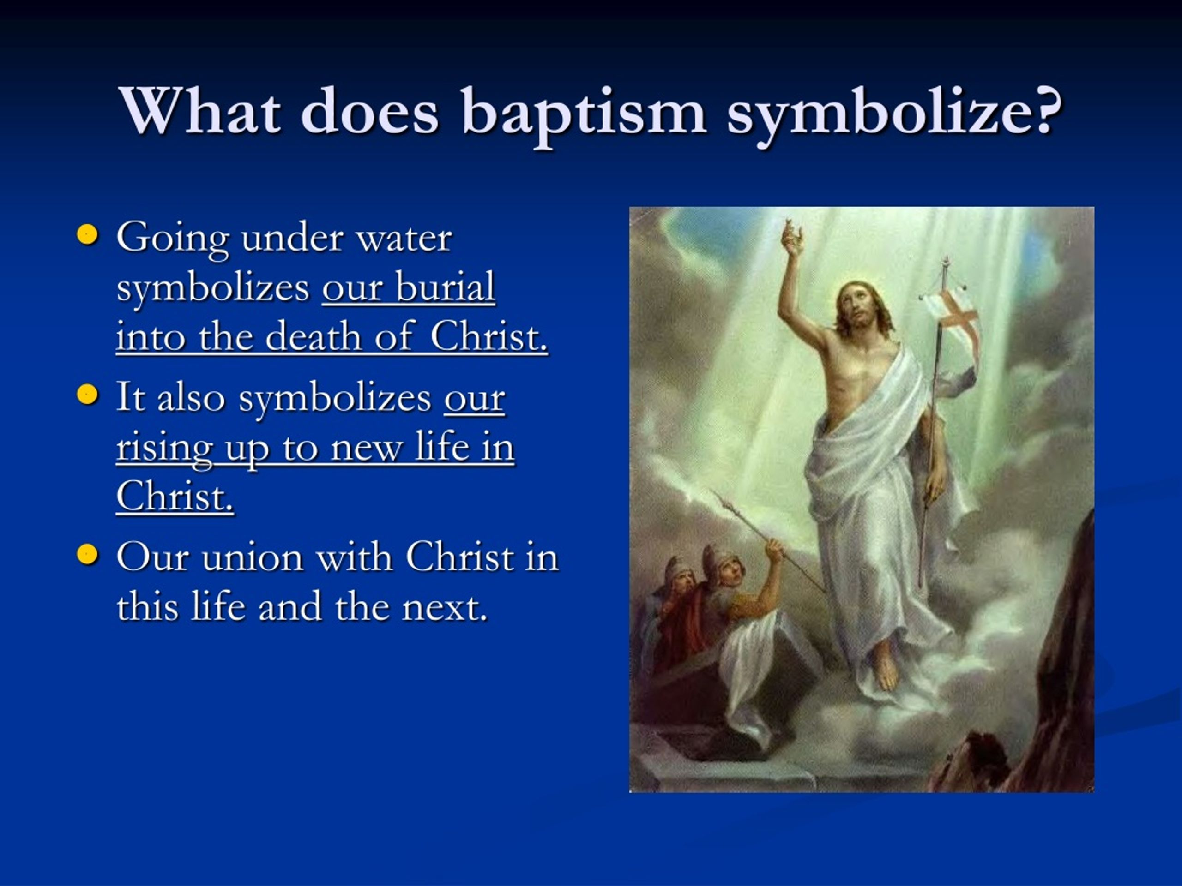


Slide 23
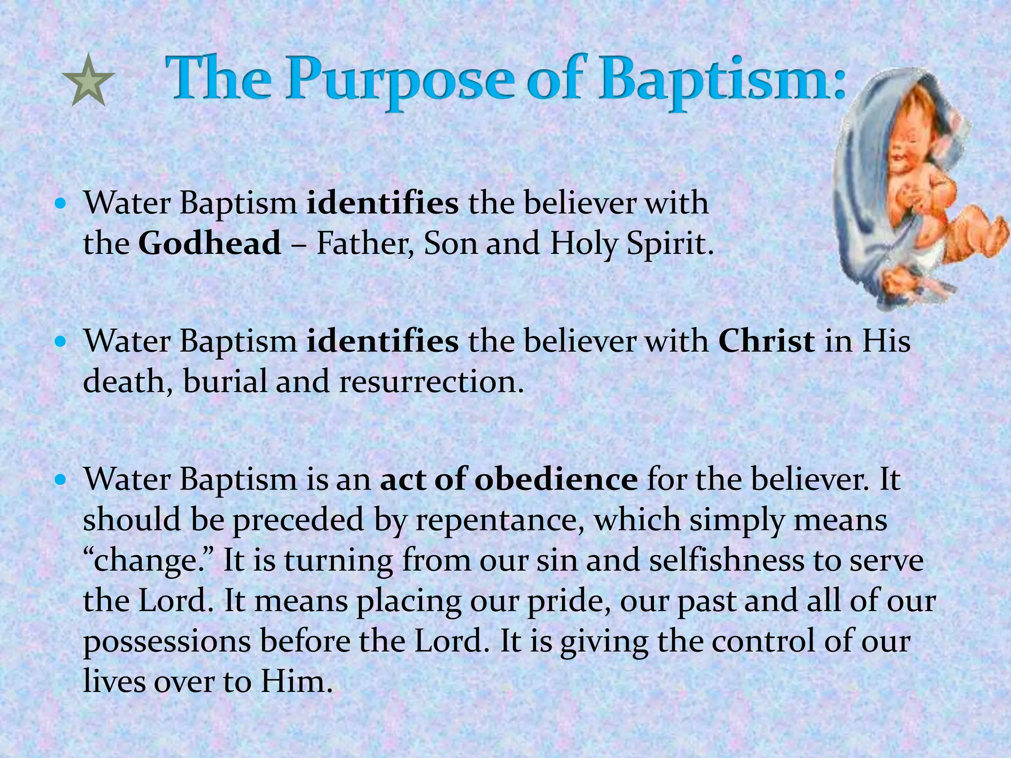

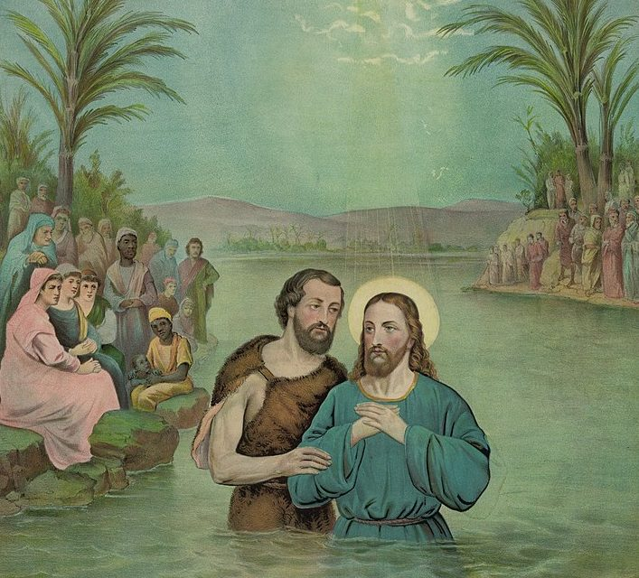


Slide 24

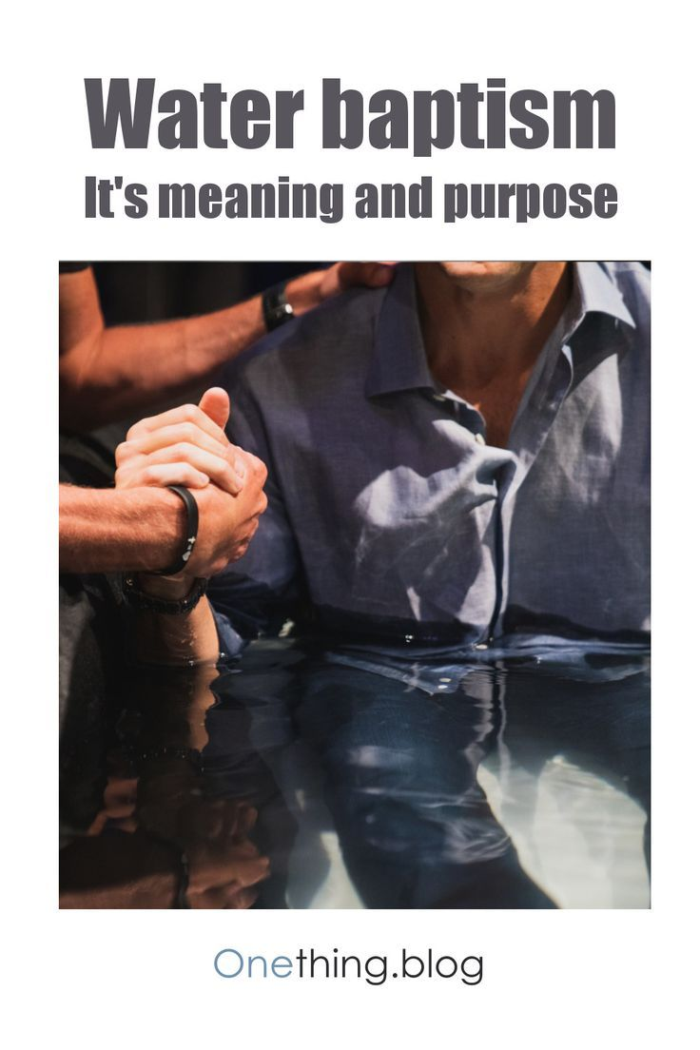

Slide 25

Analogy : Wedding Ring In Marriage
A wedding ring does NOT make you married but symbolises it publicly.
Similarly, water baptism does
NOT make one a saved person.
It’s only a public testimony.
More importantly, one must be
baptized in Christ.

Slide 26
5. How Is Baptism Practised?
Immersion is the biblical method
- Jesus Himself was baptized this way (Matthew 3:16)
- The Ethiopian eunuch too (Acts 8:36-38)
JSM Practices :
- JSM also baptizes believers via sprinkling (exceptions rather than the norm
(eg. those who are aged and sick)
- Only baptized members partake the Lord’s Supper (Holy Communion)
- Only baptized members may take on key leadership roles in the church
- JSM does not subscribe to infant baptism. The infant is unable to profess
faith publicly. We only dedicate infants to God.

Slide 27
6. Discussion / Reflection
What stands out to you about baptism that you didn’t know before?
Are you ready to be baptized? Why or why not?
Do you think every believer should be baptized?
What does baptism mean to you personally?
How does baptism strengthen your identity as a follower of Jesus?
How can baptism encourage others around you?
Encourage those who are ready to view it as a joyful
declaration of their faith.

Slide 28
7. Baptismal Testimony Guide
Purpose :
To help each baptismal candidate share his/her faith story with clarity and confidence as part of his/her baptism.
His/her testimony is a way to glorify God, encourage others, and declare his/her new life in Christ.
What was your life like before you came to know Jesus?
How did you come to trust in Jesus for salvation?
What has changed since you came to Christ?

Slide 29
8. Church Membership & The Lord’s Supper
Every believer should join a local church (See Lesson 4 on Church and Fellowship). In many churches, including JSM, only baptized believers are accepted as members of the church.
“Then they that gladly received his word were baptized: and the same day there were added unto them about three thousand souls. And they continued steadfastly in the apostles' doctrine and fellowship, and in breaking of bread, and in prayers.” (Acts 2:41-42)
The New Testament teaches two ordinances given by Christ to the Church. The first is Baptism and the second is the Lord’s Supper.
In JSM, only baptised believers are allowed to partake of the Lord’s Supper (also known as the Holy Communion).

Slide 30
8. Church Membership & The Lord’s Supper
The Lord’s Supper (Holy Communion) is instituted by our Lord on the night when he was betrayed. It serves multiple purposes:
- Regular remembrance of Christ’s sacrifice – “This do in remembrance
of me.” (1 Cor 11:24)
- Self examination & a time of personal examination- “Let a man
examine himself, and so let him eat of that bread, and drink of that cup.”
(1 Cor 11:28)
- Proclaiming our hope in His Second Coming – “For as often as ye eat
this bread, and drink this cup, ye do show the Lord’s death till He came.”
(1 Cor 11:26)

