Slide 1
Jesus Saves Mission
Baptismal Class
Introduction & Lesson 1

Slide 2
Goals of a Baptism Class
Ensure a clear understanding of salvation and the gospel
Explain the meaning of baptism
Encourage habits that lead to spiritual growth
Teach about being part of the body of Christ (the Church)
Prepare believers for life of obedience, service, and witness

Slide 3
5 - Session Outline
1. The Gospel & Salvation → Grace, faith, repentance, assurance
2. Understanding Baptism → Symbolism, meaning, obedience
3. Spiritual Growth → Prayer, scripture, devotion, resisting temptation
4. Church & Fellowship → Community, worship, ordinances, accountability
5. Living for Christ : Service & Witness
→ Spiritual gifts, serving with love, sharing faith, living as salt & light

Slide 4
Lesson 1 : The Gospel & Salvation
Objectives :
Before we talk about baptism, we must be clear about what it means
to be saved? Baptism is for believers who have already trusted in
Jesus Christ.
○ Need to understand the core message of the gospel
○ Clarify the meaning of salvation biblically
○ Encourage personal faith & assurance in Jesus Christ as Lord &
Saviour

Slide 5
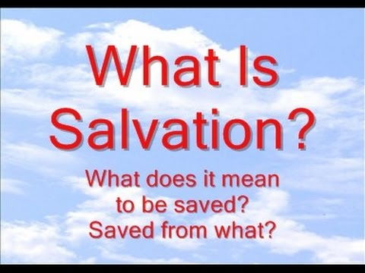

1. Knowing Jesus Personally

Slide 6




Slide 7
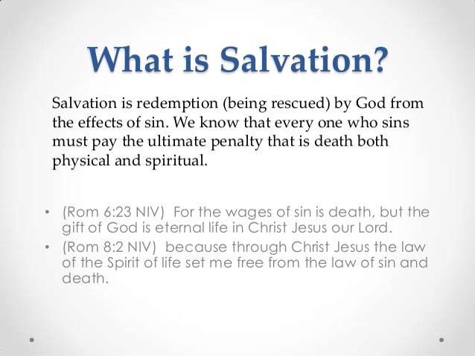



Slide 8

2. Knowing The Gospel Message Personally

Slide 9

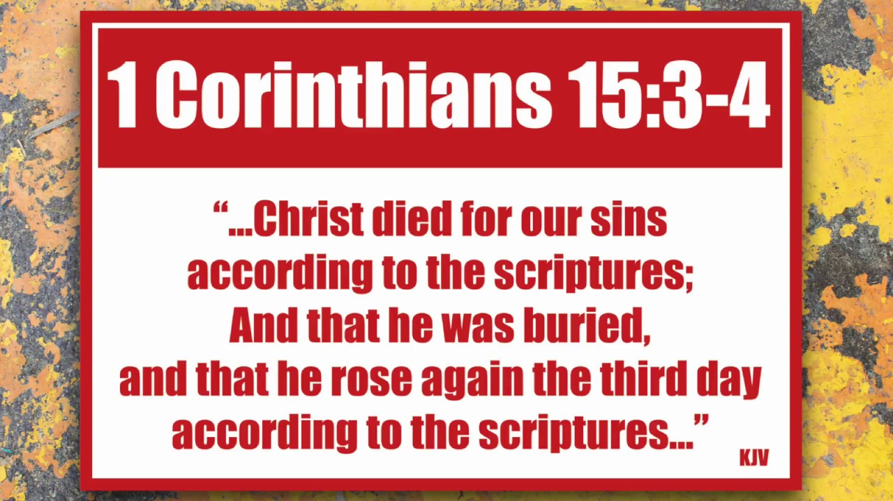

Slide 10
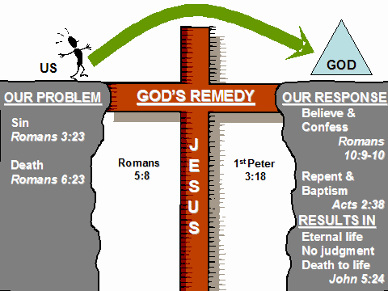

Slide 11


Slide 12
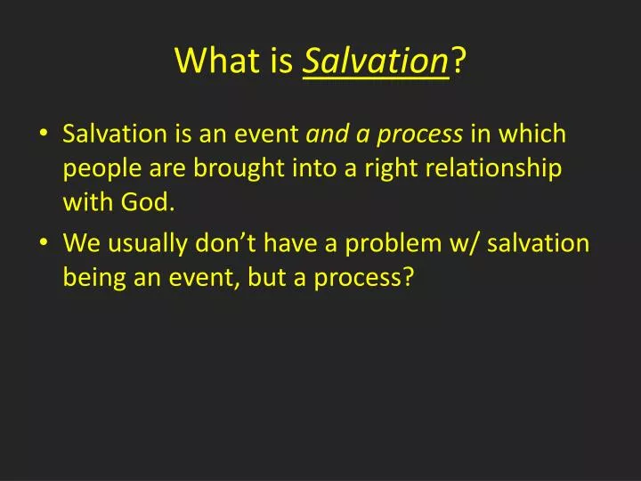

Slide 13
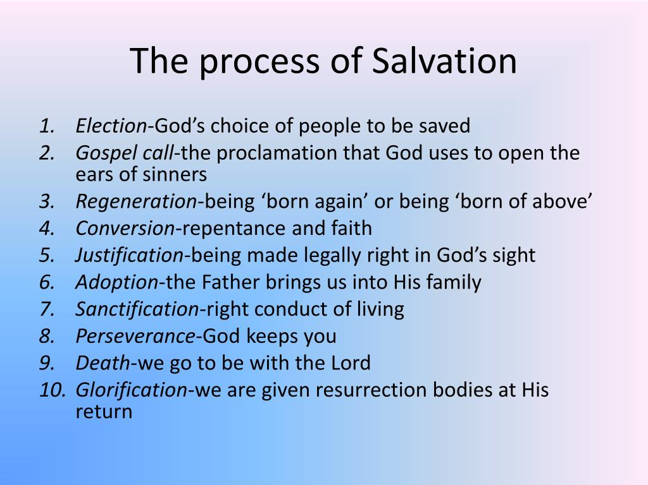

Slide 14
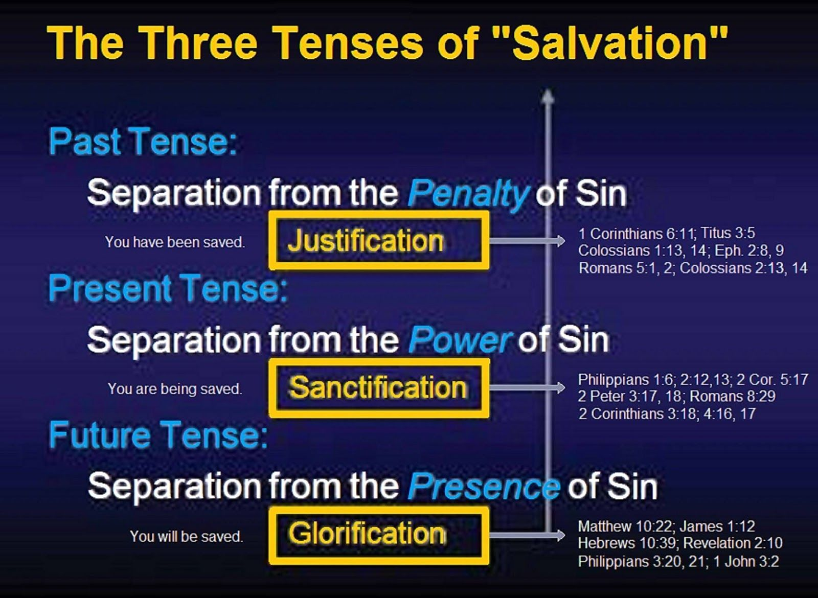

Slide 15
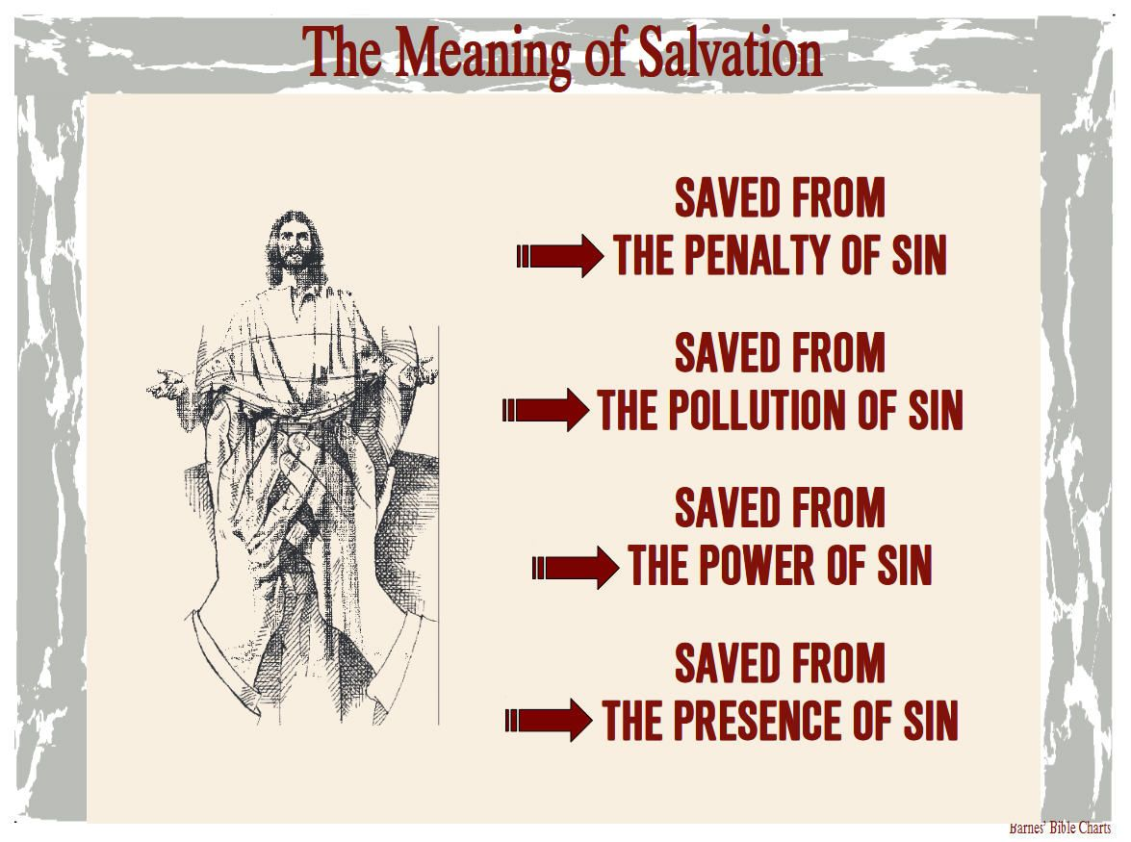

Slide 16
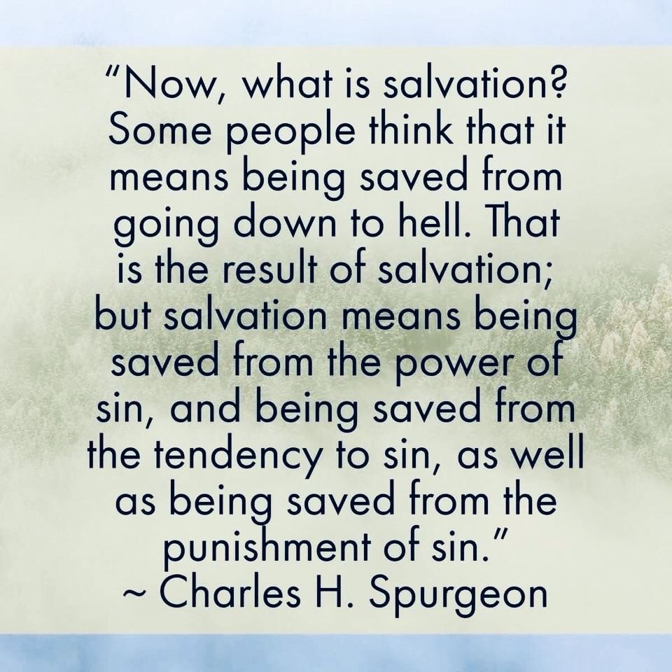

Slide 17


Slide 18
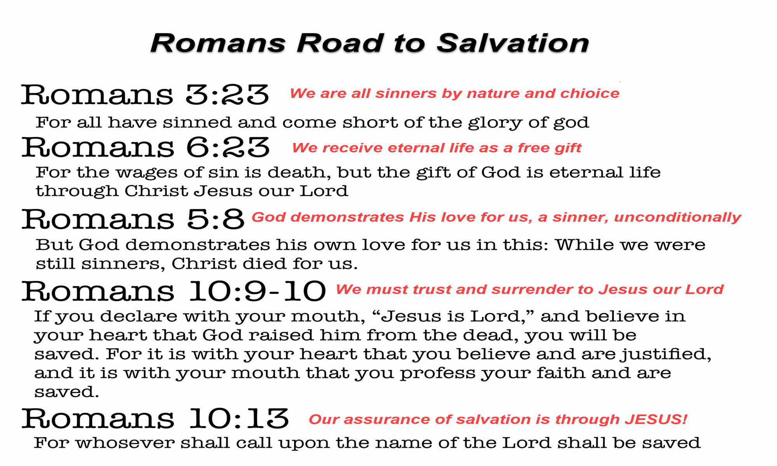

Slide 19
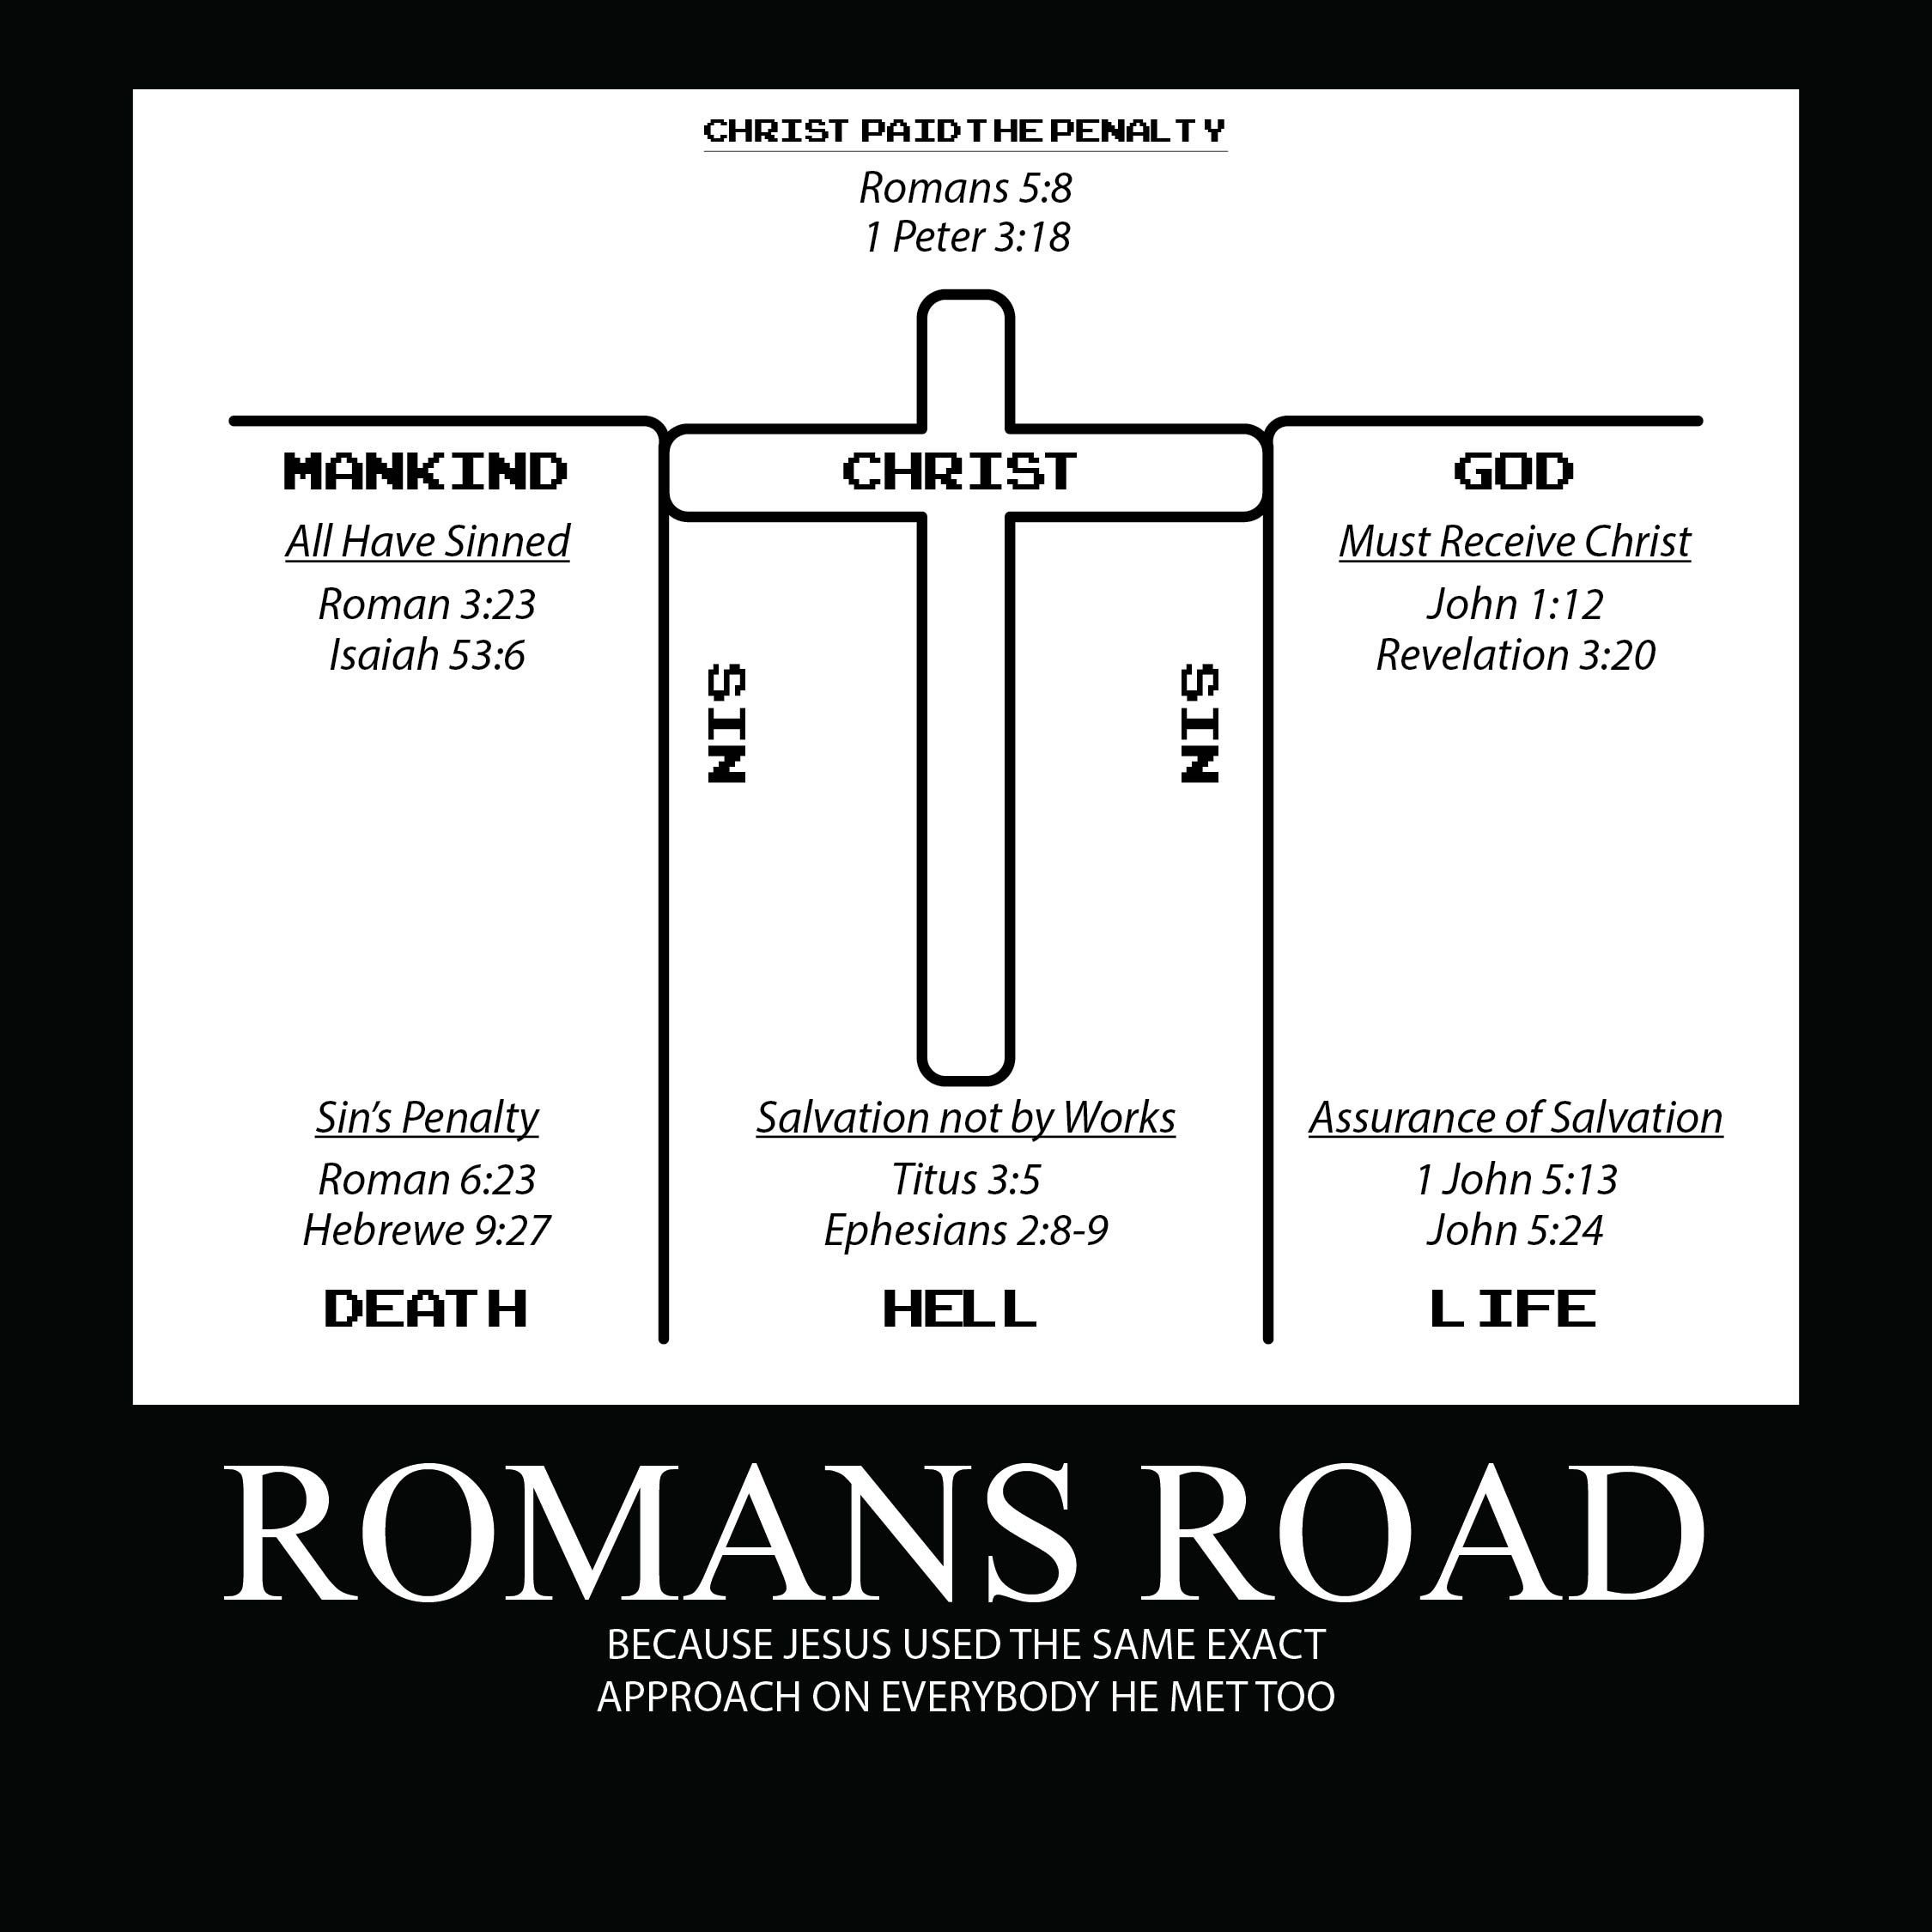


Slide 20
Our Response : Faith & Repentance
“Repent ye therefore, and be converted, that your sins may be blotted out, when the times of refreshing shall come from the presence of the Lord;” (Acts 3:19)
“Testifying both to the Jews, and also to the Greeks, repentance toward God, and faith toward our Lord Jesus Christ.” (Acts 20:21)
“That if thou shalt confess with thy mouth the Lord Jesus, and shalt believe in thine heart that God hath raised him from the dead, thou shalt be saved.” (Rom 10:9)
“For with the heart man believeth unto righteousness; and with the mouth confession is made unto salvation.” (Rom 10:10)

Slide 21

“For by grace are ye saved through faith; and that not of yourselves: it is the gift of God: Not of works, lest any man should boast.” (Eph 2:8, 9)

Slide 22
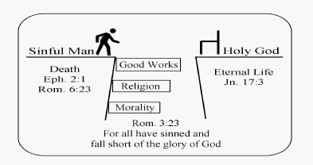
God’s Holiness & Our Sin
No one is righteous on their own
Sin separates us from a holy God

Slide 23
Consequence Of Sin
- Death & Separation
“For the wages of sin is death; but the gift of God is eternal life through Jesus Christ our Lord.” (Rom 6:23)
Sin earns us death (physical & spiritual)

Slide 24
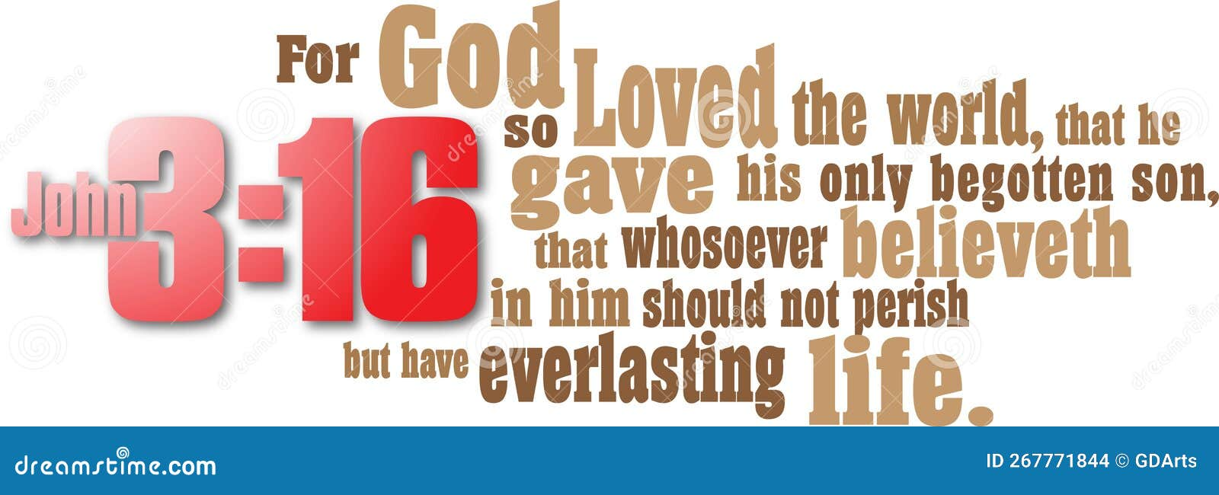
God’
God’s Solution : Jesus Christ
Rom 6 :23 “… the gift of God is eternal life through Jesus Christ our Lord”.
God offers eternal life through Christ
Christ died in our place on the cross, rose again, conquered sin & death
Christ’s death is the only sufficient payment for sin

Slide 25
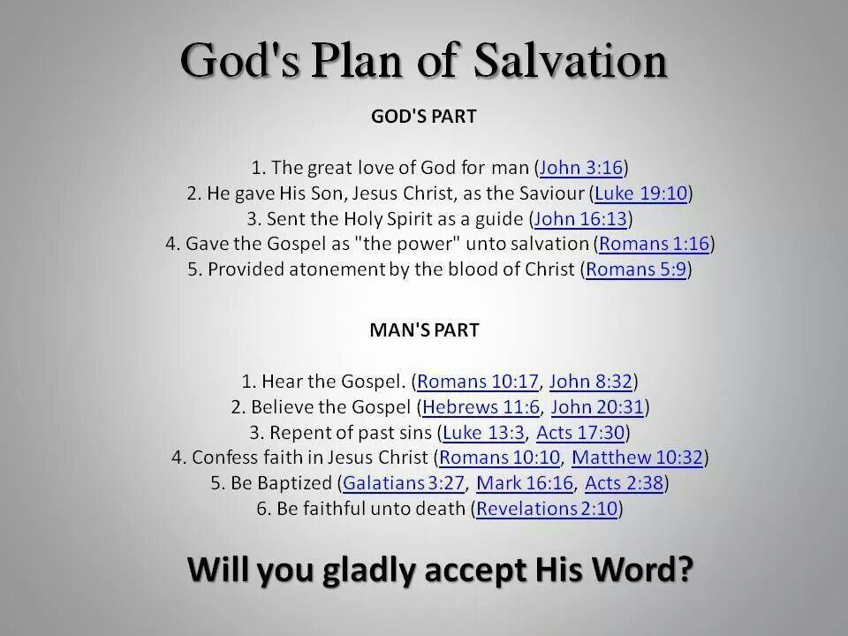

Slide 26
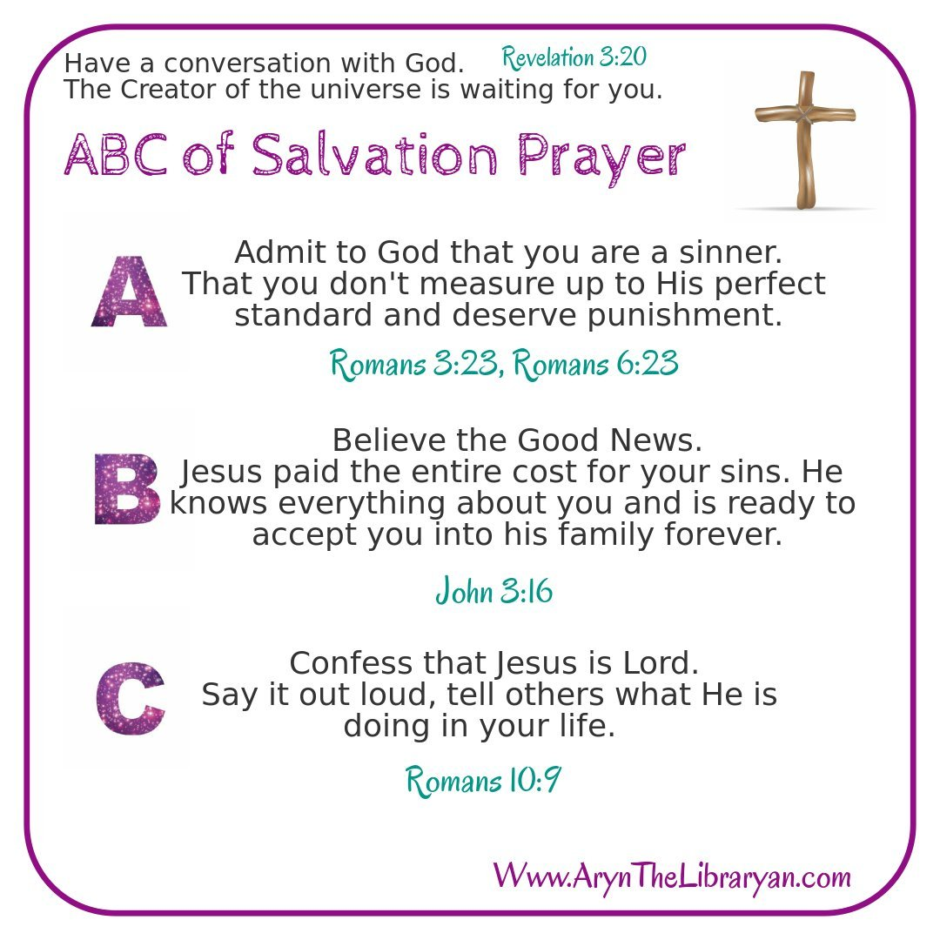
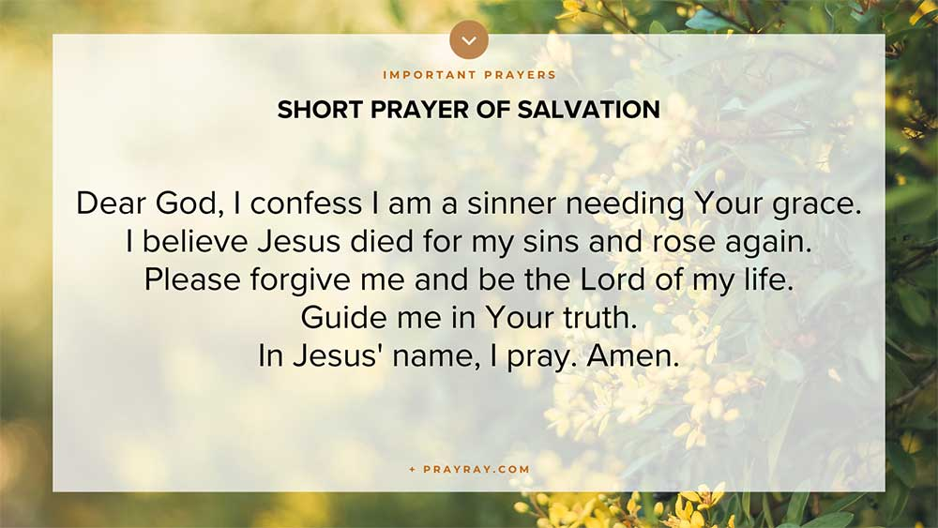

Slide 27
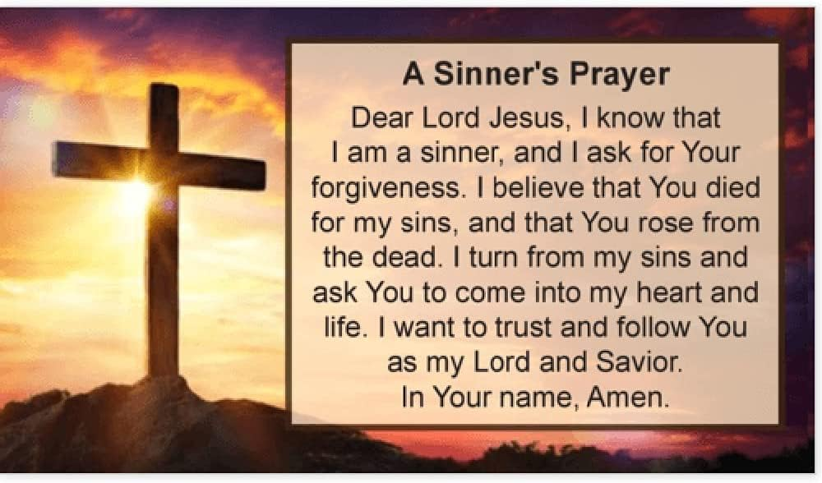

Slide 28
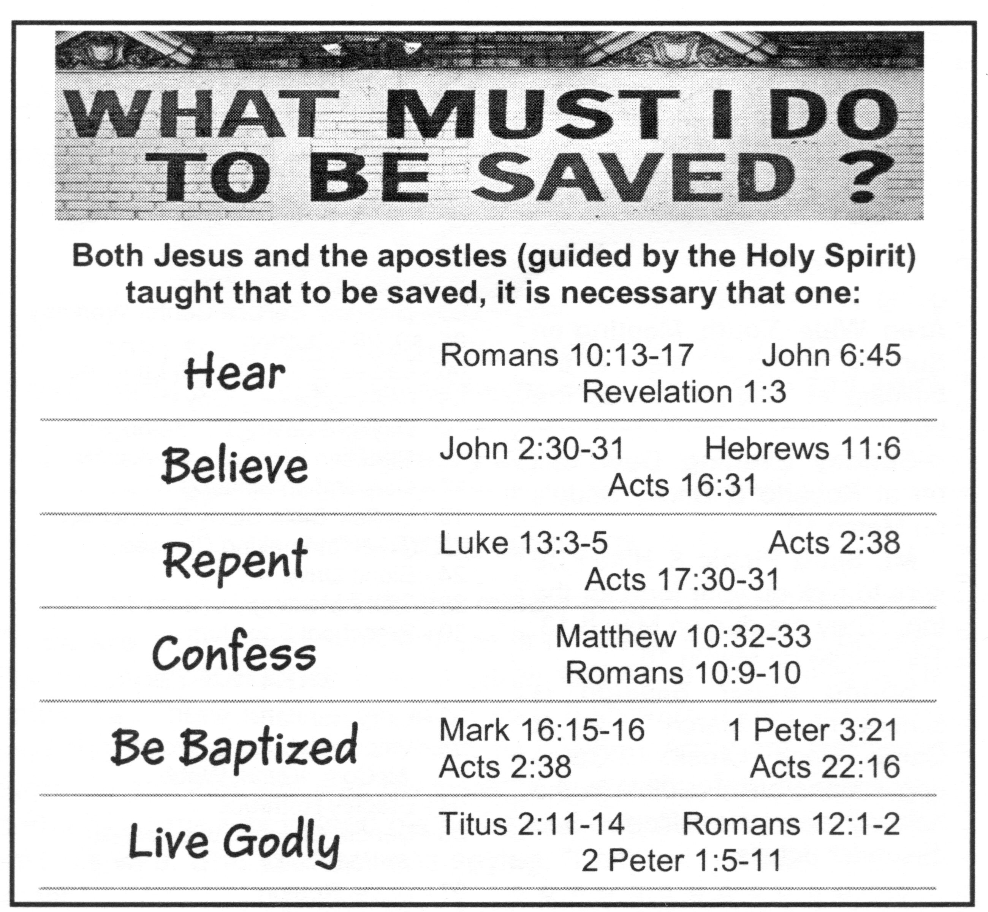


Slide 29


Slide 30
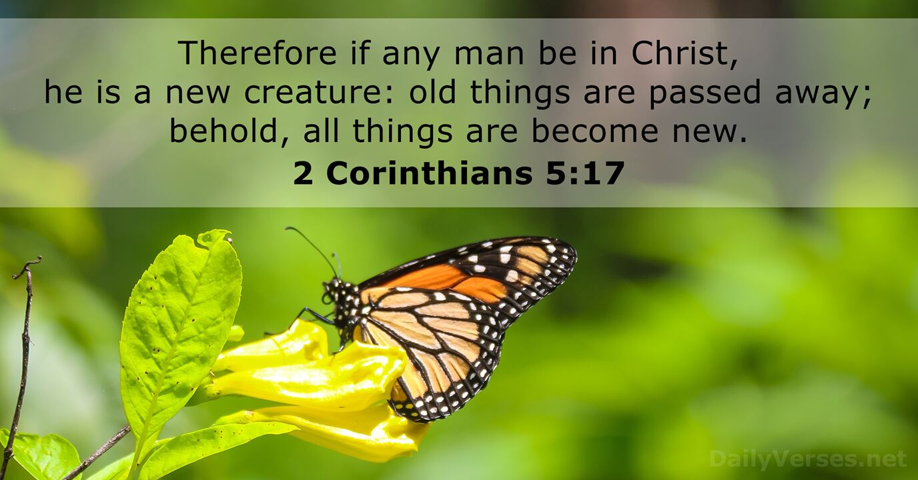
Result : New Life & Relationship With God
Salvation makes us new
- A fresh start in Christ
Salvation reconciles us
to God
– Holy Spirit dwells in us

Slide 31
3. Reflection
What stood out to you about the gospel?
Have you personally trusted Jesus Christ as your personal Saviour?
What does repentance mean for your life?
What does it mean to you that salvation is a gift, not earned?
Important : Salvation is by grace alone
through faith alone
in Christ alone
Christ is our substitution.

Slide 32
4. Assurance Of Salvation
God’s Promises NOT Feelings
“These things have I written unto you that believe on the name of the
Son of God; that ye may know that ye have eternal life, …” (1 John 5 : 13)
- We can know, not just hope or guess
- Assurance comes from God’s promises, not our feelings
“He that believeth on the Son hath everlasting life: and he that believeth not
the Son shall not see life; but the wrath of God abideth on him.” (John 3:36)
“For whosoever shall call upon the name of the Lord shall be saved.”
(Romans 10 :13)

Slide 33
Reflection
Genuine faith produces works – It is not just intellectual belief.
The devil also believe (in fact, he trembles)
The remaining lessons (Lessons 2 – 5) on obedience, growth, repentance, service, fruit bearing, etc. are evidence of one’s salvation. One should question one’s faith if these are missing in one’s life.
“Even so faith, if it hath not works, is dead, being alone.” (James 2:17)
Reflect on your faith and trust. How do you know you are saved?

Slide 34
5. More Discussion Questions
What does Rom 3:23 teach us about ourselves?
What do you learn about God’s love and what He did for us in John 3:16?
What does it mean to “repent” (Acts 3:19) How is that different from just feeling sorry?
According to Rom 10:19, what must we believe and confess to be saved?
2 Cor 5:17 says that a believer becomes a “new creature”. What does that look like in real life?
What’s the difference between “feeling saved” and “being saved”? Why does this matter?
If someone asked you how to be saved, what would you say?
What changes has God already made in your life since believing in Christ?
Is there anything in your life that God is calling you to surrender to Him today?
Why do you believe you are saved?
What about the concept of “once saved, forever saved”?

Slide 35
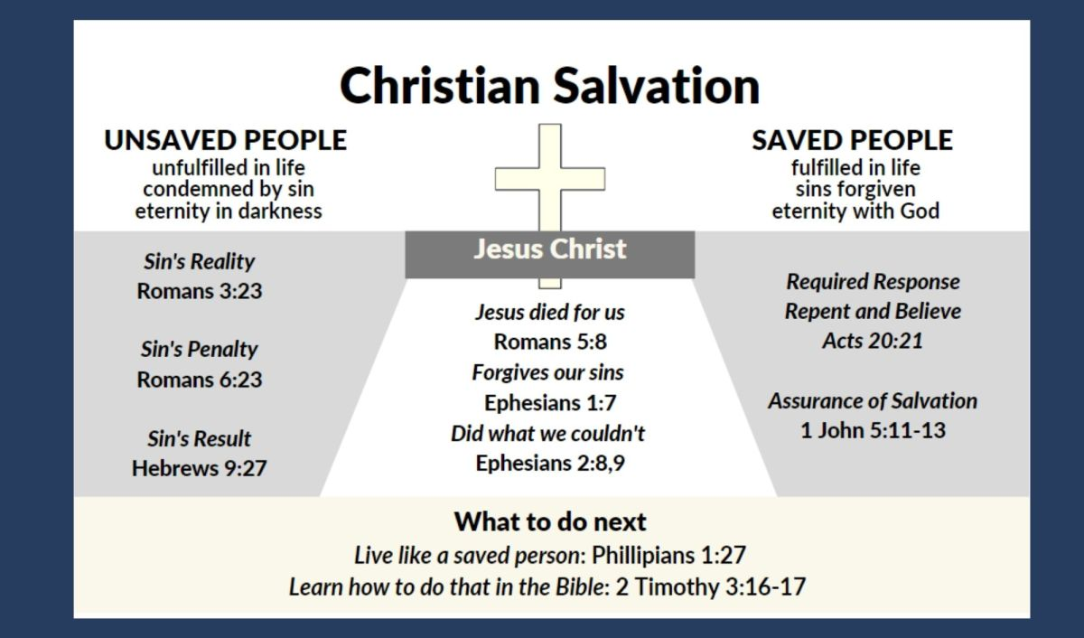
Add a Slide Title - 1

